Slide 1
Automatic Differentiation Using Complex and Hypercomplex Variables
Section 1: Complex Taylor Series Expansion (CTSE) method for first order sensitivities
University of Texas at San Antonio
July, 2023

Slide 2
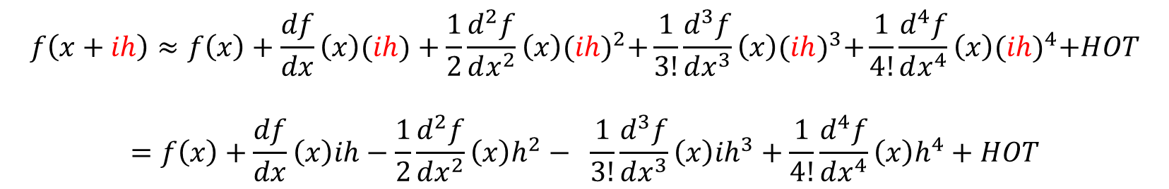

Complex Taylor Series Expansion (CTSE)
Complex variables can be used to compute accurate first order sensitivities. The derivation starts from the classical Taylor series expansion shown below.
$$f\left(x+h\right)≈f\left(x\right)+\frac{df}{dx}h+\frac{1}{2}\frac{d^{2}f}{dx^{2}}h^{2}+\frac{1}{3!}\frac{d^{3}f}{dx^{3}}h^{3}+\frac{1}{4!}\frac{d^{4}f}{dx^{4}}h^{4}+HOT$$
where $h$ is the step, $\frac{d^{n}f}{dx^{n}}$ is the $n$’th derivative at $(x)$, and $HOT$ denotes the higher order terms.
If we replace real variable step $h$ by an imaginary step $ih$, we obtain the following
$$f\left(x+ih\right)≈f\left(x\right)+\frac{df}{dx}\left(x\right)(ih)+\frac{1}{2}\frac{d^{2}f}{dx^{2}}\left(x\right){(ih)}^{2}+\frac{1}{3!}\frac{d^{3}f}{dx^{3}}\left(x\right){(ih)}^{3}+\frac{1}{4!}\frac{d^{4}f}{dx^{4}}\left(x\right){(ih)}^{4}+HOT$$
$$=f\left(x\right)+\frac{df}{dx}\left(x\right)ih−\frac{1}{2}\frac{d^{2}f}{dx^{2}}\left(x\right)h^{2}− \frac{1}{3!}\frac{d^{3}f}{dx^{3}}\left(x\right){ih}^{3}+\frac{1}{4!}\frac{d^{4}f}{dx^{4}}\left(x\right)h^{4}+HOT$$

Slide 3

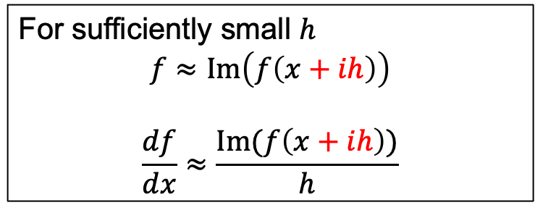

Complex Taylor Series Expansion (CTSE)
The end result, separated into real and imaginary terms, is
$f\left(x+ih\right)≈\left(f\left(x\right)−\frac{1}{2}\frac{d^{2}f}{dx^{2}}h^{2}\right)$+ $i\left(\frac{df}{dx}h−\frac{1}{3!}\frac{d^{3}f}{dx^{3}}{ih}^{3}\right)+HOT$
The real result is
$Re(f\left(x+ih\right)$)= $f\left(x\right)+−\frac{1}{2}\frac{d^{2}f}{dx^{2}}h^{2}+HOT$
The imaginary result is
$Im(f\left(x+ih\right))=\frac{df}{dx}h−\frac{1}{3!}\frac{ d^{3}f}{dx^{3}}{ih}^{3}+HOT$
For sufficiently small $h$
$$f≈Im\left(f\left(x+ih\right)\right)$$
$$\frac{df}{dx}≈\frac{Im(f\left(x+ih\right))}{h}$$
Real part unchanged.
Imaginary part contains the first derivative.

Slide 4

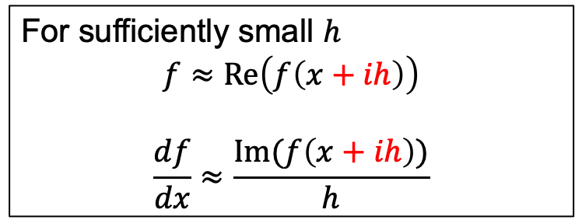
Complex Taylor Series Expansion (CTSE)
Summary, the first order derivative can be approximated as
For sufficiently small $h$
$$f≈Re\left(f\left(x+ih\right)\right)$$
$$\frac{df}{dx}≈\frac{Im(f\left(x+ih\right))}{h}$$
Note 1: that the derivative can be computed without any subtraction of terms, hence $h$ can be made sufficiently small such that the terms of $O\left(h^{2}\right)$ can be reduced to below machine precision.
Note 2: the real part is also affected but again terms of order $O\left(h^{2}\right)$can be reduced to below machine precision, hence, practically speaking, the real part is not affected.

Slide 5

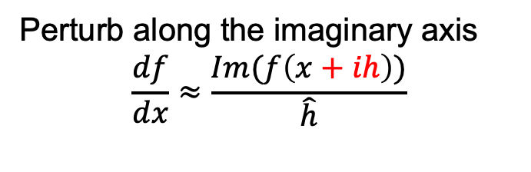

Analogy with the finite difference method
Finite Difference (FD)
Complex Taylor
Series Expansion (CTSE)
Perturb along the real axis
$$\frac{df}{dx}≈\frac{f\left(x+\hat{h}\right)−f(x)}{\hat{h}}$$
Perturb along the imaginary axis
$$\frac{df}{dx}≈\frac{Im(f\left(x+ih\right))}{\hat{h}}$$
Subtraction errors occur when $h→0$
The step size can be made arbitrarily small with no concern about round-off error – no subtraction error.
CTSE is performed analogously to FD

Slide 6
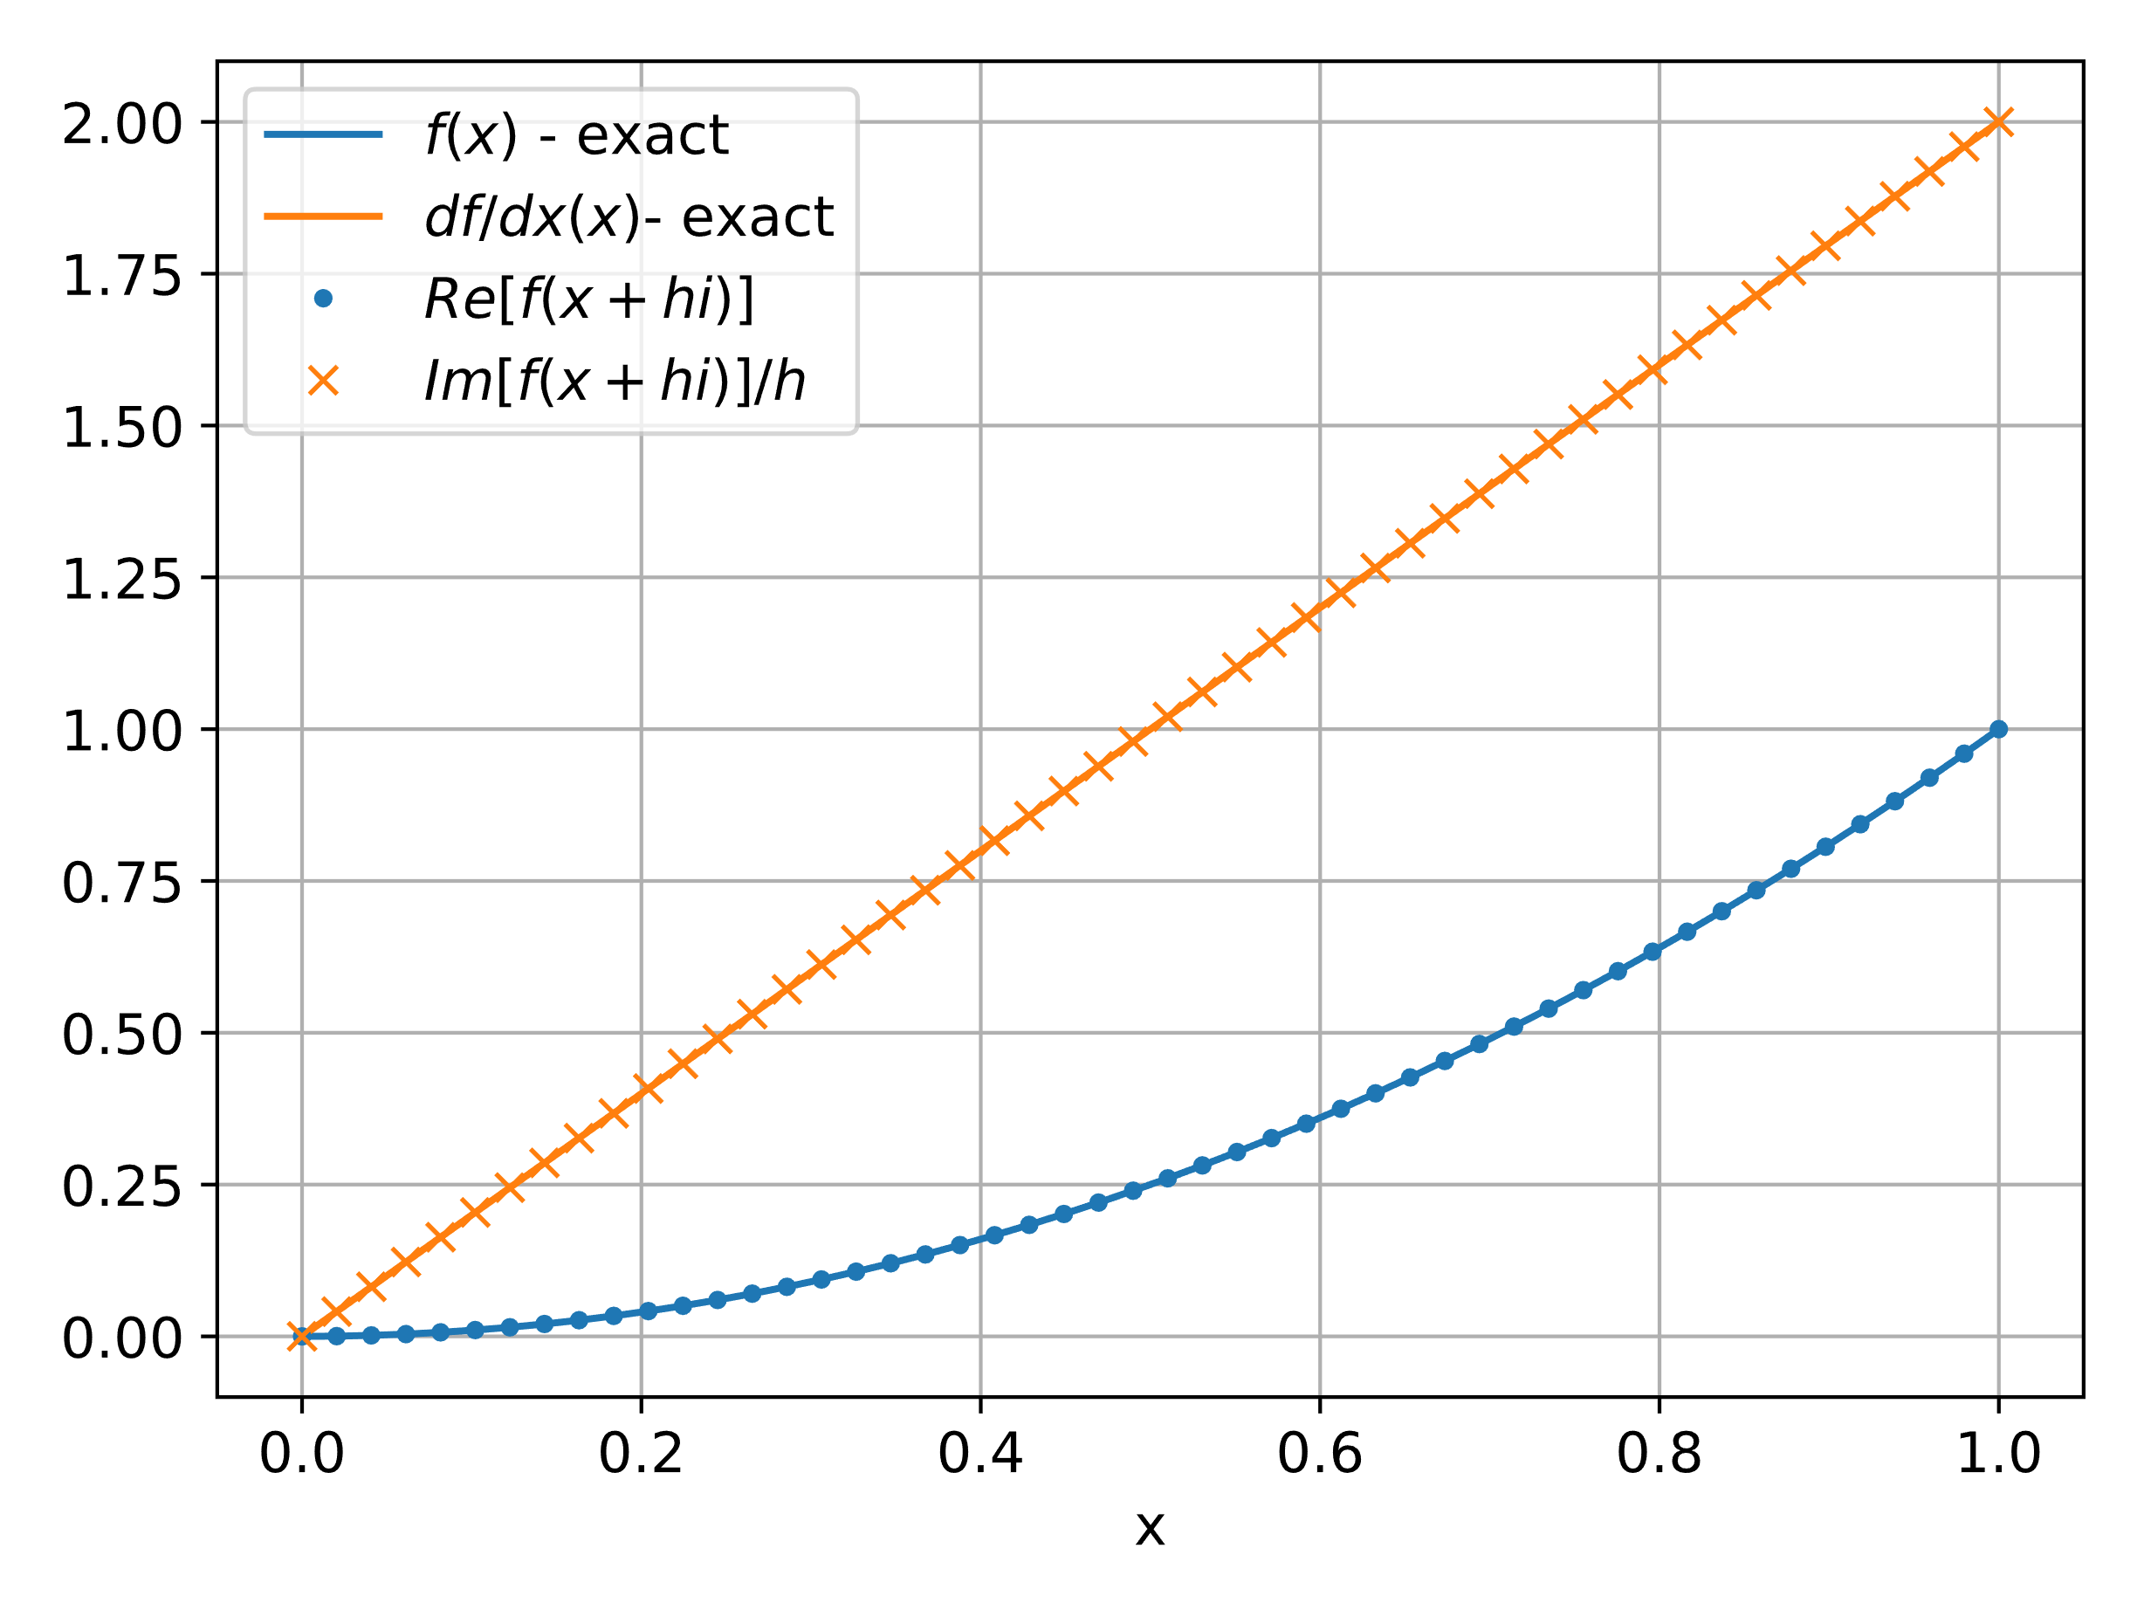


Closed-form example: $f\left(x\right)=x^{2}$
The use of CTSE to compute derivatives can be demonstrated using some closed-form examples.
$$f\left(x\right)=x^{2}$$
$$f\left(x+ih\right)={\left(x+ih\right)}^{2}=x^{2}−h^{2}+2ihx$$
$$\frac{df}{dx}=\frac{Im(f\left(x+ih\right))}{h}=\frac{2hx}{h}=2x$$
In this example we see that CTSE is exact.
$$h = {10}^{−10}$$

Slide 7
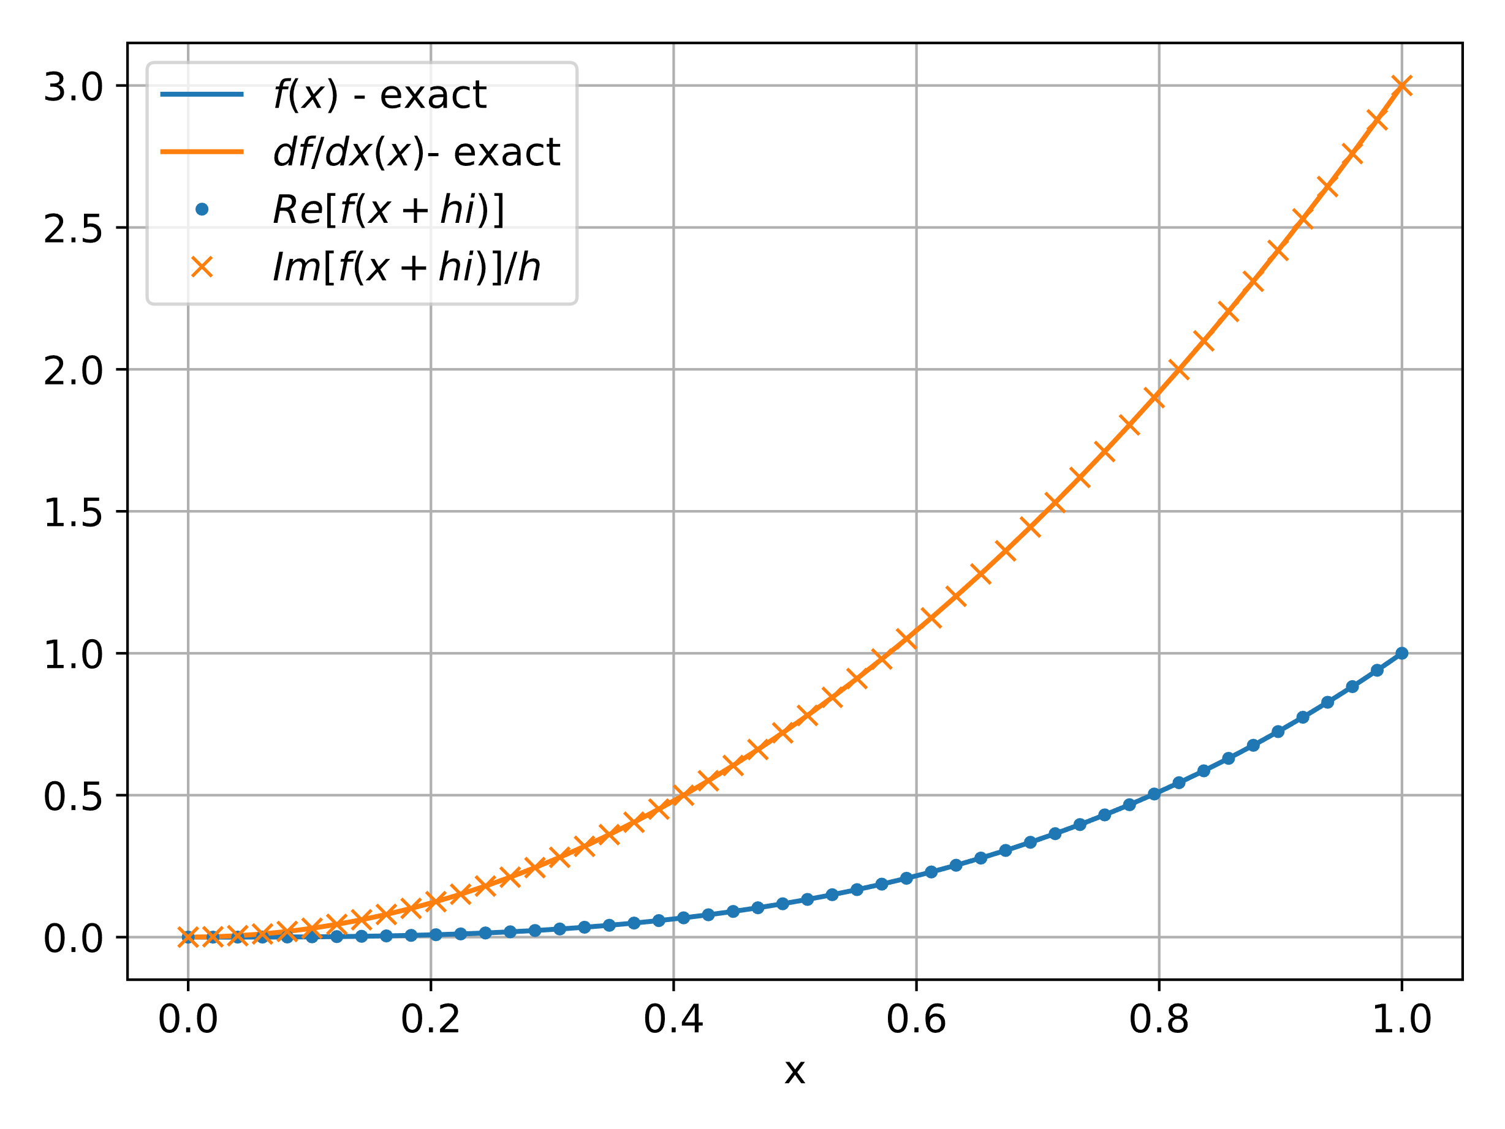
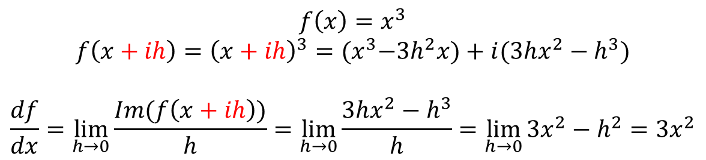

Closed-form example: $f\left(x\right)=x^{3}$
$$f\left(x\right)=x^{3}$$
$$f\left(x+ih\right)={\left(x+ih\right)}^{3}={(x}^{3}−3h^{2}x)+i(3hx^{2}−h^{3})$$
$$\frac{df}{dx}=\lim_{h→0}{\frac{Im(f\left(x+ih\right))}{h}}=\lim_{h→0}{\frac{3hx^{2}−h^{3}}{h}}=\lim_{h→0}{3x^{2}−h^{2}}=3x^{2}$$
CTSE is exact in the limit as $h→0$.
$$h = {10}^{−10}$$

Slide 8
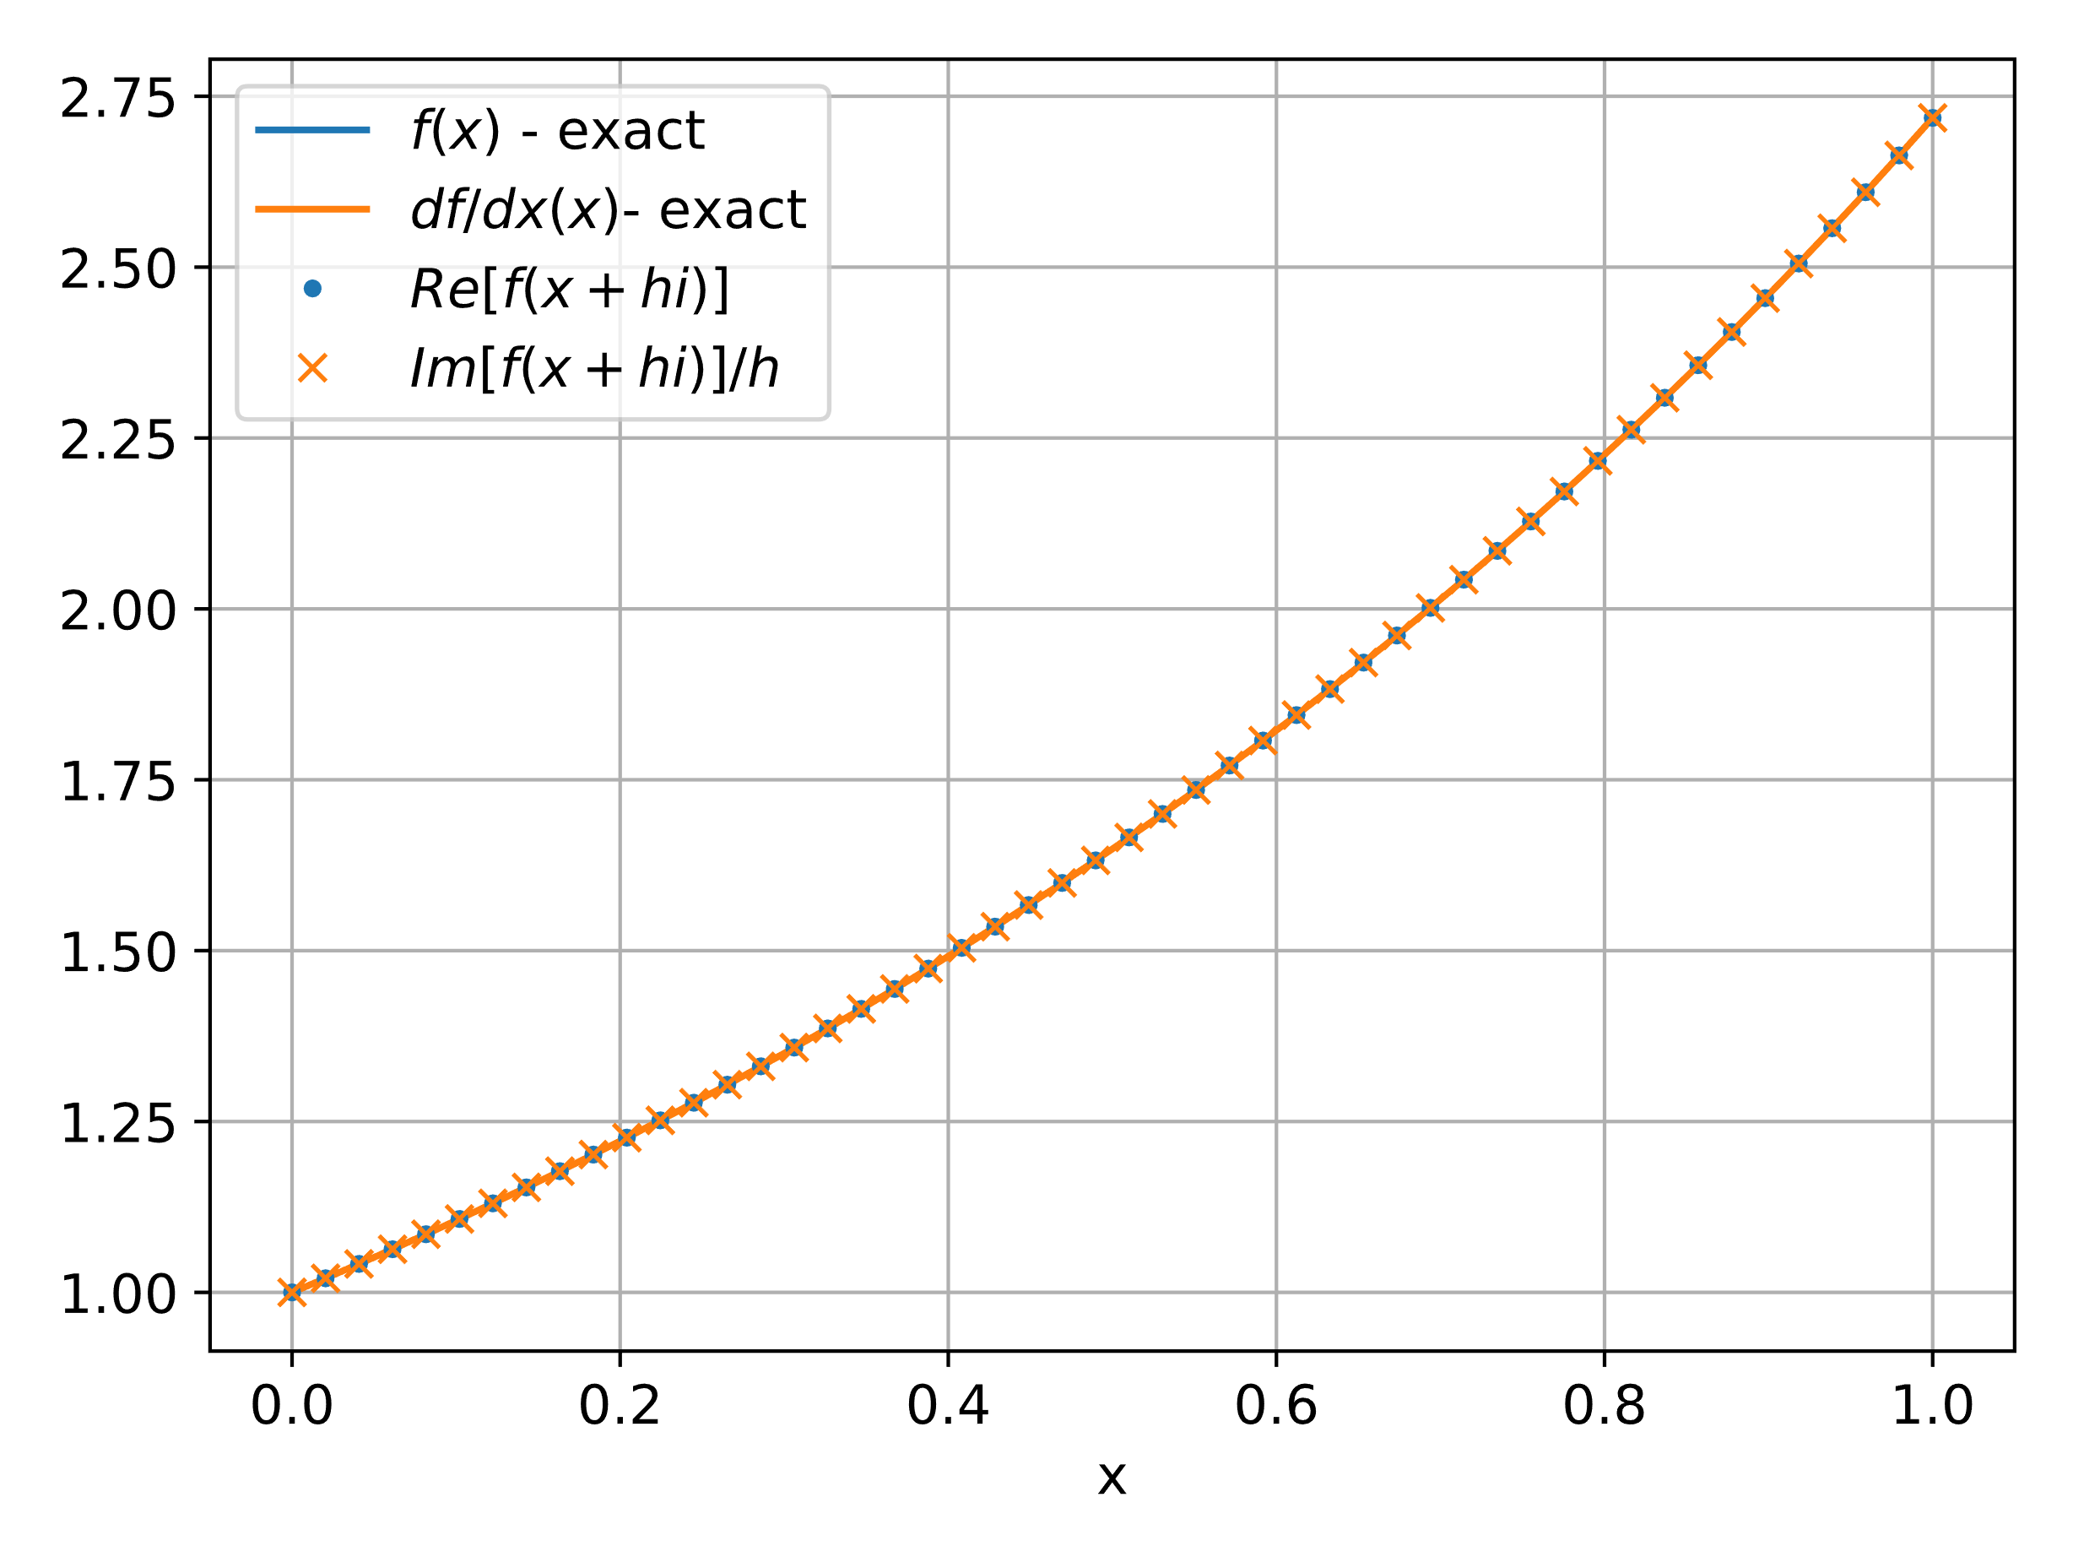
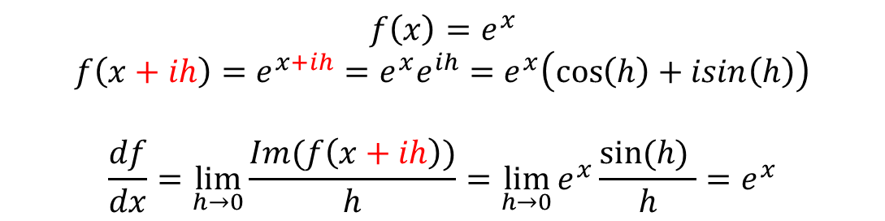

Closed-form example: $f\left(x\right)=e^{x}$
$$f\left(x\right)=e^{x}$$
$f\left(x+ih\right)=e^{x+ih}=e^{x}e^{ih}=$ $e^{x}\left(\cos\left(h\right)+isin\left(h\right)\right)$
$$\frac{df}{dx}=\lim_{h→0}{\frac{Im(f\left(x+ih\right))}{h}}=\lim_{h→0}{e^{x}\frac{sin⁡(h) }{h}}=e^{x}$$
CTSE is exact in the limit as $h→0$ since $\lim_{h→0}{\frac{sin⁡(h) }{h}=1}$.
$$h = {10}^{−10}$$

Slide 9
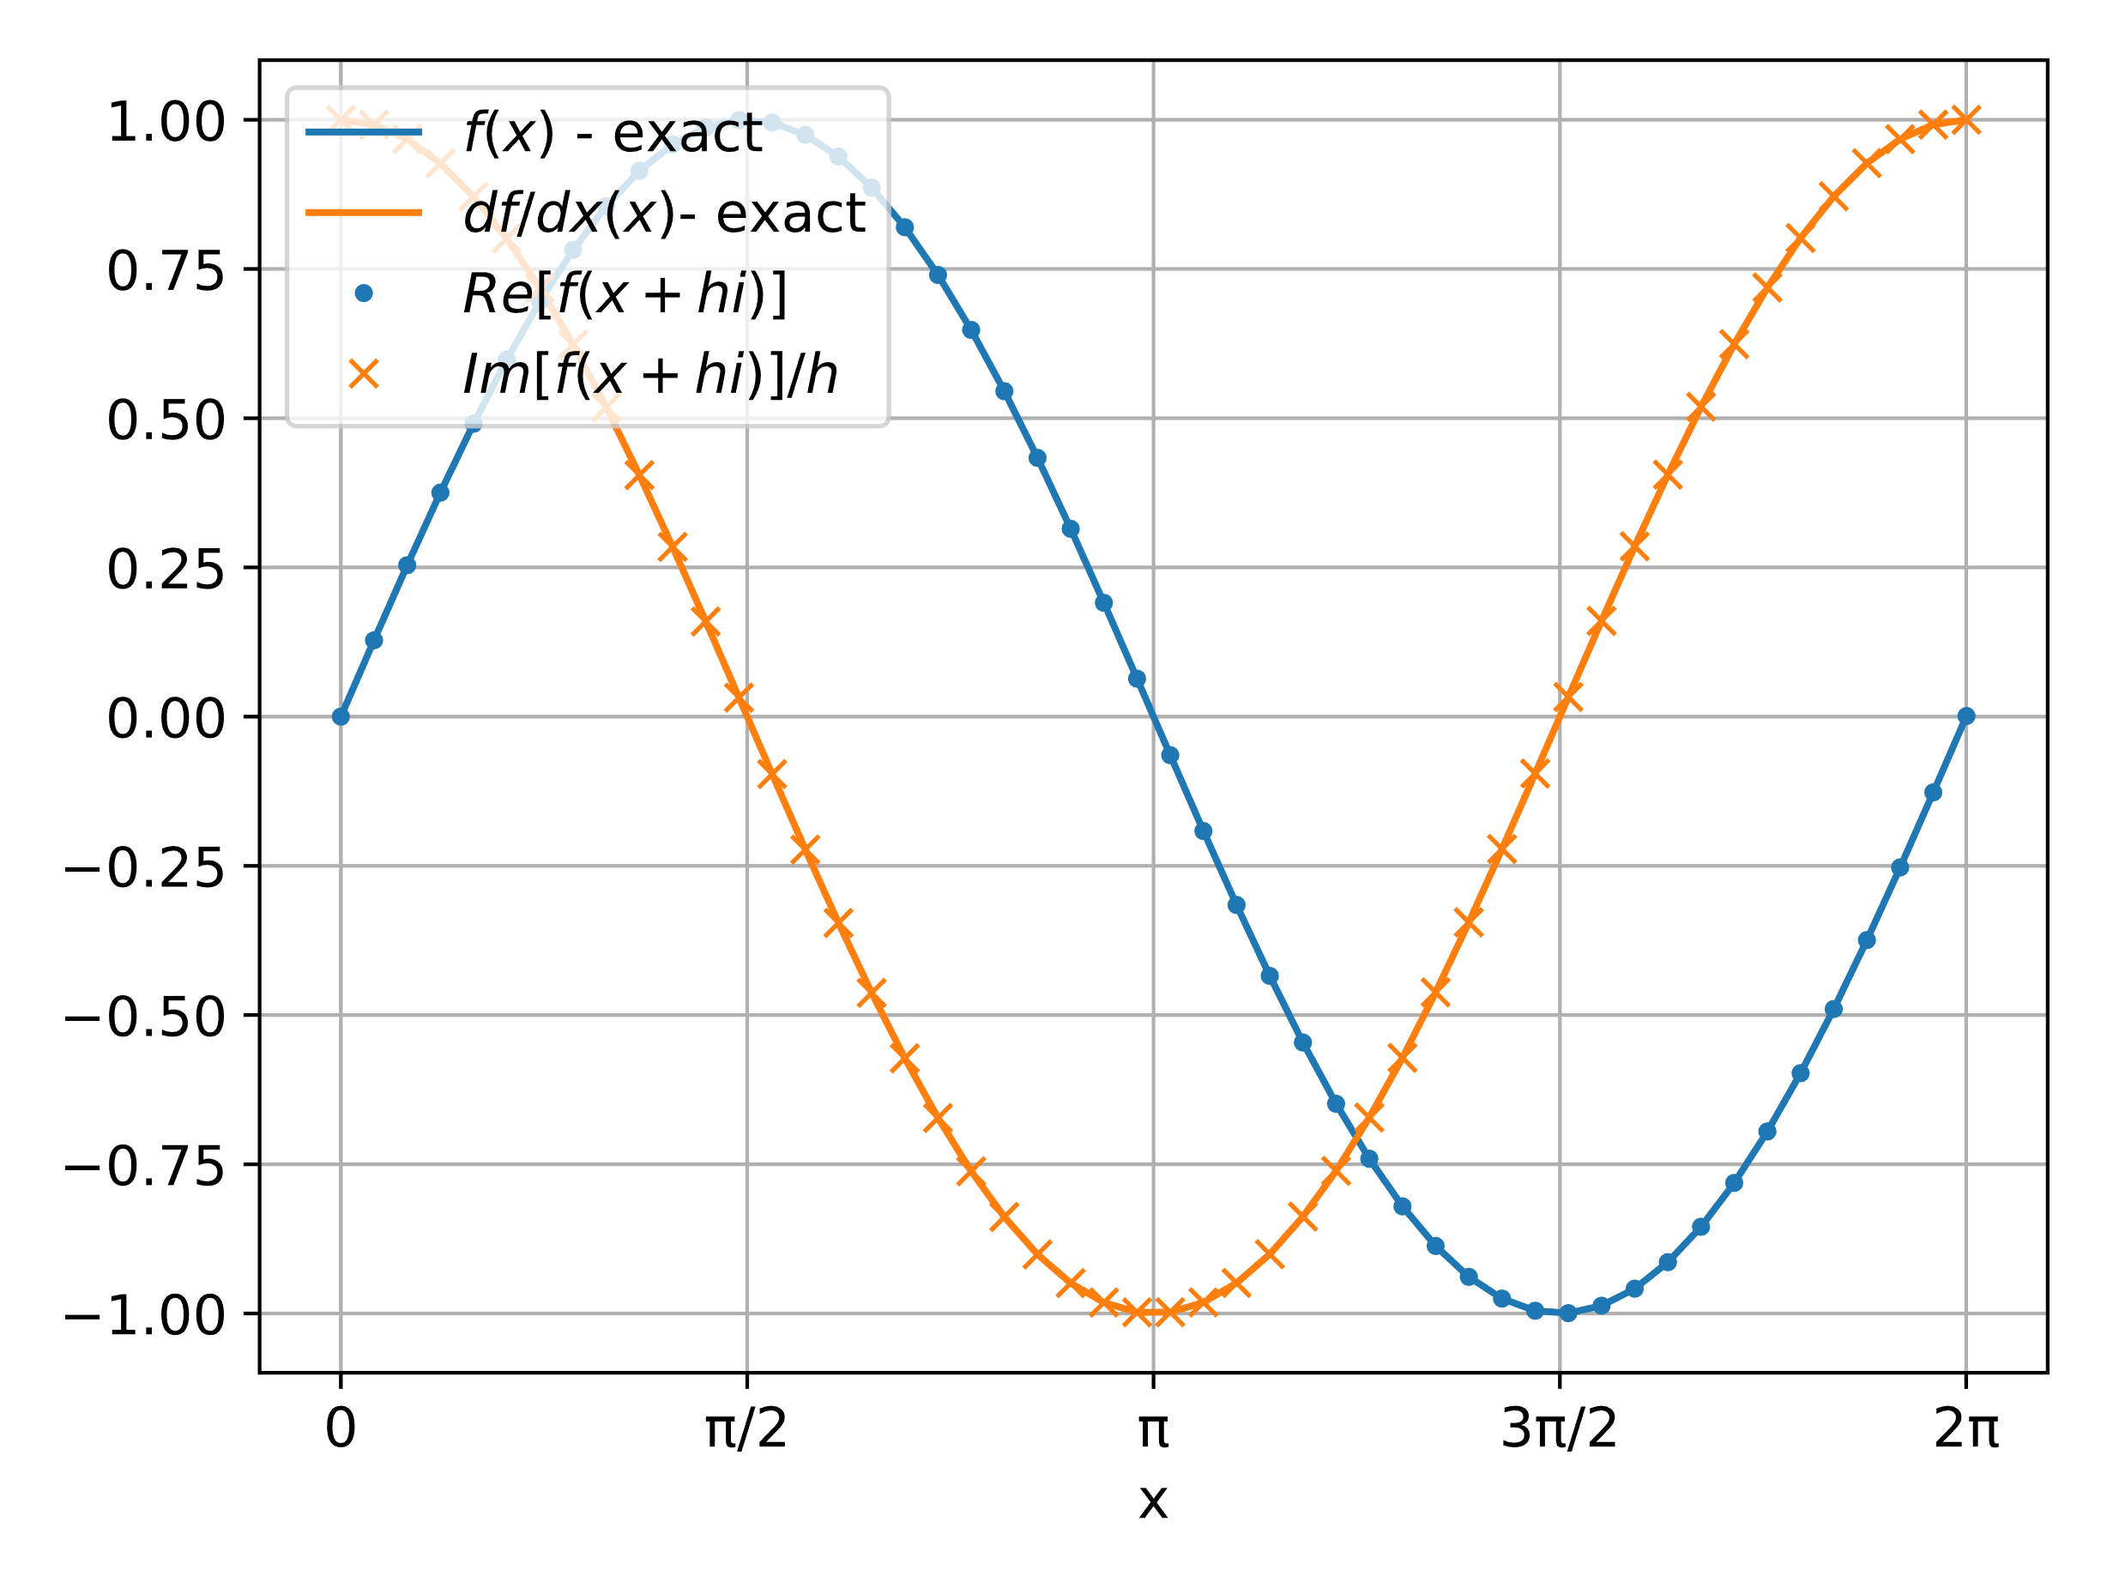
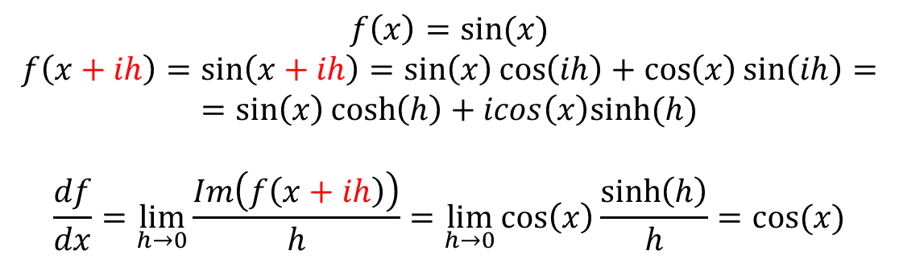

Closed-form example $f\left(x\right)=sin⁡(x)$
$$f\left(x\right)=sin⁡(x)$$
$$f\left(x+ih\right)=\sin\left(x+ih\right)=\sin\left(x\right)\cos\left(ih\right)+\cos\left(x\right)\sin\left(ih\right)=$$
$$=\sin\left(x\right)\cosh\left(h\right)+icos\left(x\right)sinh⁡(h)$$
$$\frac{df}{dx}=\lim_{h→0}{\frac{Im\left(f\left(x+ih\right)\right)}{h}}=\lim_{h→0}{\cos\left(x\right)\frac{\sinh\left(h\right)}{h}}=cos(x)$$
CTSE is exact in the limit as $h→0$ since $\lim_{h→0}{\frac{sinh⁡(h) }{h}=1}$.
$$h = {10}^{−10}$$

Slide 10
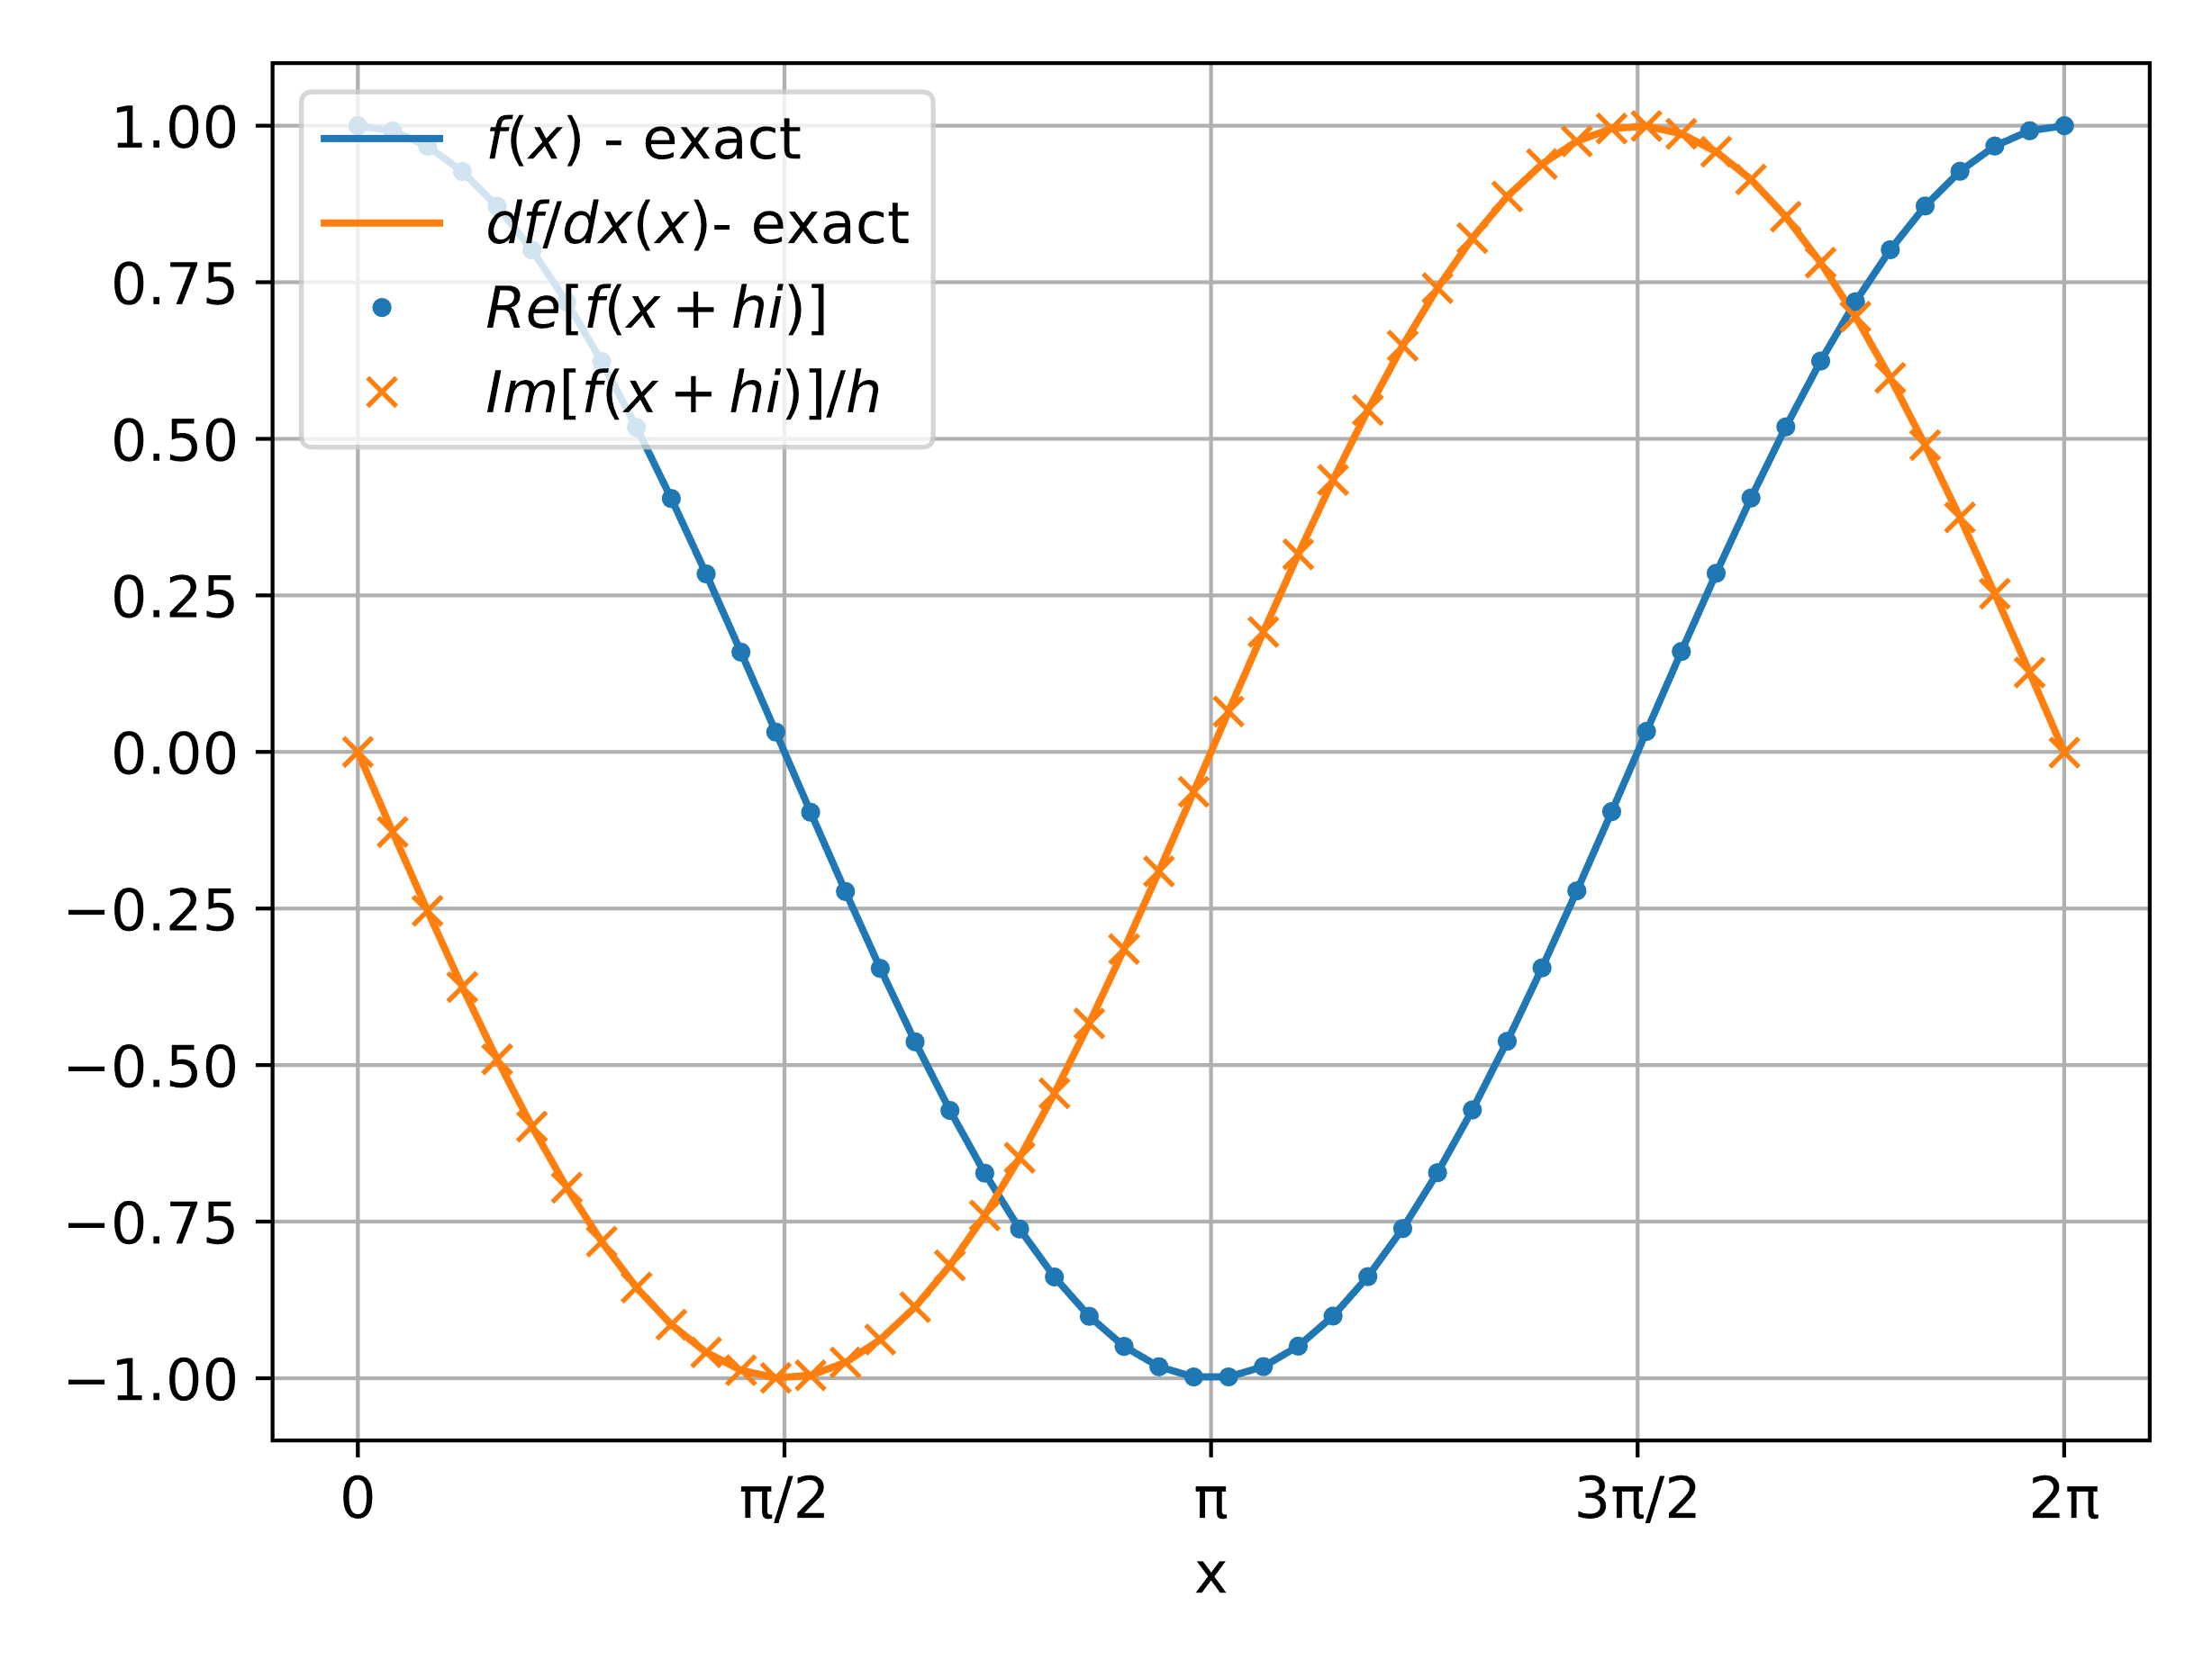
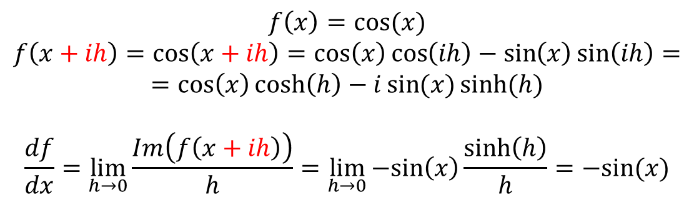

Closed-form example: $f\left(x\right)=cos⁡(x)$
$$f\left(x\right)=cos⁡(x)$$
$$f\left(x+ih\right)=\cos\left(x+ih\right)=\cos\left(x\right)\cos\left(ih\right)−\sin\left(x\right)\sin\left(ih\right)=$$
$$=\cos\left(x\right)\cosh\left(h\right)−i\sin{(x)}sinh⁡(h)$$
$$\frac{df}{dx}=\lim_{h→0}{\frac{Im\left(f\left(x+ih\right)\right)}{h}}=\lim_{h→0}{−sin\left(x\right)\frac{\sinh\left(h\right)}{h}}=−sin(x)$$
CTSE is exact in the limit as $h→0$ since $\lim_{h→0}{\frac{sinh⁡(h) }{h}=1}$.
$$h = {10}^{−10}$$

Slide 11
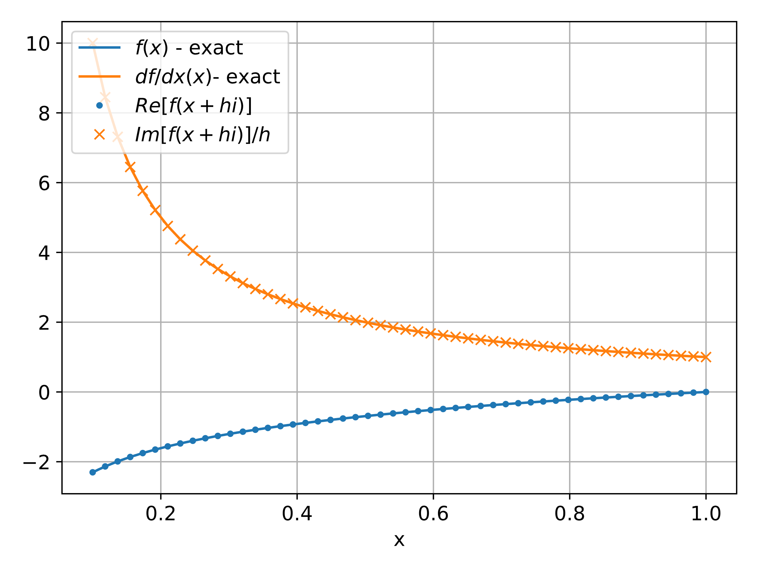
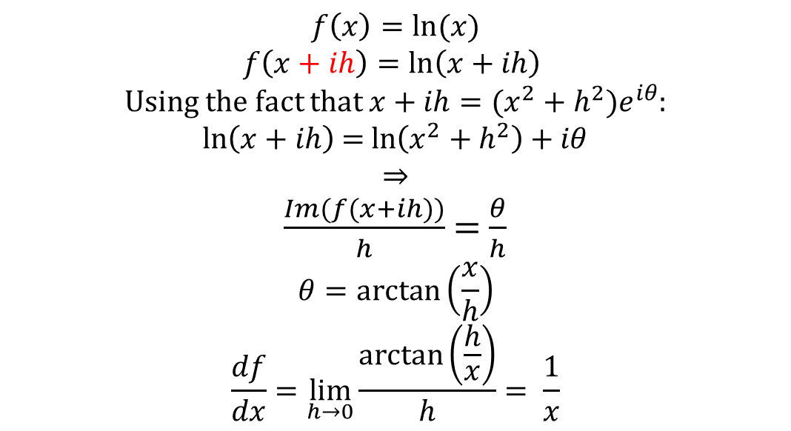

Closed-form example: $f\left(x\right)=ln(x)$
$$f\left(x\right)=ln⁡(x)$$
$f\left(x+ih\right)=\ln\left(x+ih\right)$
Using the fact that $x+ih=(x^{2}+h^{2})e^{iθ}$:
$\ln\left(x+ih\right)$= $\ln\left(x^{2}+h^{2}\right)+iθ$
⇒
$\frac{Im(f(x+ih))}{h}$ = $\frac{θ}{h}$
$$θ=\arctan\left(\frac{x}{h}\right)$$
$$\frac{df}{dx}=\lim_{h→0}{\frac{\arctan\left(\frac{h}{x}\right)}{h}}= \frac{1}{x}$$
$$h = {10}^{−10}$$
CTSE is exact in the limit as $h→0$ since $\lim_{h→0}{\frac{\arctan\left(\frac{h}{x}\right)}{h}}= \frac{1}{x}$.

Slide 12
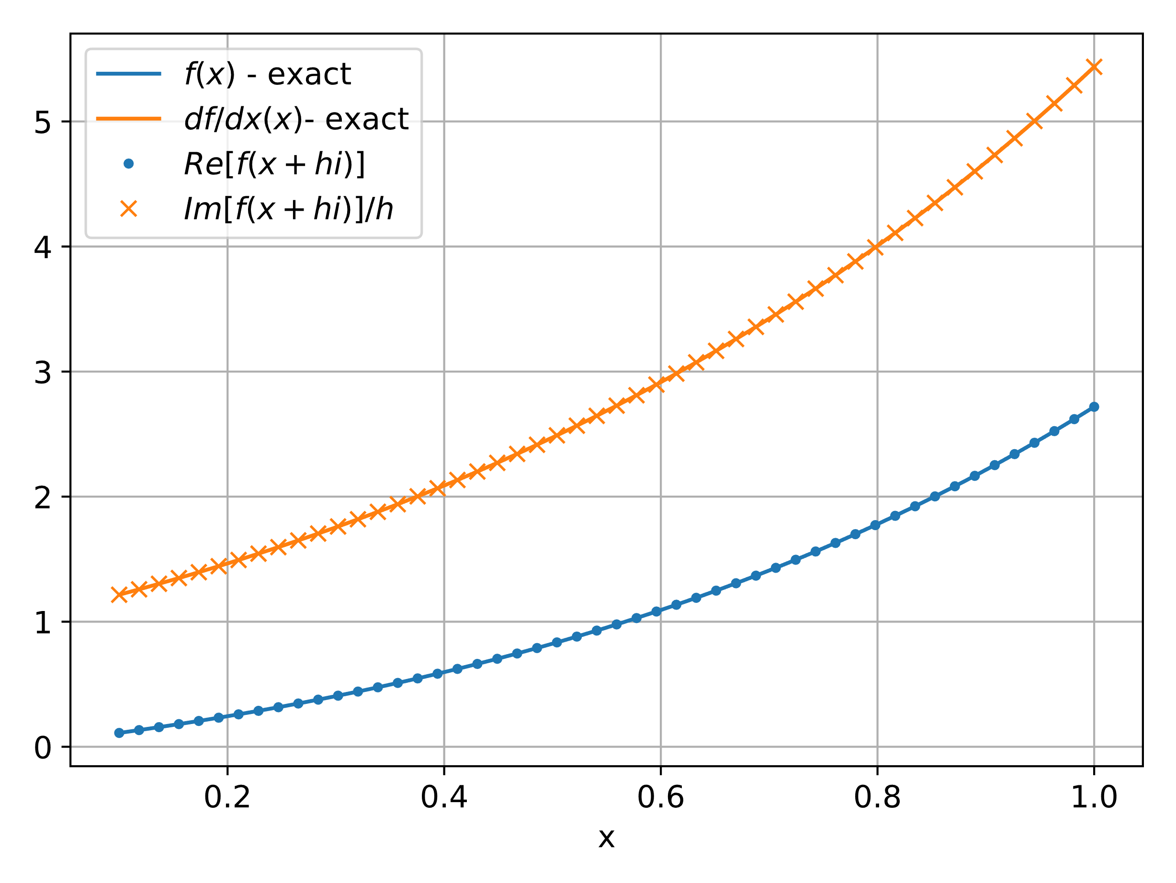
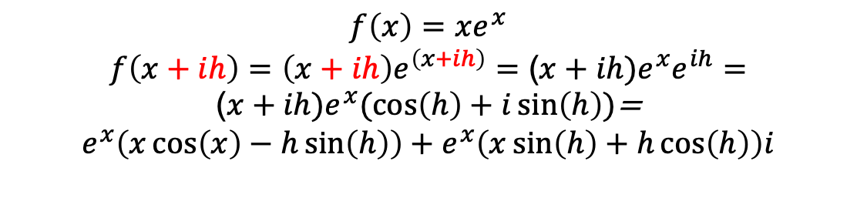

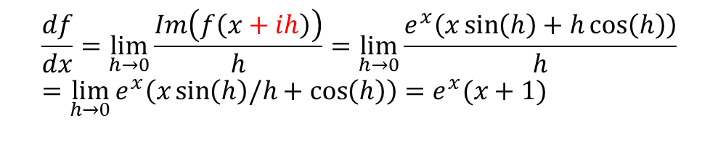
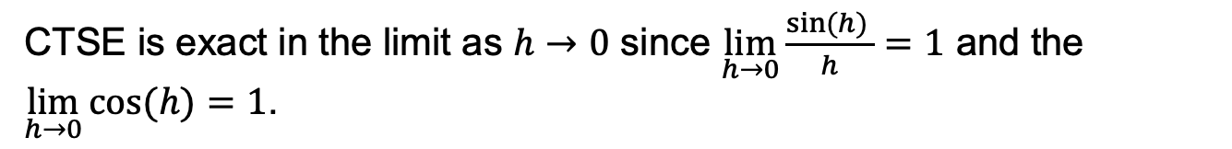
Closed-form example: $f\left(x\right)={xe}^{x}$
$$f\left(x\right)=xe^{x}$$
$$f\left(x+ih\right)=\left(x+ih\right)e^{\left(x+ih\right)}=\text{(}x+ih){e^{x}e}^{ih}=$$
$\text{(}x+ih)e^{x}(\cos\left(h\right)+i\sin\left(h\right))$=
$$e^{x}\left(x\cos\left(x\right)−h\sin\left(h\right)\right)+e^{x}\left(x\sin\left(h\right)+h\cos\left(h\right)\right)i$$
$$\frac{df}{dx}=\lim_{h→0}{\frac{Im\left(f\left(x+ih\right)\right)}{h}}=\lim_{h→0}{\frac{e^{x}\left(x\sin\left(h\right)+h\cos\left(h\right)\right)}{h}}=\lim_{h→0}{e^{x}\left(x\sin\left(h\right)/h+\cos\left(h\right)\right)=e^{x}(x+1) }$$
$$h = {10}^{−10}$$
CTSE is exact in the limit as $h→0$ since $\lim_{h→0}{\frac{sin⁡(h) }{h}=1}$ and the $\lim_{h→0}{cos⁡(h)=1}$.

Slide 13
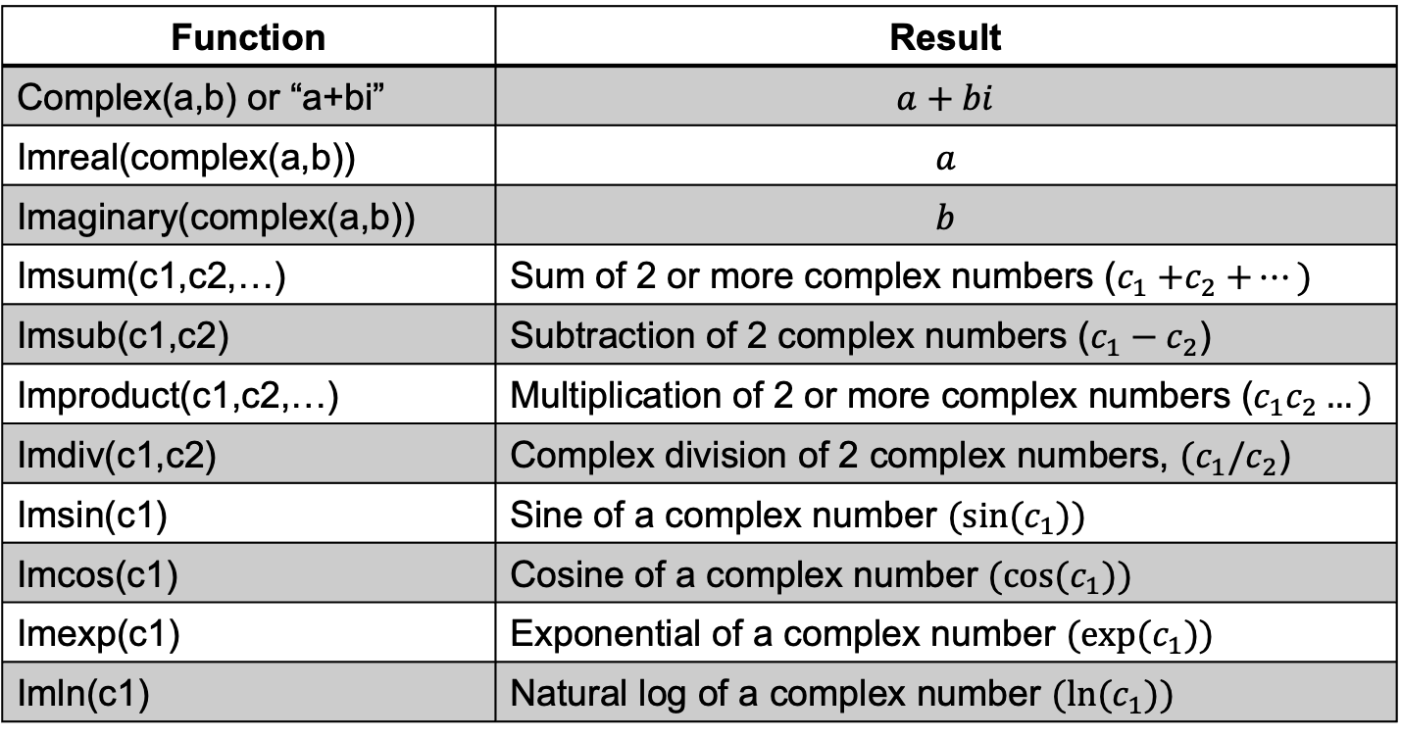
CTSE using Excel
CTSE can be employed with Excel - although somewhat cumbersome and only with single precision accuracy. In all cases, complex functions must be used.
Function | Result
Complex(a,b) or “a+bi” | $$a+bi$$
Imreal(complex(a,b)) | $$a$$
Imaginary(complex(a,b)) | $$b$$
Imsum(c1,c2,…) | Sum of 2 or more complex numbers ($c_{1}{+c}_{2}+…)$
Imsub(c1,c2) | Subtraction of 2 complex numbers ($c_{1}−c_{2}$)
Improduct(c1,c2,…) | Multiplication of 2 or more complex numbers ($c_{1}c_{2}…)$
Imdiv(c1,c2) | Complex division of 2 complex numbers, $(c_{1}/c_{2}$)
Imsin(c1) | Sine of a complex number ${(sin⁡(c}_{1}))$
Imcos(c1) | Cosine of a complex number ${(cos⁡(c}_{1}))$
Imexp(c1) | Exponential of a complex number ${(exp⁡(c}_{1}))$
Imln(c1) | Natural log of a complex number ${(ln⁡(c}_{1}))$

Slide 14
CTSE examples using Excel
Several examples are shown below. In all cases $x=1.5+ih$ with $h={10}^{−10}$, that is $x^{∗}=1.5+{10}^{−10}i$ and $x^{∗}$is located in cell A1.
Function | Excel command | dfdx-CTSE | dfdx-exact
X^2 | = Improduct(A1,A1) | 3.0000 | 3.0000
X^3 | = Improduct(A1,A1,A1) | 6.7500 | 6.7500
Sin(x) | = Imsin(A1) | 0.0707 | 0.0707
Cos(x) | = Imcos(A1) | -0.9975 | -0.9975
Exp(x) | = Imexp(A1) | 4.4817 | 4.4817
ln(x) | = Imln(A1) | 0.6667 | 0.6667
x exp(x) | = Improduct(A1,Imexp(a1)) | 11.2042 | 11.2042
Sin(x^2) | = Imsin(Improduct(A1,A1)) | -1.8845 | -1.8845
Simulated Spreadsheet

Slide 15
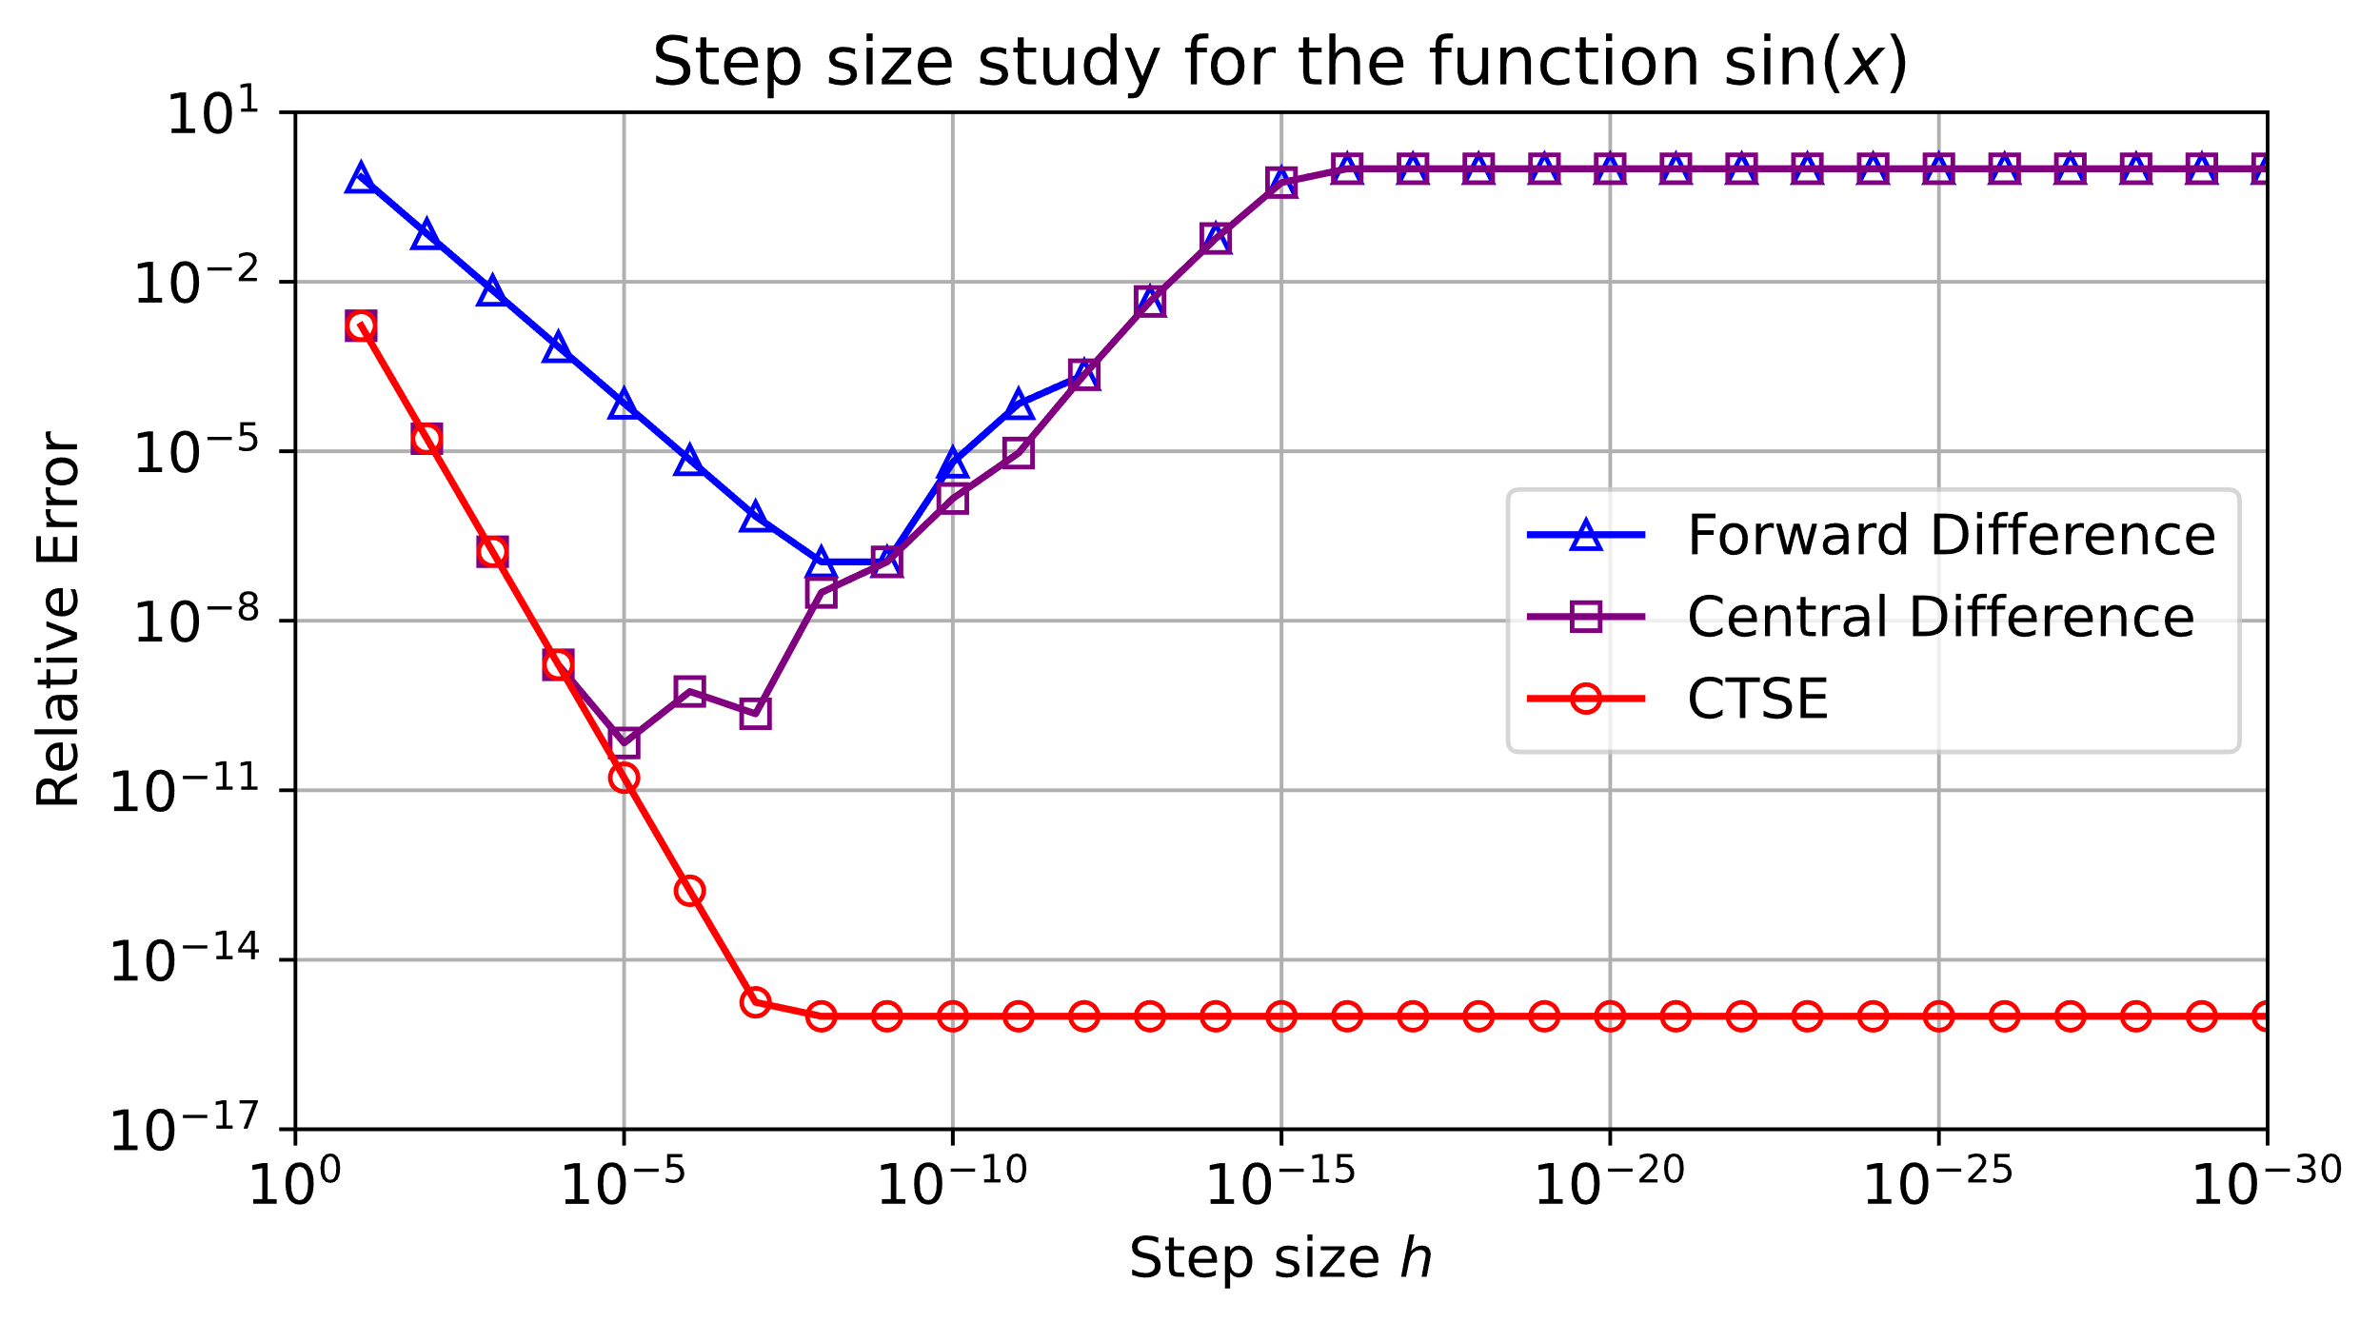
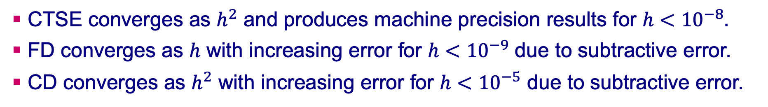

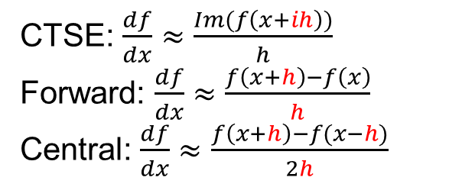
Step size study - $f\left(x\right)=sin\left(x\right)$
CTSE converges as $h^{2}$ and produces machine precision results for $h<{10}^{−8}.$
FD converges as $h$ with increasing error for $h<{10}^{−9}$ due to subtractive error.
CD converges as $h^{2}$ with increasing error for $h<{10}^{−5}$ due to subtractive error.
CTSE: $\frac{df}{dx}≈\frac{Im(f\left(x+ih\right))}{h}$
Forward: $\frac{df}{dx}≈\frac{f\left(x+h\right)−f\left(x\right)}{h}$
Central: $\frac{df}{dx}≈\frac{f\left(x+h\right)−f(x−h)}{2h}$
How small can we make $h$ for CTSE?
For a double precision system, $h$ can be as small as ${10}^{−307}$.

Slide 16
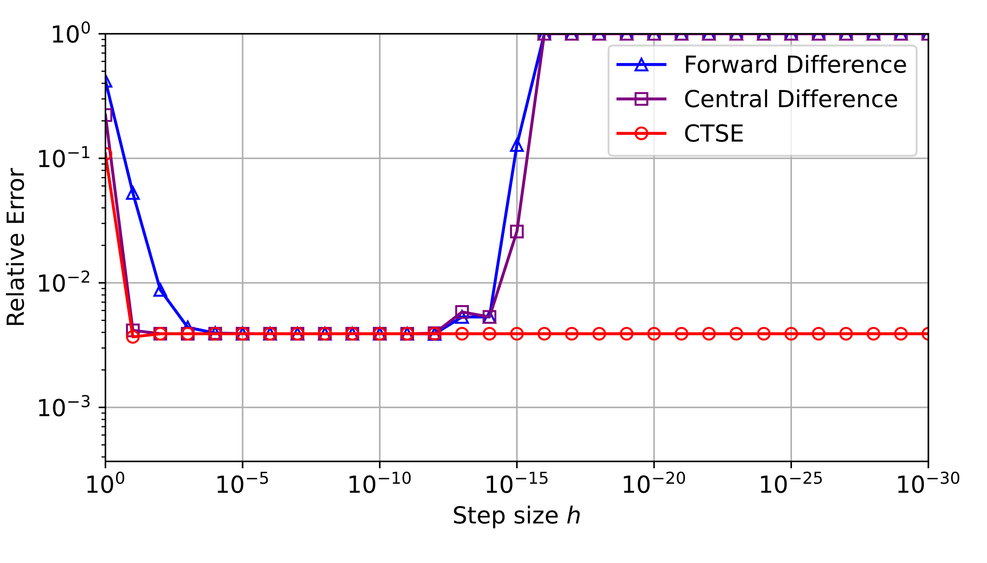
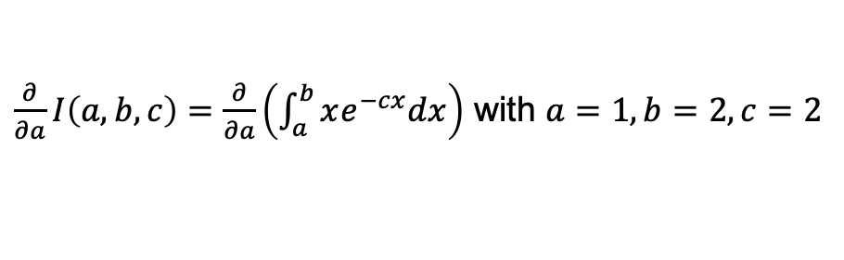
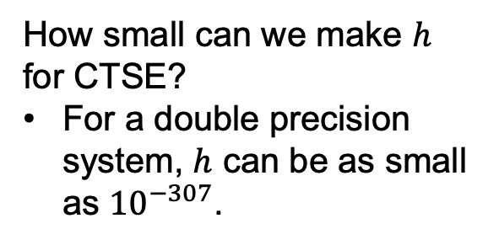

Step size study – numerical integration
A similar behavior will be seen for more complicated algorithms; however, CTSE will not always provide machine precision accuracy– the accuracy is dependent upon the algorithm in which it is deployed.
$\frac{∂}{∂a}I\left(a,b,c\right)=\frac{∂}{∂a}\left(\int_{a}^{b}{xe^{−cx}dx}\right)$ with $a=1,b=2,c=2$
How small can we make $h$ for CTSE?
For a double precision system, $h$ can be as small as ${10}^{−307}$.
$\frac{∂}{∂a}I\left(a,b,c\right)$ using Simpson’s rule

Slide 17
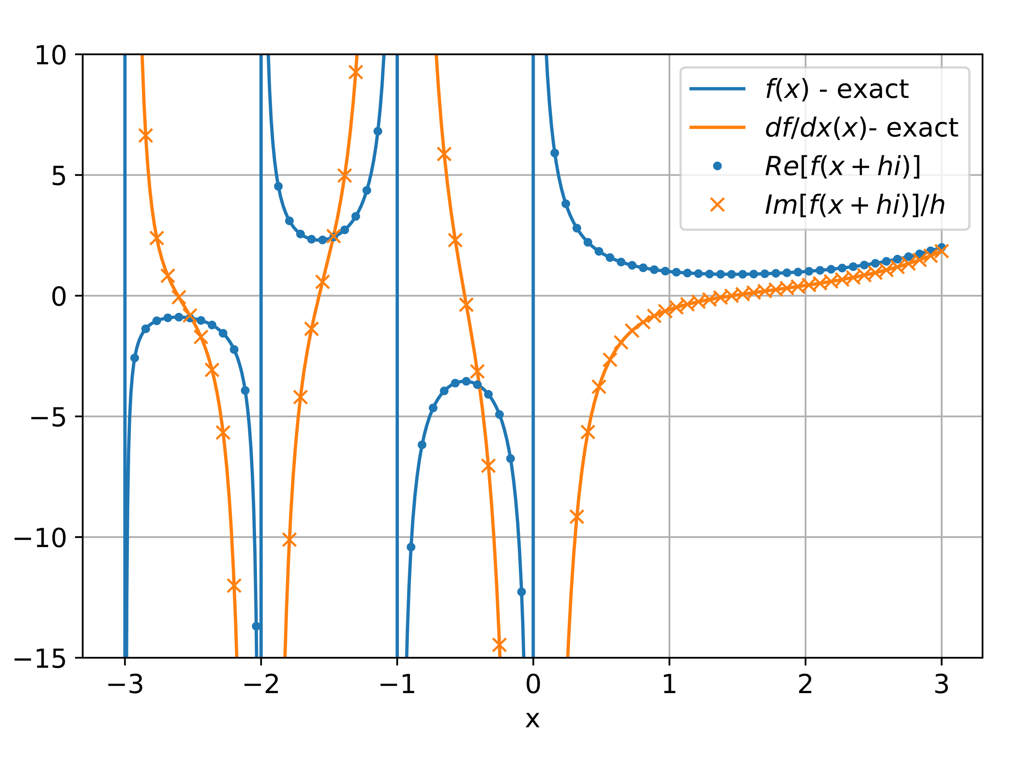
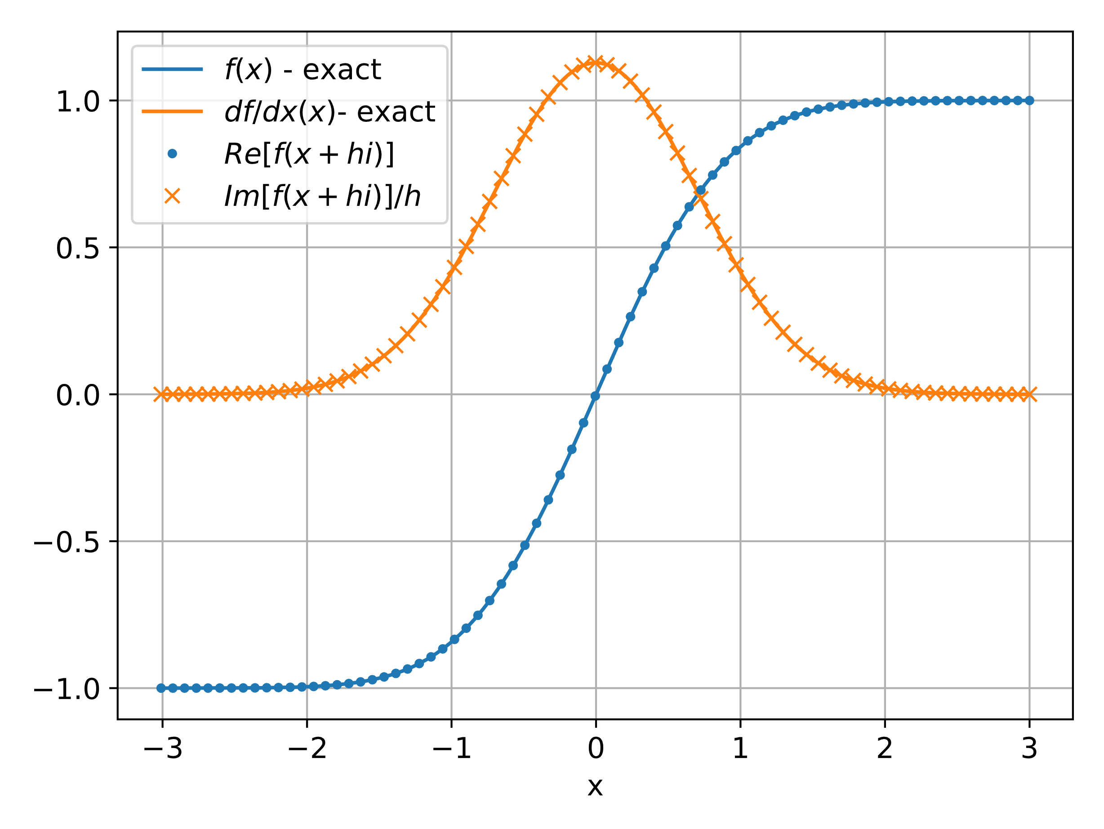


Numerical evaluation of special functions
CTSE can be easily used to numerically compute the derivative of special functions such as the Error and complementary Error functions (Erf, Erfc), Gamma function, Beta function, inverse trigonometric functions, elliptic integrals, and many others as long as they have complex variable versions.
Re and Im plots of Gamma(x+ih) alongside their analytical counterparts. $h={10}^{−10}$
Re and Im plots of Erf(x+ih) alongside their analytical counterparts. $h={10}^{−10}$

Slide 18
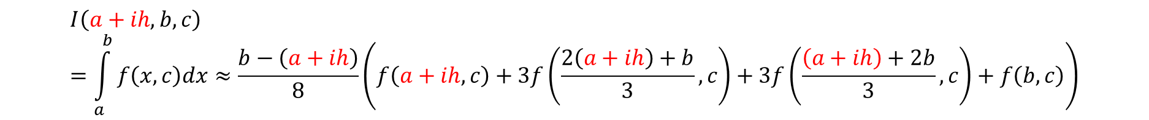
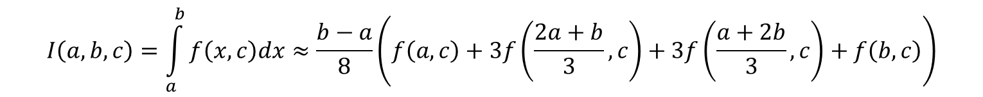
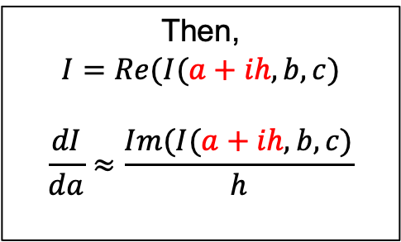
Application: Simpson’s rule
Let’s study the behavior of CTSE to calculate the derivative the parameters of an integral using Simpson’s rule.
Simpson’s Rule
$$I\left(a,b,c\right)=\int_{a}^{b}{f\left(x,c\right)dx≈\frac{b−a}{8}\left(f\left(a,c\right)+3f\left(\frac{2a+b}{3},c\right)+3f\left(\frac{a+2b}{3},c\right)+f\left(b,c\right)\right)}$$
To calculate: $\frac{dI}{da}≈\frac{Im(I(a+ih,b,c)}{h}$, replace $a$ with $a+ih$within Simpson’s rule.
$$I\left(a+ih,b,c\right)=\int_{a}^{b}{f\left(x,c\right)dx≈\frac{b−\left(a+ih\right)}{8}\left(f\left(a+ih,c\right)+3f\left(\frac{2\left(a+ih\right)+b}{3},c\right)+3f\left(\frac{\left(a+ih\right)+2b}{3},c\right)+f\left(b,c\right)\right)}$$
Then,
$$I=Re(I(a+ih,b,c)$$
$$\frac{dI}{da}≈\frac{Im(I(a+ih,b,c)}{h}$$

Slide 19
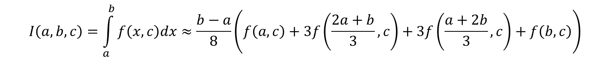
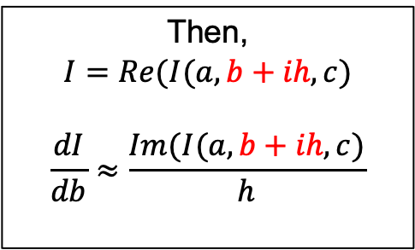
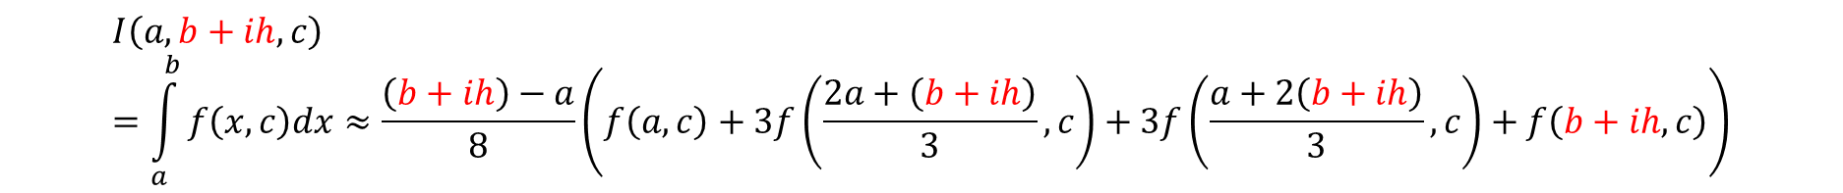
Application: Simpson’s rule, $dI/db$
Simpson’s Rule
$$I\left(a,b,c\right)=\int_{a}^{b}{f\left(x,c\right)dx≈\frac{b−a}{8}\left(f\left(a,c\right)+3f\left(\frac{2a+b}{3},c\right)+3f\left(\frac{a+2b}{3},c\right)+f\left(b,c\right)\right)}$$
To calculate: $\frac{dI}{db}≈\frac{Im(I(a,b+ih,c)}{h}$, replace $b$ with $b+ih$within Simpson’s rule.
$$I\left(a,b+ih,c\right)=\int_{a}^{b}{f\left(x,c\right)dx≈\frac{\left(b+ih\right)−a}{8}\left(f\left(a,c\right)+3f\left(\frac{2a+\left(b+ih\right)}{3},c\right)+3f\left(\frac{a+2\left(b+ih\right)}{3},c\right)+f\left(b+ih,c\right)\right)}$$
Then,
$$I=Re(I(a,b+ih,c)$$
$$\frac{dI}{db}≈\frac{Im(I(a,b+ih,c)}{h}$$

Slide 20
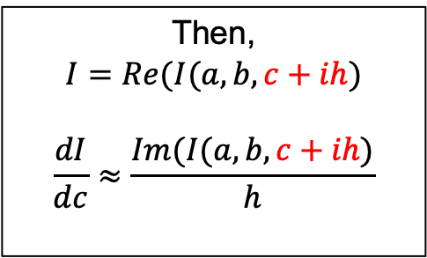
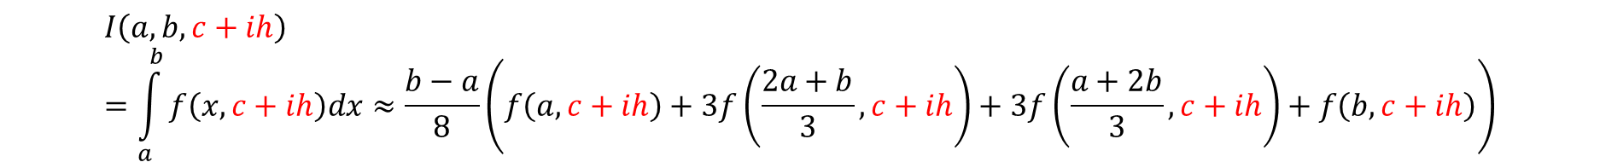
Application: Simpson’s rule, $dI/dc$
Simpson’s Rule
$$I\left(a,b,c\right)=\int_{a}^{b}{f\left(x,c\right)dx≈\frac{b−a}{8}\left(f\left(a,c\right)+3f\left(\frac{2a+b}{3},c\right)+3f\left(\frac{a+2b}{3},c\right)+f\left(b,c\right)\right)}$$
To calculate: $\frac{dI}{dc}≈\frac{Im(I(a,b,c+ih)}{h}$, replace $c$ with $c+ih$within Simpson’s rule.
$$I\left(a,b,c+ih\right)=\int_{a}^{b}{f\left(x,c+ih\right)dx≈\frac{b−a}{8}\left(f\left(a,c+ih\right)+3f\left(\frac{2a+b}{3},c+ih\right)+3f\left(\frac{a+2b}{3},c+ih\right)+f\left(b,c+ih\right)\right)}$$
Then,
$$I=Re(I(a,b,c+ih)$$
$$\frac{dI}{dc}≈\frac{Im(I(a,b,c+ih)}{h}$$

Slide 21

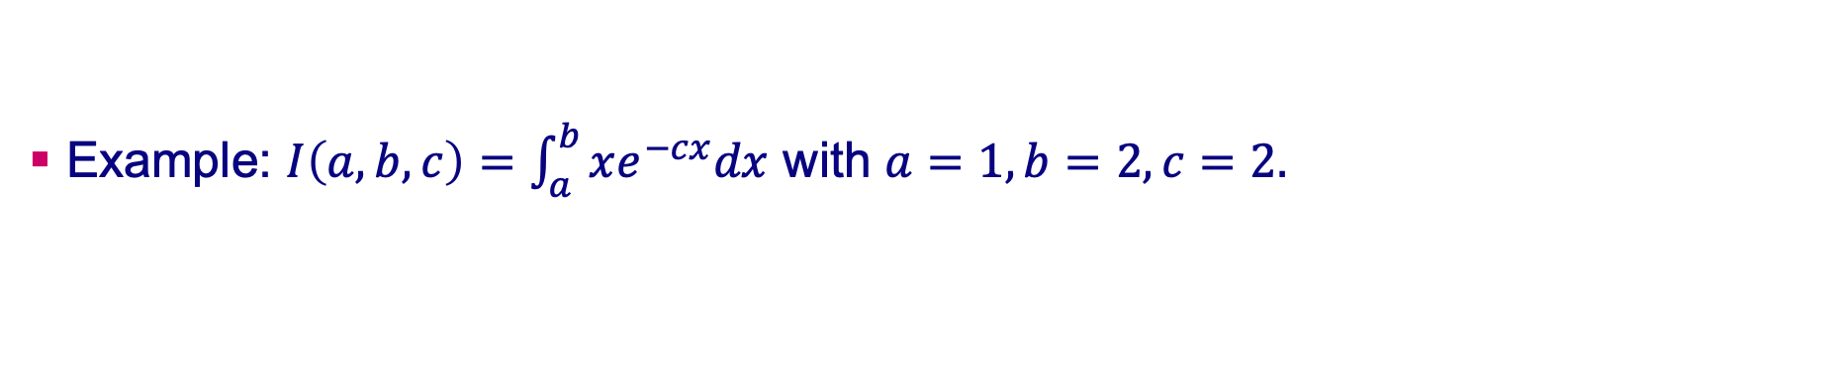
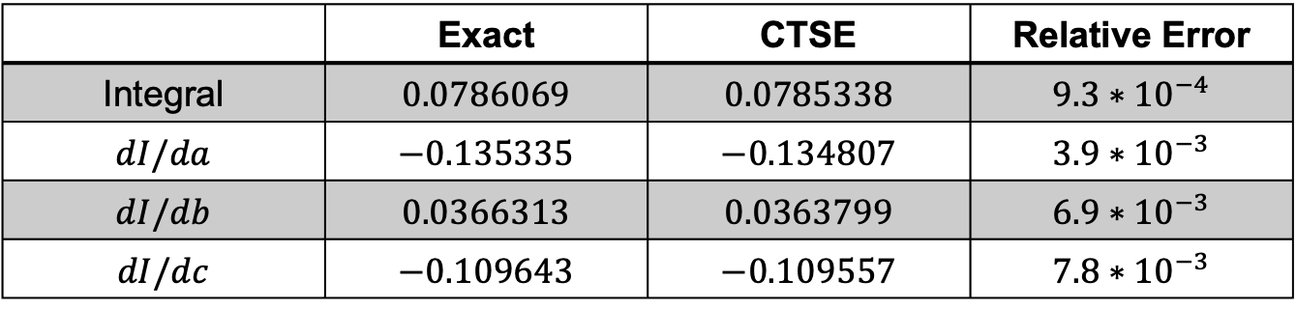
Application: Simpson’s rule
Example: $I\left(a,b,c\right)=\int_{a}^{b}{xe^{−cx}dx}$ with $a=1,b=2,c=2.$
 | Exact | CTSE | Relative Error
Integral | $$0.0786069$$ | $$0.0785338$$ | $$9.3∗{10}^{−4}$$
$$dI/da$$ | $$−0.135335$$ | $$−0.134807$$ | $$3.9∗{10}^{−3}$$
$$dI/db$$ | $$0.0366313$$ | $$0.0363799$$ | $$6.9∗{10}^{−3}$$
$$dI/dc$$ | $$−0.109643$$ | $$−0.109557$$ | $$7.8∗{10}^{−3}$$
CTSE results ($h={10}^{−10}$ was used).
Note that the accuracy of the derivatives are ~one order of magnitude less than the integral. This behavior is often seen in other applications.

Slide 22
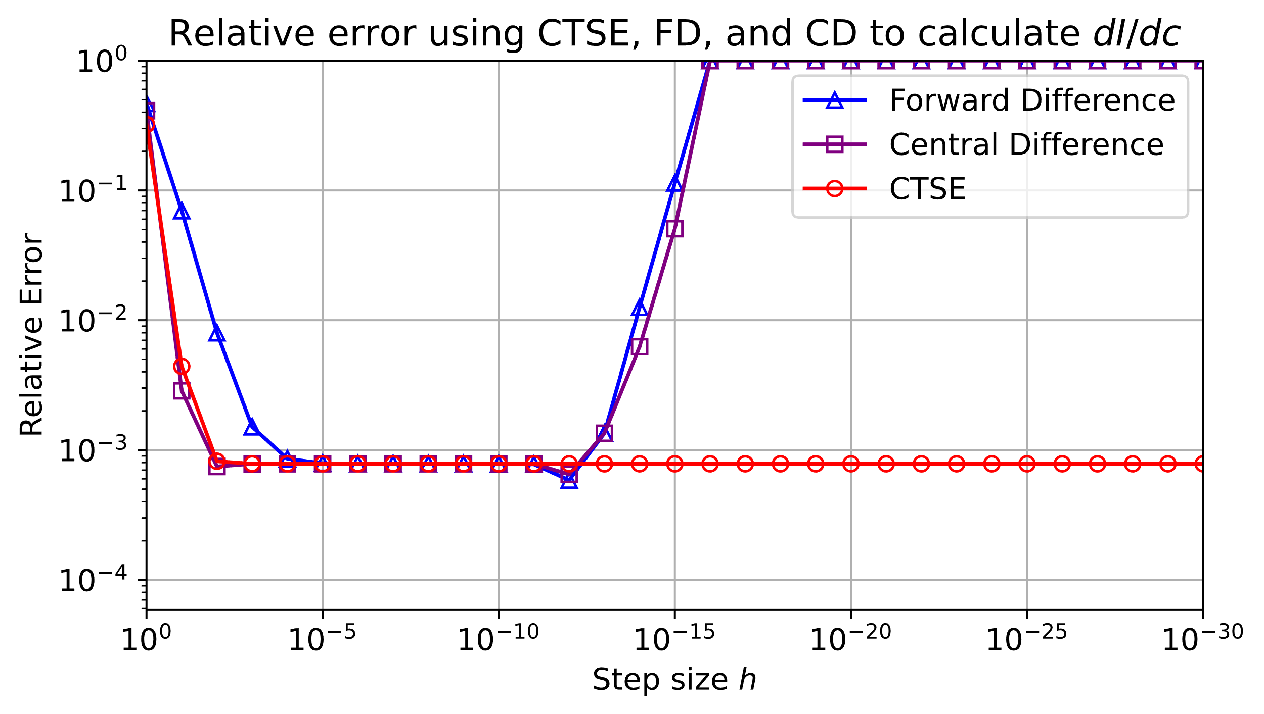
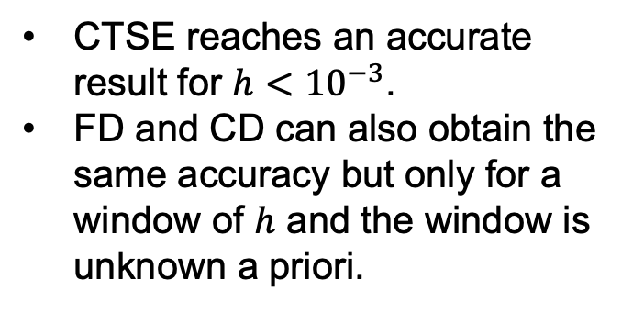
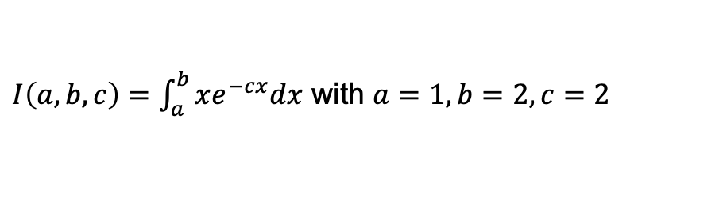

Application: Simpson’s rule
Observe the accuracy of the derivative $dI/dc$ as a function of the step size for CTSE, FD, and CD.
$I\left(a,b,c\right)=\int_{a}^{b}{xe^{−cx}dx}$ with $a=1,b=2,c=2$
CTSE reaches an accurate result for $h<{10}^{−3}$.
FD and CD can also obtain the same accuracy but only for a window of $h$ and the window is unknown a priori.
Numerical integration of $I\left(a,b,c\right)$ using Simpson’s rule

Slide 23
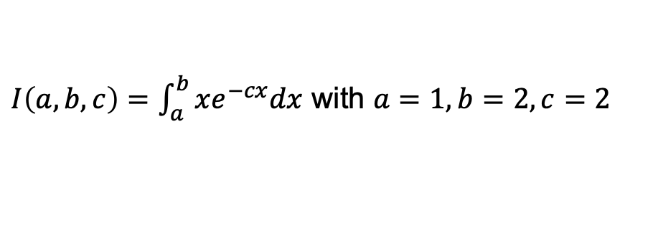
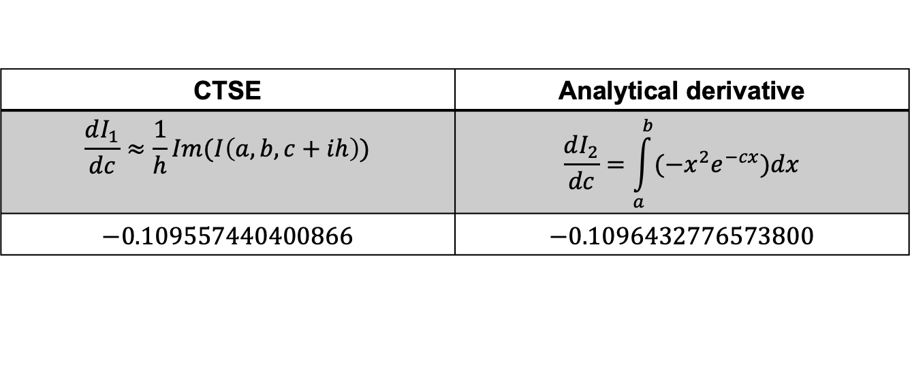
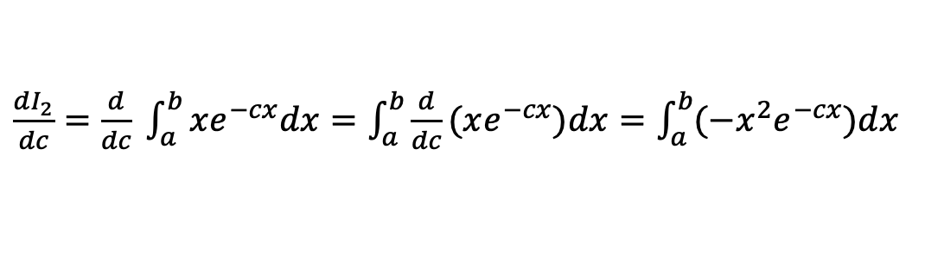

Application: Simpson’s rule
Compare the accuracy of $dI/dc$ computed 2 ways: 1)CTSE applied directly to $I$, and 2) Integration of the analytical equation. Both integrals computed using Simpson’s rule.
$I\left(a,b,c\right)=\int_{a}^{b}{xe^{−cx}dx}$ with $a=1,b=2,c=2$
$$\frac{dI_{1}}{dc}≈\frac{1}{h}Im(I\left(a,b,c+ih\right))$$
$\frac{dI_{2}}{dc}=$ $\frac{d}{dc} \int_{a}^{b}{xe^{−cx}dx}=\int_{a}^{b}{\frac{d}{dc}(xe^{−cx})dx}=\int_{a}^{b}{(−x^{2}e^{−cx})dx}$
CTSE | Analytical derivative
$$\frac{dI_{1}}{dc}≈\frac{1}{h}Im(I\left(a,b,c+ih\right))$$ | $$\frac{dI_{2}}{dc}=\int_{a}^{b}{(−x^{2}e^{−cx})dx}$$
$$−0.109557440400866$$ | $$−0.1096432776573800$$
To summarize, CTSE provides the most accurate derivative possible (given sufficiently small step size) – the accuracy is only limited in this case by the accuracy of Simpson’s rule.

Slide 24

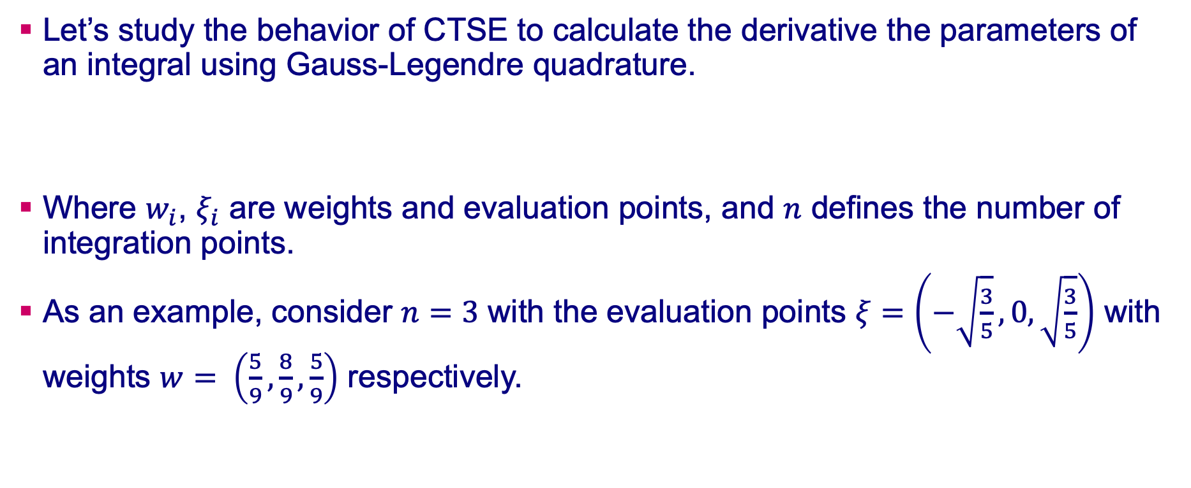
Application: Gauss-Legendre quadrature
Let’s study the behavior of CTSE to calculate the derivative the parameters of an integral using Gauss-Legendre quadrature.
Where $w_{i}$, $ξ_{i}$ are weights and evaluation points, and $n$ defines the number of integration points.
As an example, consider $n=3$ with the evaluation points $ξ=\left(−\sqrt{\frac{3}{5}}, 0, \sqrt{\frac{3}{5}}\right)$ with weights $w= \left(\frac{5}{9},\frac{8}{9},\frac{5}{9}\right)$ respectively.
$$I\left(a,b,c\right)=\int_{a}^{b}{f\left(x,c\right)≈ \left(\frac{b −a}{2}\right)}\sum_{i=1}^{n}{w_{i}f\left(\frac{b −a}{2}ξ_{i}+\frac{b+a}{2},c\right)}$$

Slide 25
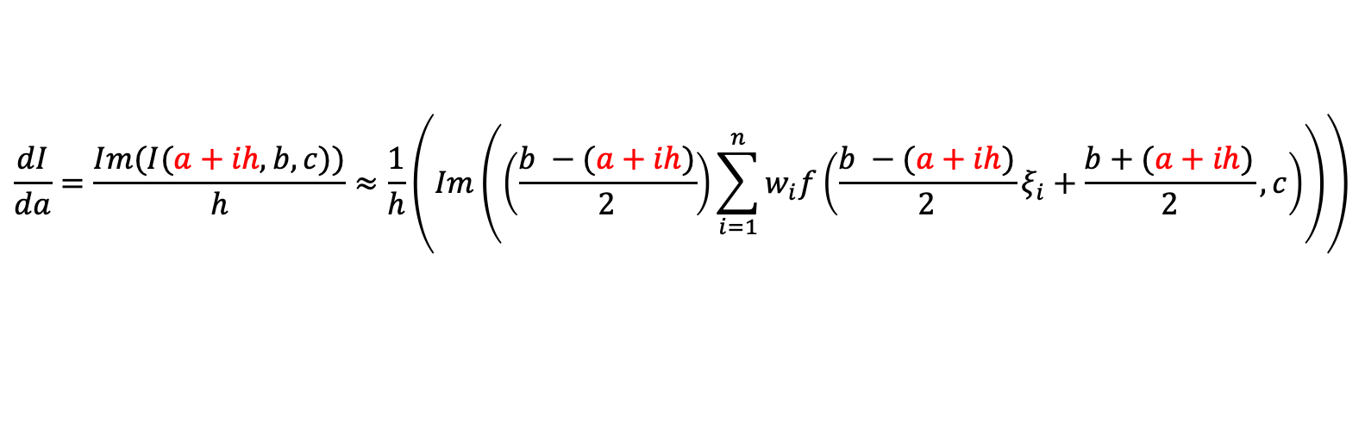
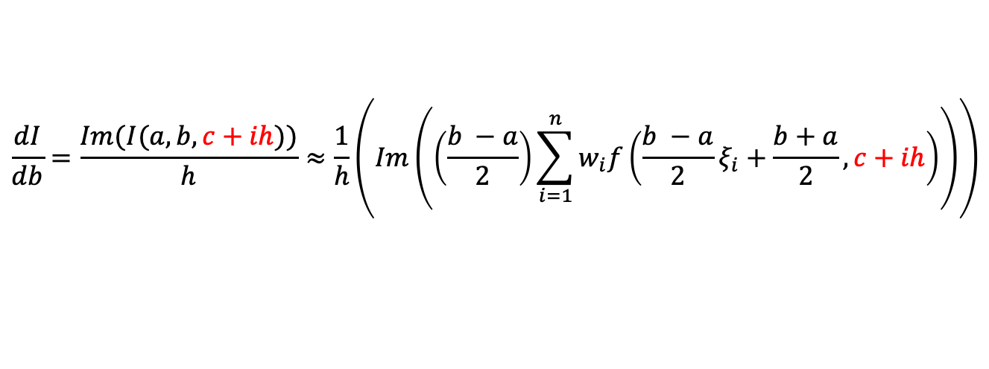
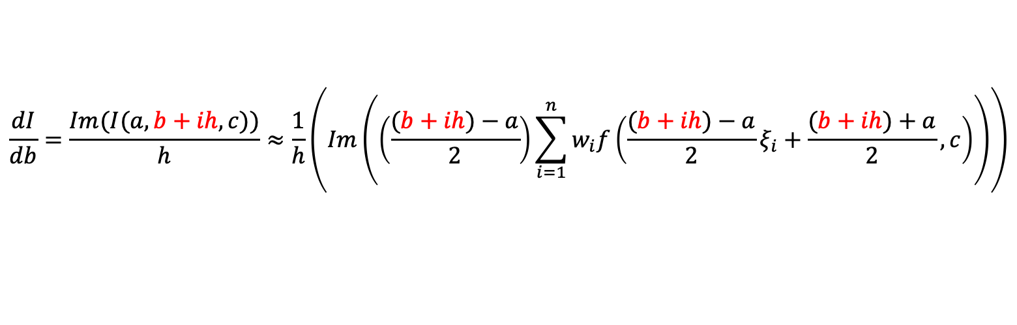
Application: Gauss-Legendre quadrature
To calculate: $dI/da≈\frac{Im(I(a+ih,b,c)}{h}$, replace $a$ with $a+ih$ within G-L quadrature and similarly for $dI/db$ and $dI/dc$.
$$\frac{dI}{da}=\frac{Im(I(a+ih, b, c))}{h}≈\frac{1}{h}\left(Im\left(\left(\frac{b −(a+ih)}{2}\right)\sum_{i=1}^{n}{w_{i}f\left(\frac{b −(a+ih)}{2}ξ_{i}+\frac{b+(a+ih)}{2},c\right)}\right)\right)$$
$$\frac{dI}{db}=\frac{Im(I(a, b+ih, c))}{h}≈\frac{1}{h}\left(Im\left(\left(\frac{(b+ih)−a}{2}\right)\sum_{i=1}^{n}{w_{i}f\left(\frac{(b+ih)−a}{2}ξ_{i}+\frac{(b+ih)+a}{2},c\right)}\right)\right)$$
$$\frac{dI}{db}=\frac{Im(I(a, b, c+ih))}{h}≈\frac{1}{h}\left(Im\left(\left(\frac{b −a}{2}\right)\sum_{i=1}^{n}{w_{i}f\left(\frac{b −a}{2}ξ_{i}+\frac{b+a}{2},c+ih\right)}\right)\right)$$

Slide 26



Application: Gauss-Legendre quadrature
Example: $I\left(a,b,c\right)=\int_{a}^{b}{xe^{−cx}dx}$ with $a=1,b=2,c=2.$
 | Exact | CTSE | Relative Error
Integral | $$0.0786069$$ | $$0.0786094$$ | $$3.17∗{10}^{−5}$$
$$dI/da$$ | $$−0.135335$$ | $$−0.135356$$ | $$1.55∗{10}^{−4}$$
$$dI/db$$ | $$0.0366313$$ | $$0.0366457$$ | $$3.93∗{10}^{−4}$$
$$dI/dc$$ | $$−0.109643$$ | $$−0.109642$$ | $$1.27∗{10}^{−5}$$
CTSE results ($h={10}^{−10}$ was used).

Slide 27


Application: Gauss-Legendre quadrature
Observe the accuracy of the integral and its derivatives as a function of the step size for CTSE, FD, and CD.
CTSE reaches an accurate result for $h<{10}^{−3}$.
FD and CD can also obtain the same accuracy but only for a window of $h$ and the window is not known a priori.
FD and CD “may” occasionally obtain a better result than CTSE but this is a numerical artifact and rarely seen.

Slide 28

Newton-Rhapson
The Newton-Raphson Method is an algorithm that can be used to approximate the root of a function. The estimate of the root of function $f$ at iteration $j + 1$can be estimated from the result at step $j$ as
$$x_{j+1}=x_{j}−\frac{f(x_{j})}{\frac{df}{dx}(x_{j})}$$
This equation can be rewritten to use CTSE as
$$x_{j+1}=x_{j}−\frac{Re\left(f\left(x_{j}+ih\right)\right)}{\frac{1}{h}Im\left(f\left(x_{j}+ih\right)\right)}$$
Hence, one complex-variable evaluation of $f\left(x_{j}+ih\right)$ can be used to estimate $f(x_{j})$ and $\frac{df}{dx}(x_{j})$.

Slide 29


Newton-Rhapson
Example1: $f\left(x\right)=\cos\left(ax\right)−x/a$
$x_{j+1}=x_{j}−$ $\frac{Re\left(\cos\left(a(x_{j}+ih)\right)−(x_{j}+ih)/a\right)}{\frac{1}{h}Im\left(\cos\left(a(x_{j}+ih)\right)−(x_{j}+ih)/a\right)}$
Iteration no. | x value | Relative error
0 | $$0.2$$
1 | $0.850777122431116$ | $$1.51∗{10}^{−1}$$
2 | $$0.741530193469262$$ | $$3.31∗{10}^{−3}$$
3 | $0.739086449877212$ | $$1.78∗{10}^{−6}$$
4 | $0.739085133215543$ | $$5.18∗{10}^{−13}$$
5 | $0.739085133215161$ | $$0$$
Results for $a=1$. Starting value $x=0.2$.

Slide 30



Ordinary Differential Equation (ODE) Solver
CTSE can be employed within an ODE algorithm in order to obtain sensitivities of the dependent variable $y(x)$ with respect to model constants, i.e., $dy(x)/dθ$, where $θ$ is any constant in the ODE including initial conditions. This can be done for any ODE solver that supports complex variables including built-in solvers in C, Fortran, Mathematica, Matlab, Python, etc. The accuracy of the solver and its convergence rate are unaltered by CTSE.
Consider the simple case of Euler’s method to solve equations of the form $y^{′}\left(x\right)=f(x,y)$. Euler’s method uses the slope $f\left(x_{i},y_{i}\right)$at $y_{i}$ to project the solution to $y_{i+1}$ that is,
$y_{i+1}=y_{i}+f\left(x_{i},y_{i}\right)h_{ode}$.
Where $h_{ode}$ is a step size to solve the ODE NOT the step size for CTSE.

Slide 31



ODE solver – Euler’s method
Consider the following ODE with parameters: $a, b, g$. The sensitivities $dy(x)/da$, $dy(x)/db$, and $dy(x)/dg$ can be obtained by perturbing each parameter by $ih$ and executing the traditional ODE solver method but now with complex variables. This will work with any ODE solver, e.g., RK45, as long as the solver supports complex variables.
${ y}^{′}\left(x\right)=ay\left(x\right)+bx−x^{2}$ $y\left(0\right)=g$
$$a=1,b=2,g=1$$
Exact solutions:
$$y\left(x\right)=x^{2}+e^{x}$$ $$\frac{dy\left(x\right)}{da}=−2−2x−x^{2}+{(2+x)e}^{x}$$ | $$\frac{dy\left(x\right)}{db}=−1−x+e^{x}$$ $$\frac{dy\left(x\right)}{dg}=e^{x}$$

Slide 32




ODE solver – Euler’s method
The numerical results using Euler’s method are shown below using a step size of $h_{ode}=0.1.$
${ y}^{′}\left(x\right)=f\left(x,y\right)=ay\left(x\right)+bx−x^{2}$ $y\left(0\right)=g$
$$a=1,b=2,g=1$$
Euler’s method:
Numerical solution:
$$y_{i+1}\left(x\right)=y_{i}+y^{′}\left(x\right)h_{ode}$$
$${ y}^{′}\left(x\right)=1y\left(x\right)+2x−x^{2}$$
$$y_{0}\left(0\right)=1$$
$$h_{ode}=0.1$$
X | $$y_{i}$$ | $$y′(x)$$ | $$y_{i+1}$$ | $$y_{exact}$$ | Relative Error
0.0 | $$1.0$$ | $$1.0$$ | $$1.1$$ | $$1.0$$ | ---
0.1 | $$1.1$$ | $$1.129$$ | $$1.290$$ | $$1.1152$$ | $$9.80∗{10}^{−2}$$
0.2 | $$1.229$$ | $$1.589$$ | $$1.388$$ | $$1.2614$$ | $$1.09∗{10}^{−1}$$
0.3 | $$1.388$$ | $$1.898$$ | $$1.578$$ | $$1.4399$$ | $$1.20∗{10}^{−1}$$
0.4 | $$1.578$$ | $$2.218$$ | $$1.799$$ | $$1.6518$$ | $$1.29∗{10}^{−1}$$
$h_{ode}$ is the step size used for Euler’s method – this is independent from the $h$ used by CTSE.

Slide 33



ODE solver – $dy(x)/da$ result
The sensitivity $dy(x)/da$ can be obtained using the standard Euler’s method but now with complex variable parameters. As shown below, parameter $a$ is replaced by $a+ih$ (with $a=1$) and the derivative with respect to $a$ is obtained as $\frac{dy\left(x\right)}{da}≈\frac{1}{h}Im(y\left(x\right))$.
${ y}^{′}\left(x\right)=(1+ih)y\left(x\right)+2x−x^{2}$ with $y\left(0\right)=1$
X | $$y(x)$$ | $$dy/da$$ | $${dy/da}_{exact}$$ | Relative Error
0.0 | --- | $$1.0$$ | $$0$$ | ---
0.1 | $$1.1+1∗{10}^{−11}i$$ | $$0.1$$ | $$0.1108$$ | $$9.80∗{10}^{−2}$$
0.2 | $$1.229+2.2∗{10}^{−11}i$$ | $$0.22$$ | $$0.2471$$ | $$1.09∗{10}^{−1}$$
0.3 | $$1.388+3.649∗{10}^{−11}i$$ | $$0.3649$$ | $$0.4147$$ | $$1.20∗{10}^{−1}$$
0.4 | $$1.578+5.402∗{10}^{−11}i$$ | $$0.5402$$ | $$0.6204$$ | $$1.29∗{10}^{−1}$$
CTSE results ($h={10}^{−10}$ was used).

Slide 34


ODE solver – $dy(x)/db$ result
The sensitivity $dy(x)/db$ can be obtained using the standard Euler’s method but now with complex variable parameters. As shown below, parameter $b$ is replaced by $b+ih$ (with $b=2$) and the derivative with respect to $b$ is obtained as $dy(x)/db≈\frac{1}{h}Im(y\left(x\right))$.
${ y}^{′}\left(x\right)=1y\left(x\right)+(2+ih)x−x^{2}$ with $y\left(0\right)=1$
X | $$y(x)$$ | $$dy/db$$ | $${dy/db}_{exact}$$ | Relative Error
0.0 | --- | $$\text{−−−}$$ | $$0$$ | ---
0.1 | $$1.1+0i$$ | $$0.0$$ | $$0.0052$$ | $$1$$
0.2 | $$1.229+1.0∗{10}^{−12}i$$ | $$0.01$$ | $$0.0214$$ | $$0.532$$
0.3 | $$1.388+3.1∗{10}^{−12}i$$ | $$0.031$$ | $$0.0499$$ | $$0.378$$
0.4 | $$1.578+6.41∗{10}^{−12}i$$ | $$0.0641$$ | $$0.0918$$ | $$0.301$$
CTSE results ($h={10}^{−10}$ was used).

Slide 35


ODE solver – $dy(x)/dg$ result
The sensitivity $dy(x)/dg$ can be obtained using the standard Euler’s method but now with complex variable parameters. As shown below, parameter $g$ is replaced by $g+ih$ (with $g=1$) and the derivative with respect to $g$ is obtained as $dy(x)/dg≈\frac{1}{h}Im(y\left(x\right))$.
${ y}^{′}\left(x\right)=1y\left(x\right)+2x−x^{2}$ with $y\left(0\right)=(1+ih)$
X | $$y(x)$$ | $$dy/dg$$ | $${dy/dg}_{exact}$$ | Relative Error
0.0 | --- | $$\text{−−−}$$ | $$1.000$$ | ---
0.1 | $$1.1+1.1∗{10}^{−10}i$$ | $$1.1$$ | $$1.105$$ | $$4.68∗{10}^{−3}$$
0.2 | $$1.229+1.21∗{10}^{−10}i$$ | $$1.21$$ | $$1.221$$ | $$9.33∗{10}^{−3}$$
0.3 | $$1.388+1.331∗{10}^{−10}i$$ | $$1.33$$ | $$1.350$$ | $$1.40∗{10}^{−2}$$
0.4 | $$1.578+1.464∗{10}^{−10}i$$ | $$1.46$$ | $$1.492$$ | $$1.86∗{10}^{−2}$$
CTSE results ($h={10}^{−10}$ was used).

Slide 36

Cauchy-Reimann (CR) form
CTSE can be employed without complex numbers using Cauchy-Reimann matrices of all real values. This is sometimes useful for numerical algorithms/software without a complex version, e.g., solvers for systems of linear equations.
Any complex number $a+bi$can be rewritten in the matrix form $\left[\begin{matrix}a & −b \\ b & a\end{matrix}\right]$.
Thus, to differentiate a function using CTSE, one computes $f\left(x+ih\right)=f(\left[\begin{matrix}x & −h \\ h & x\end{matrix}\right]$) where $h$ is again a small step size. Then
$$\frac{df}{dx}=\frac{f(\left[\begin{matrix}x & −h \\ h & x\end{matrix}\right]{\text{)}}_{21}}{h}$$
Where the subscript 21 indicates the first column second row of the resulting matrix.

Slide 37


Closed-form example: $f\left(x\right)=x^{2}$
Compute the derivative of $f\left(x\right)=x^{2}$ using the CR form for complex numbers.
$$f\left(x\right)=x^{2}$$
$$f\left(x+ih\right)={\left[\begin{matrix}x & −h \\ h & x\end{matrix}\right]}^{2}=\left[\begin{matrix}x^{2}−h^{2} & −2hx \\ 2hx & x^{2}−h^{2}\end{matrix}\right]$$
$$\frac{df}{dx}=\frac{f(\left[\begin{matrix}x & −h \\ h & x\end{matrix}\right]{\text{)}}_{21}}{h}={\frac{1}{h}\left[\begin{matrix}x^{2}−h^{2} & −2hx \\ 2hx & x^{2}−h^{2}\end{matrix}\right]}_{21}=2x$$

Slide 38


Closed-form example: $f\left(x\right)=x^{3}$
Compute the derivative of $f\left(x\right)=x^{3}$ using the CR form for complex numbers.
$$f\left(x\right)=x^{3}$$
$$f\left(x+ih\right)={\left[\begin{matrix}x & −h \\ h & x\end{matrix}\right]}^{3}=\left[\begin{matrix}{x\left(x^{2}−h^{2}\right)−2h^{2}x}^{2} & {−h\left(x^{2}−h^{2}\right)−2hx}^{2} \\ {h\left(x^{2}−h^{2}\right)+2hx}^{2} & {x\left(x^{2}−h^{2}\right)−2h^{2}x}^{2}\end{matrix}\right]$$
$$\frac{df}{dx} =\lim_{h→0}{\frac{f(\left[\begin{matrix}x & −h \\ h & x\end{matrix}\right]{\text{)}}_{21}}{h}}=$$
$${\lim_{h→0}{\frac{1}{h}\left[\begin{matrix}{x\left(x^{2}−h^{2}\right)−2h^{2}x}^{2} & {−h\left(x^{2}−h^{2}\right)−2hx}^{2} \\ {h\left(x^{2}−h^{2}\right)+2hx}^{2} & {x\left(x^{2}−h^{2}\right)−2h^{2}x}^{2}\end{matrix}\right]}}_{21}{=x}^{2}+2x^{2}=3x^{2}$$
CTSE is exact in the limit as $h→0$.

Slide 39



Closed-form example: $f\left(x\right)=e^{x}$
Compute the derivative of $f\left(x\right)=e^{x}$using the CR form for complex numbers.
$$f\left(x\right)=e^{x}$$
$$f\left(x+ih\right)=expM(\left[\begin{matrix}x & −h \\ h & x\end{matrix}\right])=\left[\begin{matrix}e^{x}cos⁡(h) & −e^{x}sin⁡(h) \\ e^{x}sin⁡(h) & e^{x}cos⁡(h)\end{matrix}\right]$$
$$\frac{df}{dx} =\lim_{h→0}{\frac{f(\left[\begin{matrix}x & −h \\ h & x\end{matrix}\right]{\text{)}}_{21}}{h}}=$$
$$\lim_{h→0}{\frac{1}{h}{\left[\begin{matrix}e^{x}\cos\left(h\right) & −e^{x}\sin\left(h\right) \\ e^{x}\sin\left(h\right) & e^{x}\cos\left(h\right)\end{matrix}\right]}_{21}}=e^{x}\frac{sin⁡(h) }{h}=e^{x}$$
CTSE is exact in the limit as $h→0$.
Note, functions of matrices must be used for the exponential operator NOT the standard exponential function.

Slide 40


Closed-form example: $f\left(x\right)=sin⁡(x)$
Compute the derivative of $f\left(x\right)=\sin\left(x\right)$using the CR form for complex numbers.
$$f\left(x\right)=sin⁡(x)$$
$$f\left(x+ih\right)=cosM(\left[\begin{matrix}x & −h \\ h & x\end{matrix}\right])=\left[\begin{matrix}\sin\left(x\right)cosh⁡(h) & −\cos\left(x\right)sinh⁡(h) \\ \cos\left(x\right)sinh⁡(h) & \sin\left(x\right)cosh⁡(h)\end{matrix}\right]$$
$$\frac{df}{dx} =\lim_{h→0}{\frac{f(\left[\begin{matrix}x & −h \\ h & x\end{matrix}\right]{\text{)}}_{21}}{h}}=$$
$$\lim_{h→0}{{\frac{1}{h}\left[\begin{matrix}\sin\left(x\right)\cosh\left(h\right) & −\cos\left(x\right)\sinh\left(h\right) \\ \cos\left(x\right)\sinh\left(h\right) & \sin\left(x\right)\cosh\left(h\right)\end{matrix}\right]}_{21}}=cos{(x)}\frac{\sinh\left(h\right)}{h}=\cos{(x)}$$
CTSE is exact in the limit as $h→0$.
Note, functions of matrices must be used for the sine operator NOT the standard sine function.

Slide 41


Closed-form example: $f\left(x\right)=cos⁡(x)$
Compute the derivative of $f\left(x\right)=\cos\left(x\right)$using the CR form for complex numbers.
$$f\left(x\right)=cos⁡(x)$$
$$f\left(x+ih\right)=cosM(\left[\begin{matrix}x & −h \\ h & x\end{matrix}\right])=\left[\begin{matrix}\cos\left(x\right)cosh⁡(h) & \sin\left(x\right)sinh⁡(h) \\ −sin\left(x\right)sinh⁡(h) & \cos\left(x\right)cosh⁡(h)\end{matrix}\right]$$
$$\frac{df}{dx} =\lim_{h→0}{\frac{f(\left[\begin{matrix}x & −h \\ h & x\end{matrix}\right]{\text{)}}_{21}}{h}}=$$
$$\lim_{h→0}{{\frac{1}{h}\left[\begin{matrix}\cos\left(x\right)\cosh\left(h\right) & \sin\left(x\right)\sinh\left(h\right) \\ −sin\left(x\right)\sinh\left(h\right) & \cos\left(x\right)\cosh\left(h\right)\end{matrix}\right]}_{21}}=−\sin\left(x\right)\frac{\sinh\left(h\right)}{h}=−sin⁡(x)$$
CTSE is exact in the limit as $h→0$.
Note, functions of matrices must be used for the cosine operator NOT the standard cosine function.

Slide 42

Functions of matrices
Functions of matrices¹ are not the same as the standard functions. For example,
$$Exp\left[\begin{matrix}a & 0 \\ c & d\end{matrix}\right]=\left[\begin{matrix}e^{a} & 0 \\ \frac{c(e^{a}−e^{d})}{a−d} & e^{d}\end{matrix}\right]$$
$$Sin\left[\begin{matrix}a & 0 \\ c & d\end{matrix}\right]=\left[\begin{matrix}sin⁡(a) & 0 \\ \frac{c(\sin\left(a\right)−\sin\left(d\right))}{a−d} & sin⁡(d)\end{matrix}\right]$$
Hence to use the CR form, one must have a language with good support of functions of matrices.
¹Higham, Nicholas J. Functions of matrices: theory and computation. Society for Industrial and Applied Mathematics, 2008.

Slide 43





Functions of matrices
Note, some matrix functions loose accuracy for small $h$ when using the complex variable CR form. Alternative: use the dual form of the CR matrix.
Complex form: $\left[\begin{matrix}x & −h \\ h & x\end{matrix}\right]$, $h$ small
$$\frac{df}{dx}≈\frac{sqrtM{\left(\left[\begin{matrix}x & −h \\ h & x\end{matrix}\right]\right)}_{21}}{h}$$
Dual form: $\left[\begin{matrix}x & 0 \\ h & x\end{matrix}\right]$, $h$ arbitrary
$$\frac{df}{dx}=\frac{sqrtM{\left(\left[\begin{matrix}x & 0 \\ h & x\end{matrix}\right]\right)}_{21}}{h}$$
$$f\left(x\right)=\sqrt{x}$$

Slide 44
Second Order Derivatives with CTSE
Second order derivatives can be computed with CTSE.
Two approaches presented here:
Method 1:
Finite differences of first-order derivatives obtained with CTSE.
Forward differences
Central differences
Requires two complex function evaluations.
Both methods prone to subtractive cancellation error.
Method 2:
Extract the second order derivative from the real coefficient of the CTSE evaluation
Requires one complex and one real function evaluations.

Slide 45




Second Order Derivatives with CTSE
Method 1: Finite differences of CTSE to obtain a second order derivative.
Evaluate first-order derivatives with CTSE at two points: $(x)$ and $(x+h_{FD})$:
Apply Forward differences with the two evaluations to get the second derivative
$$\frac{ d^{2}f}{dx^{2}}(x)≈\frac{\frac{df}{dx}\left(x+h_{FD}\right)−\frac{df}{dx}\left(x\right)}{h_{FD}}=\frac{Im\left(f\left(\left(x+h_{FD}\right)+ih\right)\right)−Im\left(f\left(x+ih\right)\right)}{h_{FD} h}$$
Easily extended to Central Differences:
$$\frac{df}{dx}\left(x\right)≈\frac{Im\left(f\left(x+ih\right)\right)}{h},$$
$$\frac{df}{dx}\left(x+h_{FD}\right)≈\frac{Im\left(f\left(\left(x+h_{FD}\right)+ih\right)\right)}{h}$$
$$\frac{d^{2}f}{dx^{2}}\left(x\right)≈\frac{Im\left(f\left(\left(x+h_{FD}\right)+ih\right)\right) −Im\left(f\left(\left(x−h_{FD}\right)+ih\right)\right)}{2h_{FD} h}$$

Slide 46



Second Order Derivatives with CTSE
$$f\left(x\right)=x^{2}e^{x}$$
Example Method 1. Closed form function:
CTSE with finite differencing outperforms traditional finite difference methods.
Second order derivatives suffers subtractive cancellation error
Step size for CTSE first derivative was fixed at $h={10}^{−10}.$
Finite Differences for 2nd order derivatives:
ForwardDiff: $\frac{d^{2}f}{dx^{2}}\left(x\right)≈\frac{f\left(x+2h_{FD}\right)−2f\left(x+h_{FD}\right)+f(x)}{h_{FD}^{2}}$
CentralDiff: $\frac{d^{2}f}{dx^{2}}\left(x\right)≈\frac{f\left(x+h_{FD}\right)−2f\left(x\right)+f(x−h_{FD})}{h_{FD}^{2}}$

Slide 47



Second Order Derivatives with CTSE
Best step-size for first-order with CTSE $≠$ best step-size for second derivative with CTSE.
Selection of best step-size still very difficult.
Subjected to subtractive cancellation error.
i.e. fixing the CTSE step size to $h=10^{−10}$ is not best practice
Lower errors can be achieved using different step-sizes:
For CTSE with CD → Best case $h_{FD}=h$
For CTSE with FD → Best case $h_{FD}=h^{2}$ *
*Can be particular to the function evaluated

Slide 48



Second Order Derivatives with CTSE
Method 2: Extract the second derivative from the real part of the CTSE evaluation.
From the Complex Taylor Series Expansion:
$f\left(x+ih\right)≈\left(f\left(x\right)−\frac{1}{2}\frac{d^{2}f}{dx^{2}}h^{2}\right)$+ $i\left(\frac{df}{dx}h−\frac{1}{3!}\frac{d^{3}f}{dx^{3}}{ih}^{3}\right)+HOT$
The real part contains the second-order derivative:
$Re(f\left(x+ih\right)$)= $f\left(x\right)−\frac{1}{2}\frac{d^{2}f}{dx^{2}}h^{2}+HOT$
In summary:
$\frac{df}{dx}≈\frac{Im(f\left(x+ih\right))}{h}$
$\frac{ d^{2}f}{dx^{2}}≈2\frac{f\left(x\right)− Re\left(f\left(x+ih\right)\right)}{h^{2}}$
Subtracting $f(x)$ from the real part leads to the second derivative
$$\frac{ d^{2}f}{dx^{2}}≈2\frac{f\left(x\right)− Re\left(f\left(x+ih\right)\right)}{h^{2}}+HOT$$

Slide 49




Second Order Derivatives with CTSE
$$f\left(x\right)=x^{2}e^{x}$$
Example Method 2. Closed form function:
Prone to subtractive cancellation error.
Similar performance to CD with CTSE.
Analytical solution:
$$\frac{d^{2}f}{dx^{2}}\left(x\right)=\left(2+4x+x^{2}\right)e^{x}$$
Approximation using CTSE
$$\frac{d^{2}f}{dx^{2}}\left(x\right)≈2\frac{f\left(x\right)− Re\left(f\left(x+ih\right)\right)}{h^{2}}$$

Slide 50
Second Order Derivatives with CTSE
Conclusion: Method 1 (apply FD to CTSE results) is slightly more accurate than Method 2 or classical CD.
Method 2
Method 1

