Slide 1
Tips & Tricks for Searching IEEE Xplore
Jalyn Kelley
IEEE Client Services Manager
5 February 2016

Slide 2
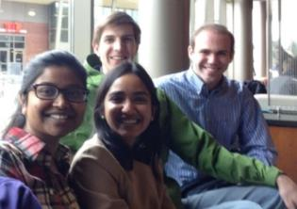
About The IEEE
A not-for-profit association
IEEE = Institute for Electrical & Electronic Engineers
World’s largest technical society with over 430,000 members in 160 countries
Four core areas of focus
Membership association
Publishing company
Conference organizer
Standards developer

Slide 3
IEEE Societies 39 societies represent a wide range of technical interests
Aerospace and Electronic Systems
Antennas and Propagation Society
Broadcast Technology Society
Circuits and Systems Society
Communications Society
Components, Packaging, and Manufacturing Technology Society
Computational Intelligence Society
Computer Society
Consumer Electronics Society
Control Systems Society
Dielectrics and Electrical Insulation
Education Society
Electron Devices Society
Electromagnetic Compatibility Society
Engineering in Medicine and Biology
Geoscience and Remote Sensing Society
Industrial Electronics Society
Industry Applications Society
Information Theory Society
Instrumentation and Measurement
Intelligent Transportation Systems Society
Magnetics Society
Microwave Theory and Techniques Society
Nuclear and Plasma Sciences Society
Oceanic Engineering Society
Photonics Society
Power Electronics Society
Power and Energy Society
Product Safety Engineering Society
Professional Communications Society
Reliability Society
Robotics and Automation Society
Signal Processing Society
Society on Social Implications of Technology
Solid-State Circuits Society
Systems, Man, and Cybernetics Society
Ultrasonics, Ferroelectrics, and Frequency Control Society
Vehicular Technology Society

Slide 4
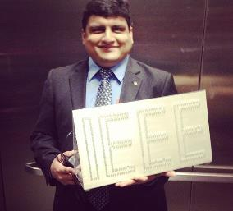
About The IEEE
A not-for-profit association
IEEE = Institute for Electrical & Electronic Engineers
World’s largest technical society with over 430,000 members in 160 countries
Four core areas of focus
Membership association
Publishing company
Conference organizer
Standards developer
Notes:
Avijit Shingari, Branch officer at Virginia Tech, now an engineer at PepCo

Slide 5
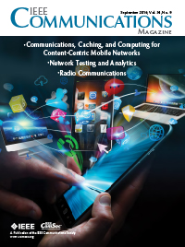
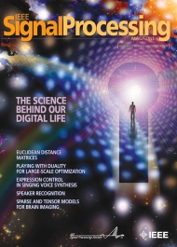
IEEE quality makes an impact
Clarivate Analytics Journal Citation Reports® by Impact Factor
IEEE journals are:
# 1 in Automation and Control
# 1 in Artificial Intelligence
# 1 in Computer Hardware
# 1 in Cybernetics
# 1 in Information Systems
# 1 in Manufacturing Engineering
# 1 in Theory and Methods
# 1 in Telecommunications
# 2 in Electrical Engineering
# 3 in Aerospace Engineering
The Clarivate Analytics Journal Citation Reports presents quantifiable statistical data that provides a systematic, objective way to evaluate the world’s leading journals.
Based on the 2016 study released June 2017

Slide 6
More than 40 Magazines Practice-oriented for immediate solutions
Aerospace and Electronic Systems
Antennas and Propagation
Communications
Computer Graphics and Applications
Consumer Electronics
Design and Test
Geoscience and Remote Sensing
IT Professional
MultiMedia
Nanotechnology
Robotics and Automation
Security & Privacy
Signal Processing
Technology and Society
Vehicular Technology
IEEE magazines include practice-oriented content, regular columns, and general news. Magazines are a good resource for undergraduate students.

Slide 7
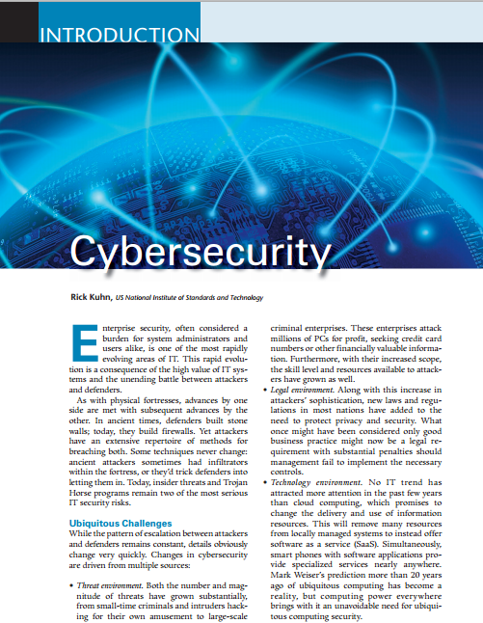
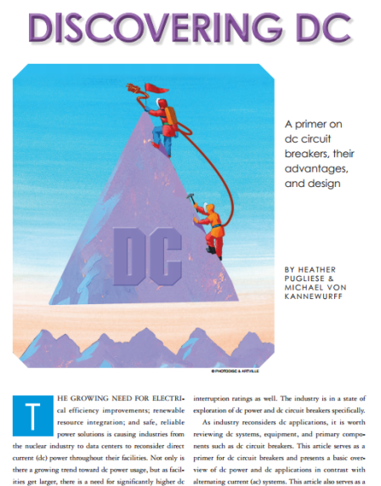
More than 40 Magazines Including technology overviews, tutorial-style articles and primers
IEEE Magazines include practice-oriented content, regular columns, and general news. Magazines are a good resource for undergraduate students.

Slide 8
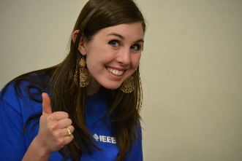
About The IEEE
A not-for-profit association
IEEE = Institute for Electrical & Electronic Engineers
World’s largest technical society with over 430,000 members in 160 countries
Four core areas of focus
Membership association
Publishing company
Conference organizer
Standards developer
Notes:
Brianna Bikker Clay, past chair Texas A&M

Slide 9
The IEEE conference collection continues to grow
Over 1,700 annual conferences in 2017 Over 2.5 million total papers

Slide 10
Why attend an IEEE conference?
“Ankit More, Research Scientist at Intel… says attending IEEE events has been one of the best ways to network.
Someone from Intel approached More after he presented his research at a conference last year.”
Notes:
Ankit More was a PhD student and IEEE graduate branch chair at Drexel. He was approached by Intel after giving presenting his paper at an IEEE conference.
Here’s a list of his IEEE publications while a student… and now as a research scientist at Intel in Portland.

Slide 11
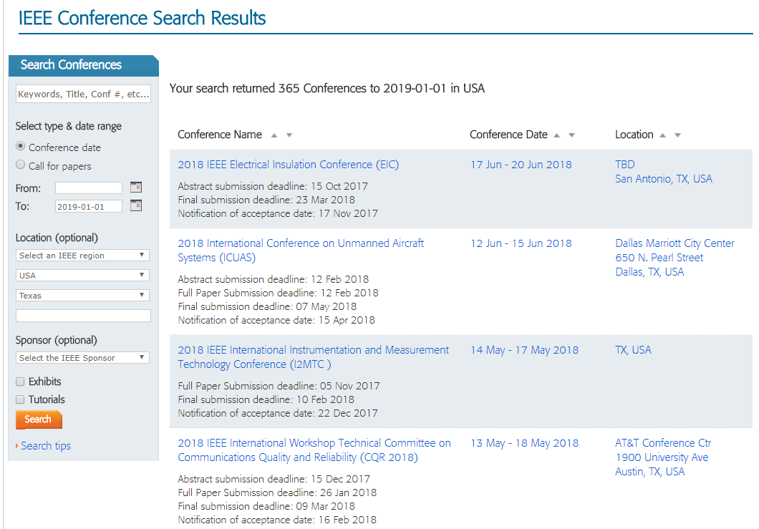
IEEE Conferences
Notes:
If relevant , a slide detailing conferences AT school or nearby

Slide 12
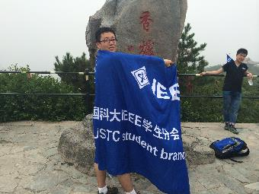
About The IEEE
A not-for-profit association
IEEE = Institute for Electrical & Electronic Engineers
World’s largest technical society with over 430,000 members in 160 countries
Four core areas of focus
Membership association
Publishing company
Conference organizer
Standards developer
Notes:
Mugging for photographer at China Student Congress in Beijing, 2014

Slide 13
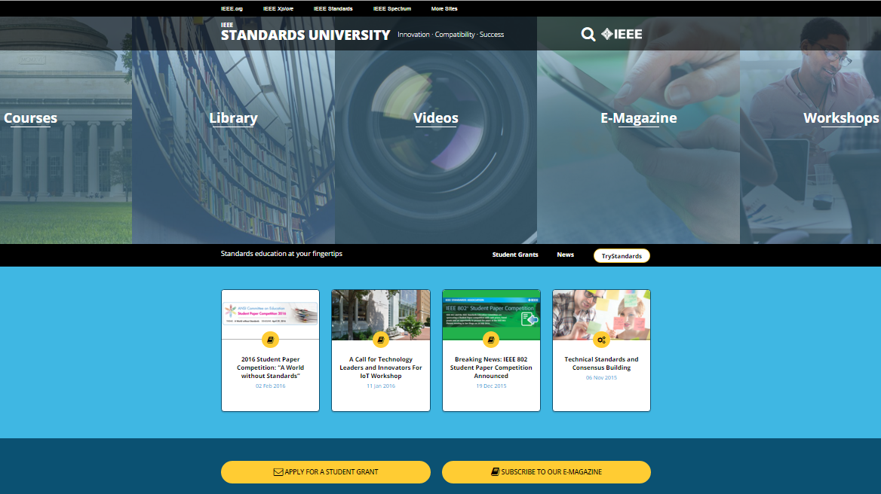
Standards knowledge
Standards in Education Grants
Undergrad and grad
$500 student/
$300 faculty advisor
“graduate and capstone design projects with an industry standards component”
http://www.standardsuniversity.org/
Notes:
If you’re not well-versed on the role of Standards as an economic driver, take the time to go over the materials freely available on IEEE’s Standards in Education website. And if you ARE using standards in your research, even if they are not IEEE standards, consider submitting your paper for a potential cash award for you and your advisor.

Slide 14
IEEE Xplore Digital Library

Slide 15
IEEE Xplore Digital Library
More than 4 million full-text documents
185+ IEEE journals & magazines
1,700+ annual IEEE conferences
Approximately 3,400 active & archived IEEE standards
IET conferences, journals & magazines
VDE Verlag conferences
IBM Journal of Research & Development
Bell Labs Technical Journal
1,400+ eBooks from IEEE-Wiley & MIT Press
IEEE Smart Grid Research Documents
Backfile to 1988 with select legacy data back to 1872

Slide 16
IEEE Xplore Digital Library ieeexplore.ieee.org

Slide 17
Sites to Remember
IEEE Xplore Digital Library www.ieee.org/ieeexplore
IEEE Conferences www.ieee.org/conferences
IEEE Author Center ieeeauthorcenter.ieee.org

Slide 18
Questions?
Jalyn Kelley
IEEE Client Services Manager
Email: jalyn.kelley@ieee.org
Phone: 210.599.6430

