Slide 1
Cybersecurity and Forensic Challenges – A Bibliographic Review
Reiner Creutzburg
Technische Hochschule Brandenburg
Department of Informatics and Media, IT- and Media Forensics Lab
P. O. Box 2132
D-14770 Brandenburg, Germany
creutzburg@th-brandenburg.de
EI 2018, San Francisco (CA)

Slide 2
Cyber security - Main Problems
Internet traffic increase
Number of connected devices – IoT
Cybercrime statistics
Lack of cyber security experts
Education and training is needed!!!!, but Hacking is forbidden!!!!

Slide 3
Statistics
Internet use growing
  ~ 4 Billion Internet users
  ~ 7 Billion Mobile phone users
Increased use of mobile devices
  Smartphones, tablets, game consoles
Increase of computer- and Internet-related crime

Slide 4
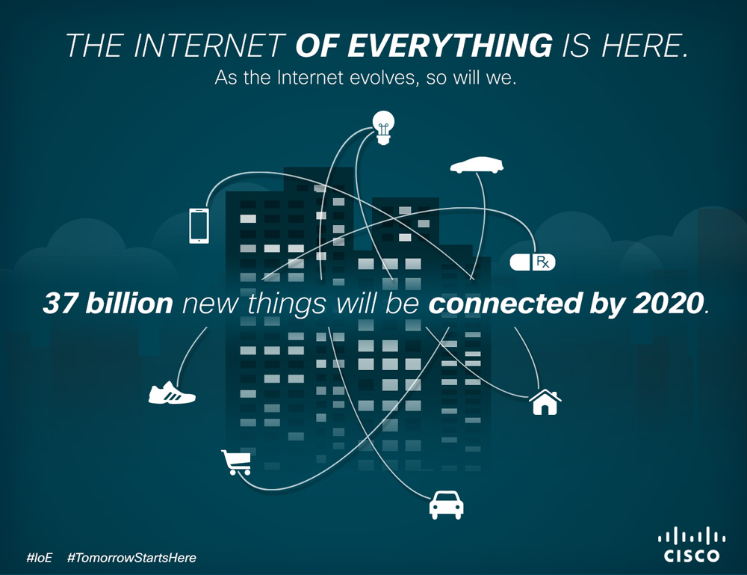

Slide 5
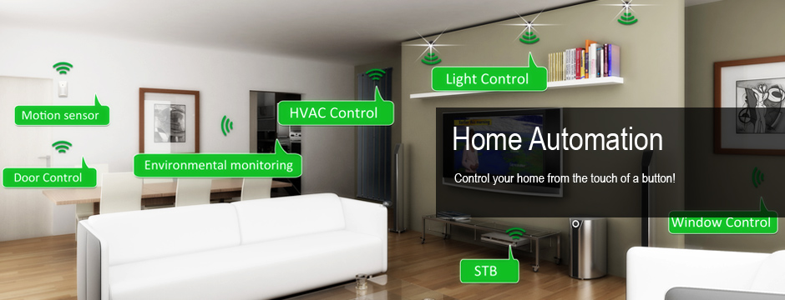
Smart home

Slide 6
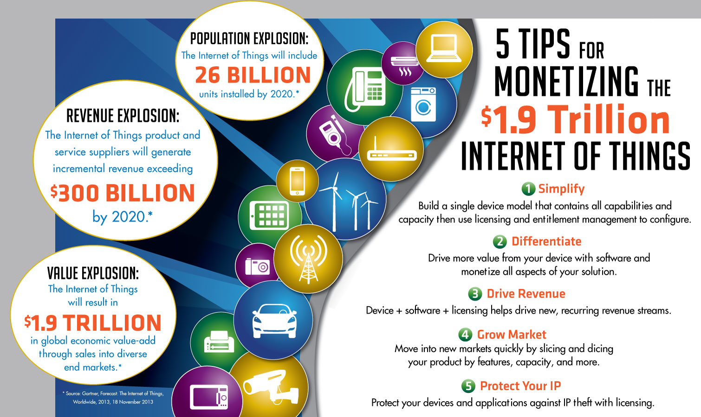

Slide 7
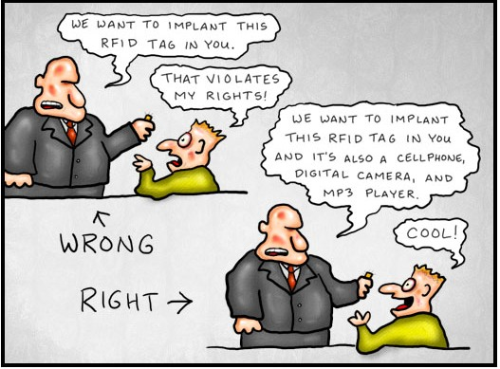

Slide 8
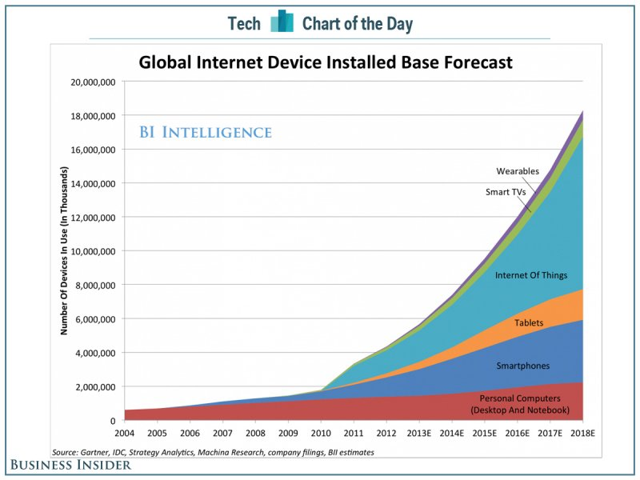

Slide 9
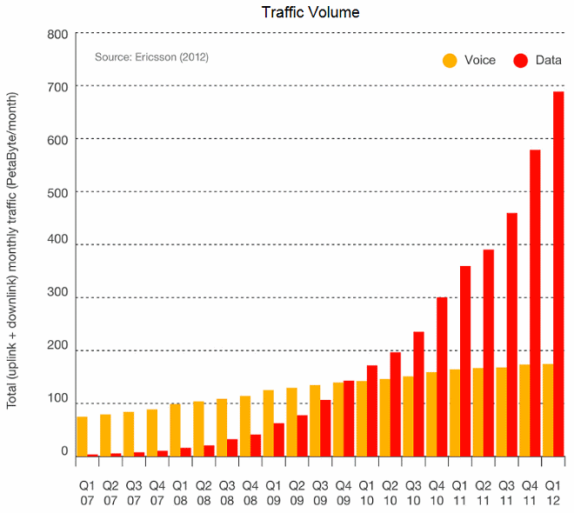

Slide 10

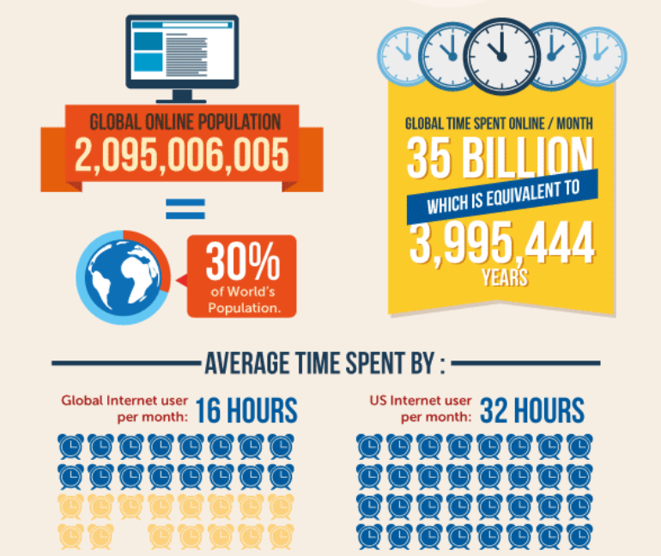
http://www.go-gulf.com/blog/online-time/

Slide 11
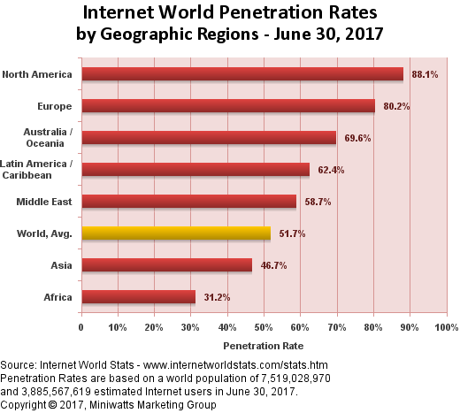

Slide 12
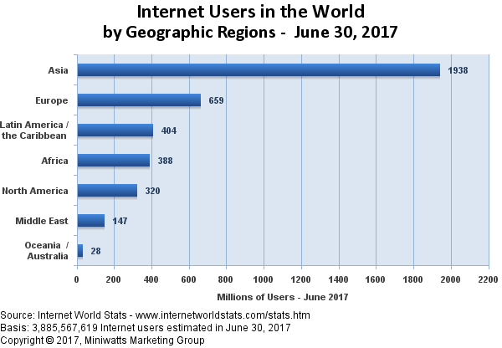

Slide 13
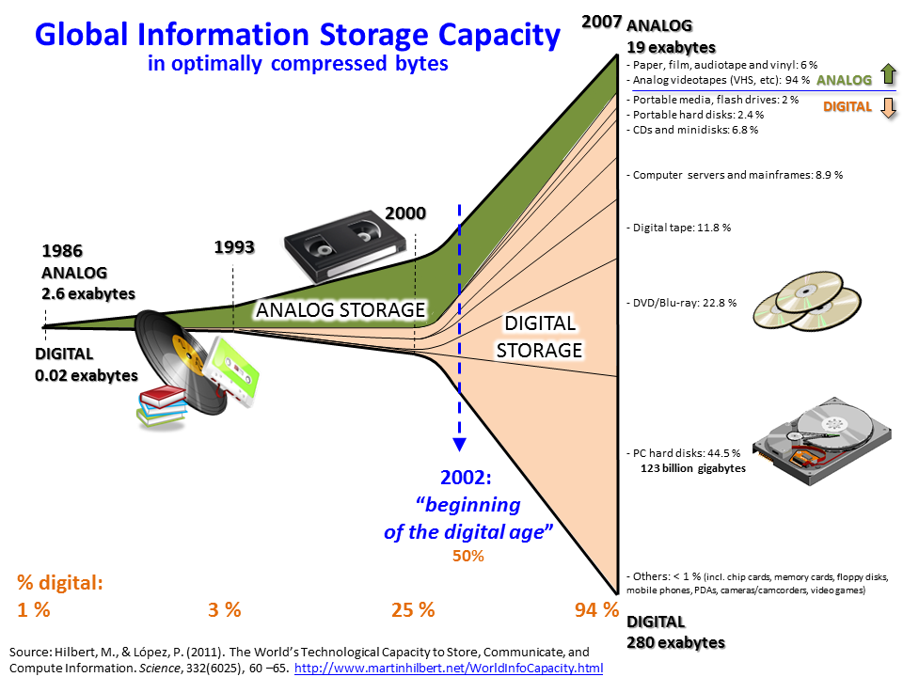

Slide 14
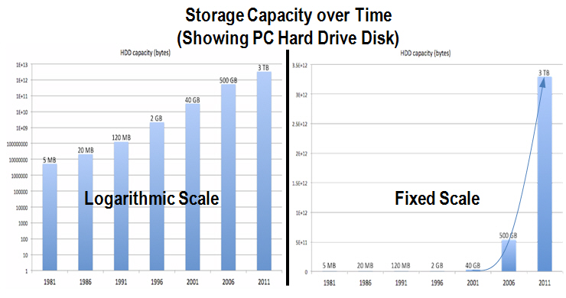

Slide 15
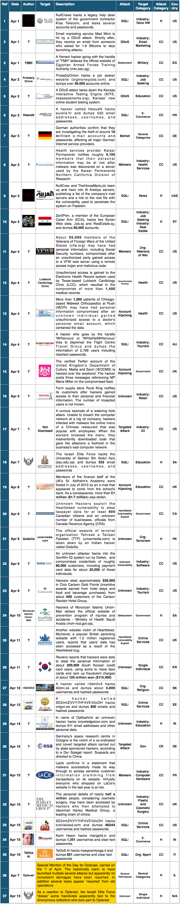
Cybercrime – www.hackmageddon.com

Slide 16
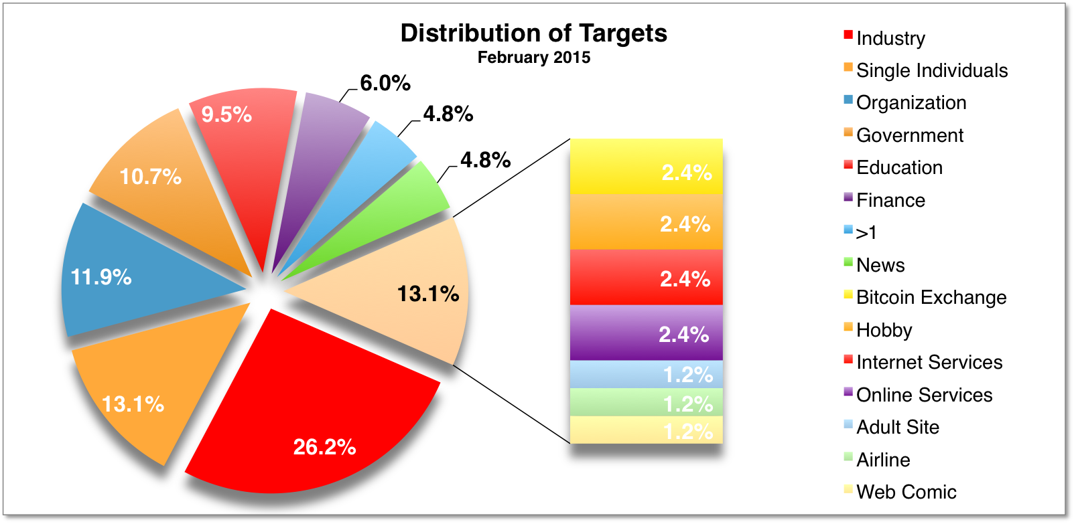
Attacked Targets

Slide 17
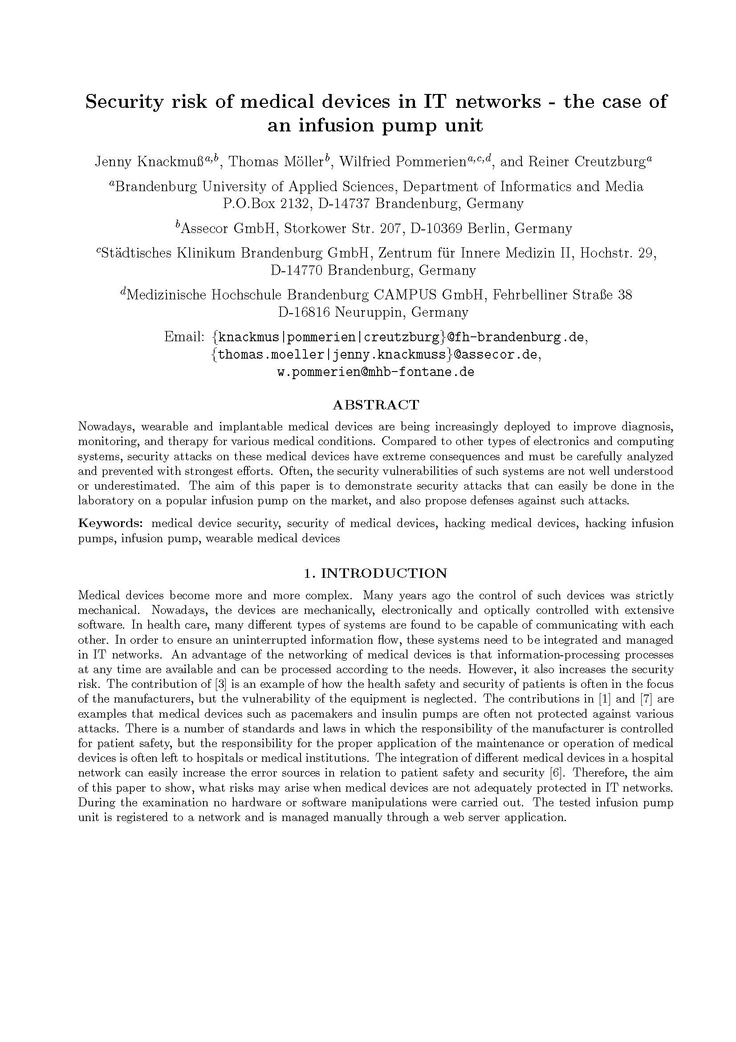

Slide 18
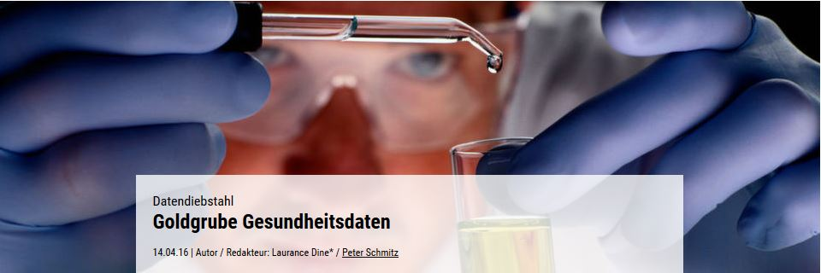
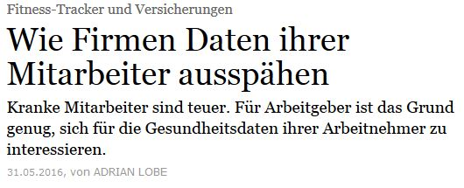
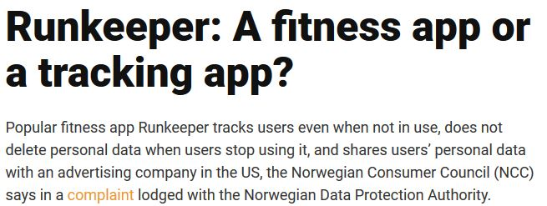
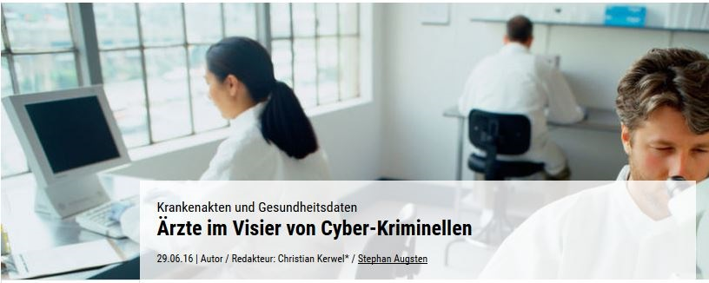
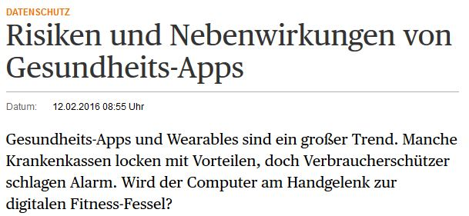
Motivation – Pressestimmen

Slide 19
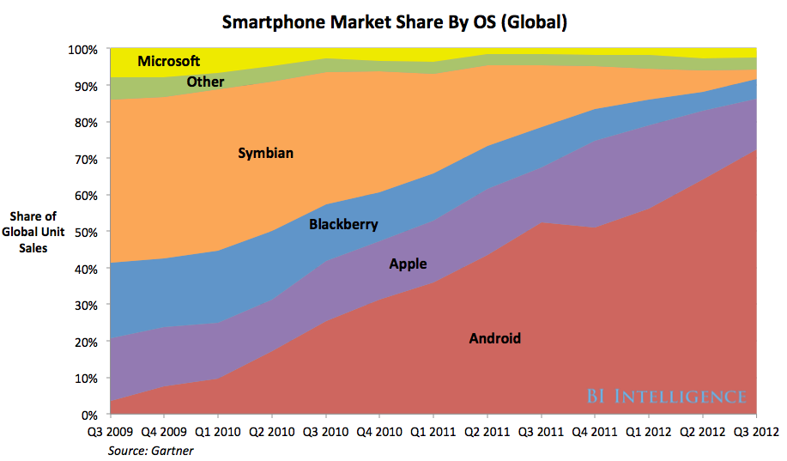
Smartphones market share

Slide 20
Introduction
IT - and Media Forensics Lab at Brandenburg University of Applied Sciences
Demand for well-trained forensic staff
Demand for different tools for specific forensic issues

Slide 21
Lab Equipment - Software
3x FTK Acces Data Forensic Toolkit
2x Encase 7
10x X-Ways
3x NUIX
1x Cellebrite
3x Oxygen Forensics Suite
1x Elcomsoft Suite Forensic Edition
1x Passware
1x Belkasoft
1x BlackBagTech
1x OS Forensics
Freeware: Wireshark, Kali Linux, …

Slide 22
Lab Equipment - Hardware
Tableau TD1, TD2, TD3 imager
various Tableau Bridges
Forensic server
12 Forensic workstations
HD Salvation Data
Flash Doctor
Mobile devices (smartphones, tablets, game consoles,….)

Slide 23
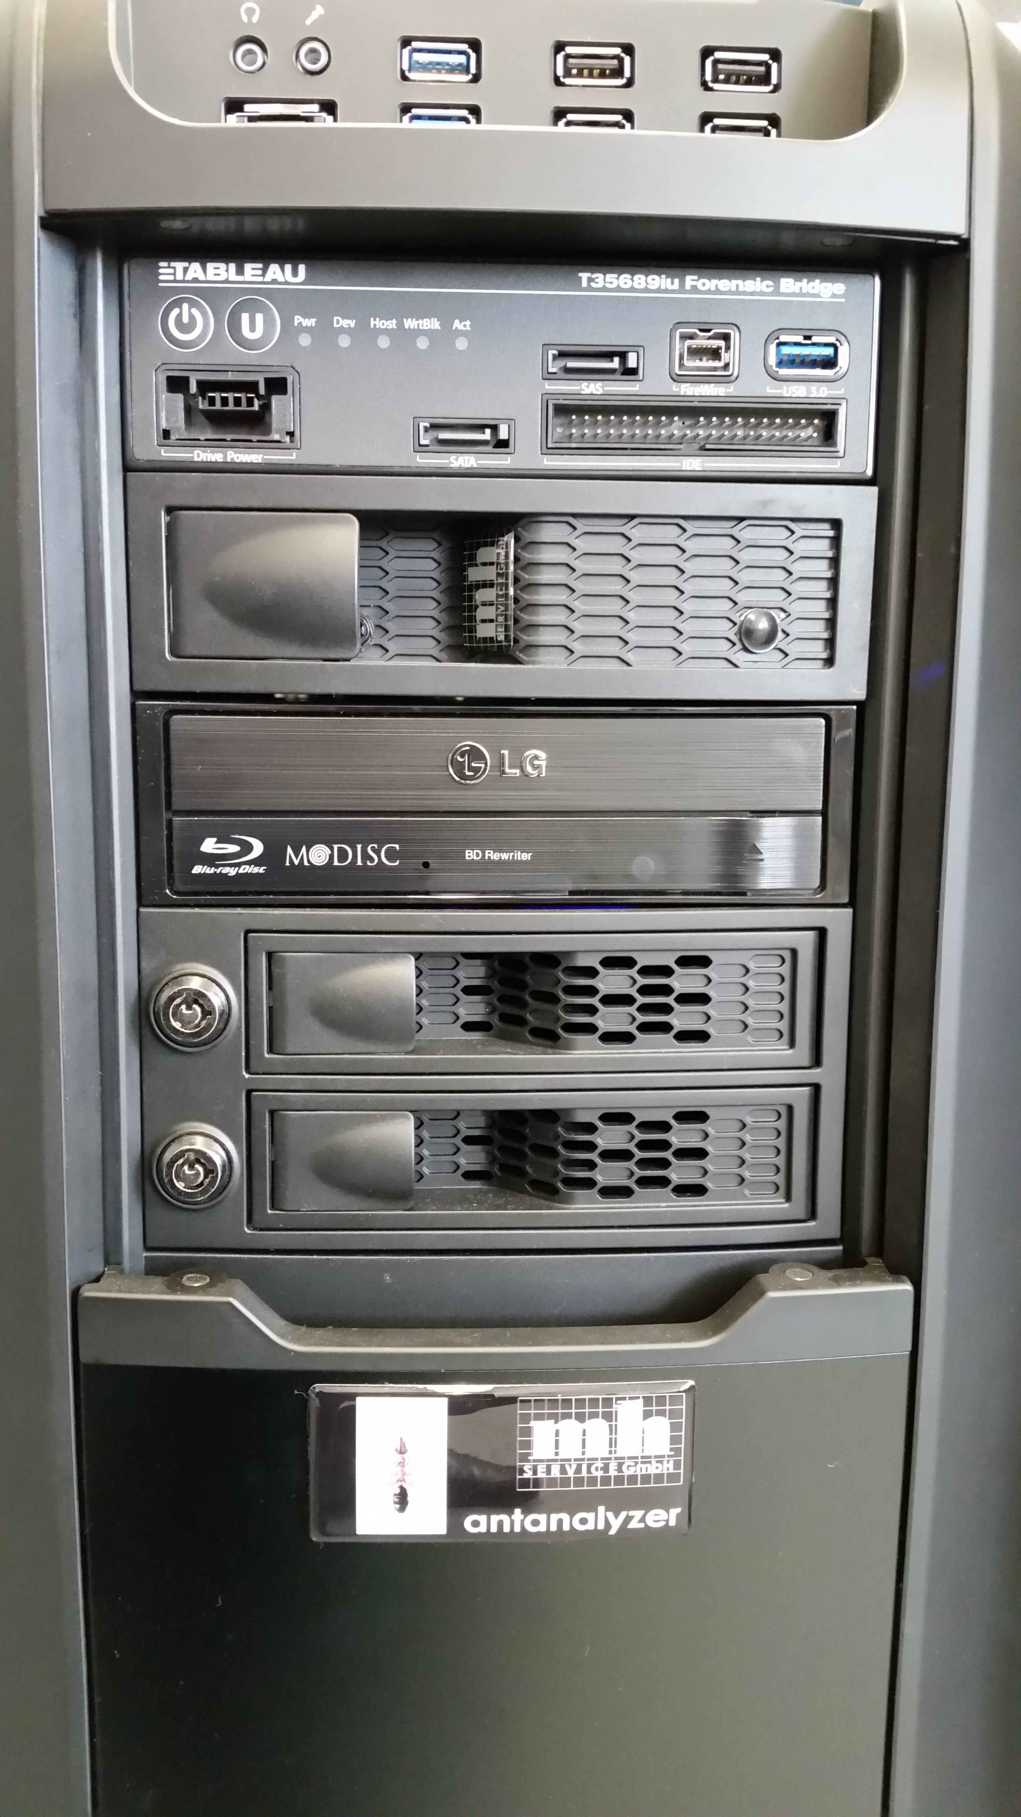
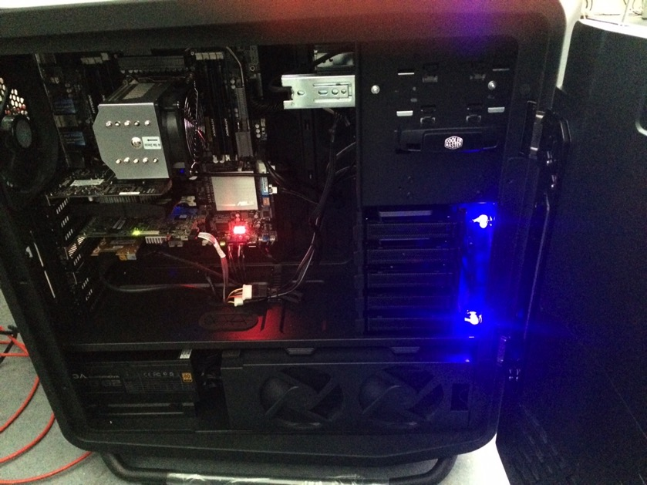
Forensic Server

Slide 24
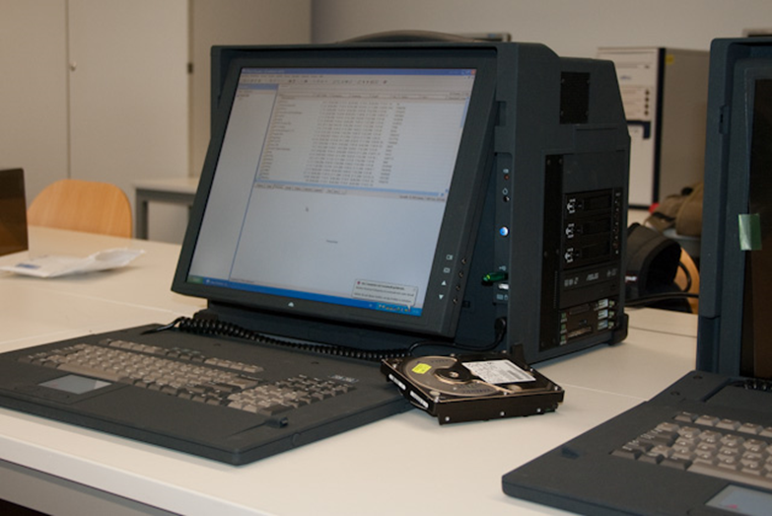
Forensic workstations

Slide 25
Smartphones

Slide 26
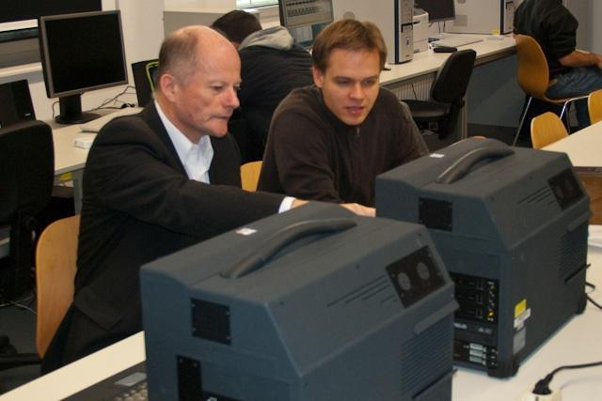
Forensics lab work

Slide 27
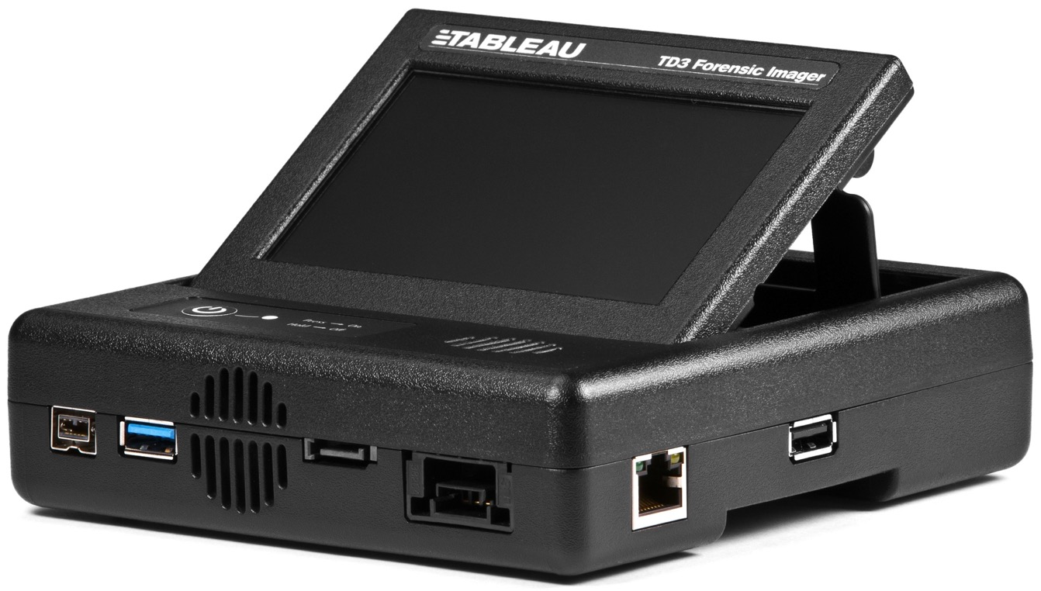
Tableau TD3 Forensic Imager

Slide 28
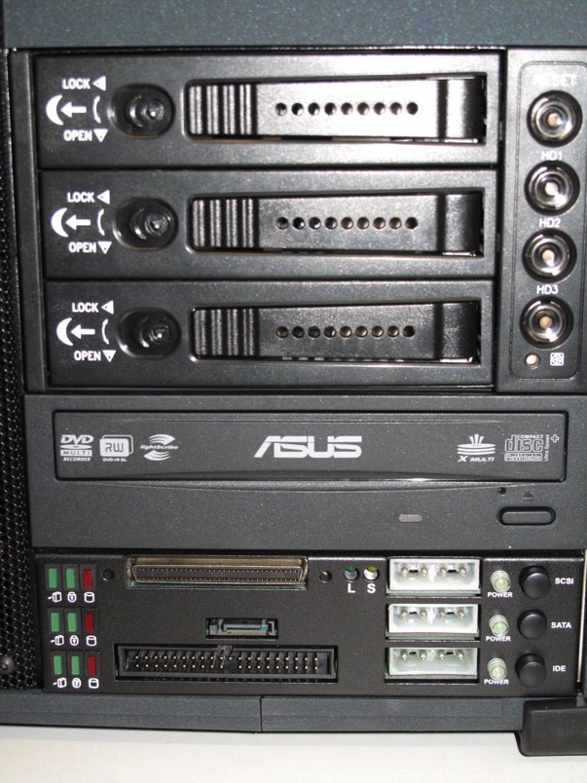
lots of interfaces for hard disk connection (SATA, eSATA, SCSI, PATA,…
Inter-changeable harddisks

Slide 29
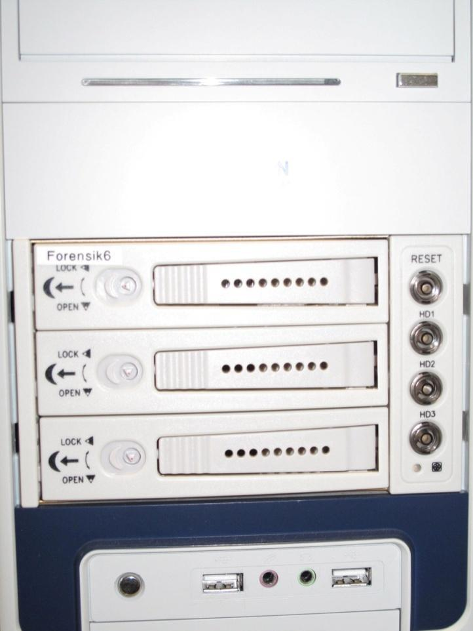
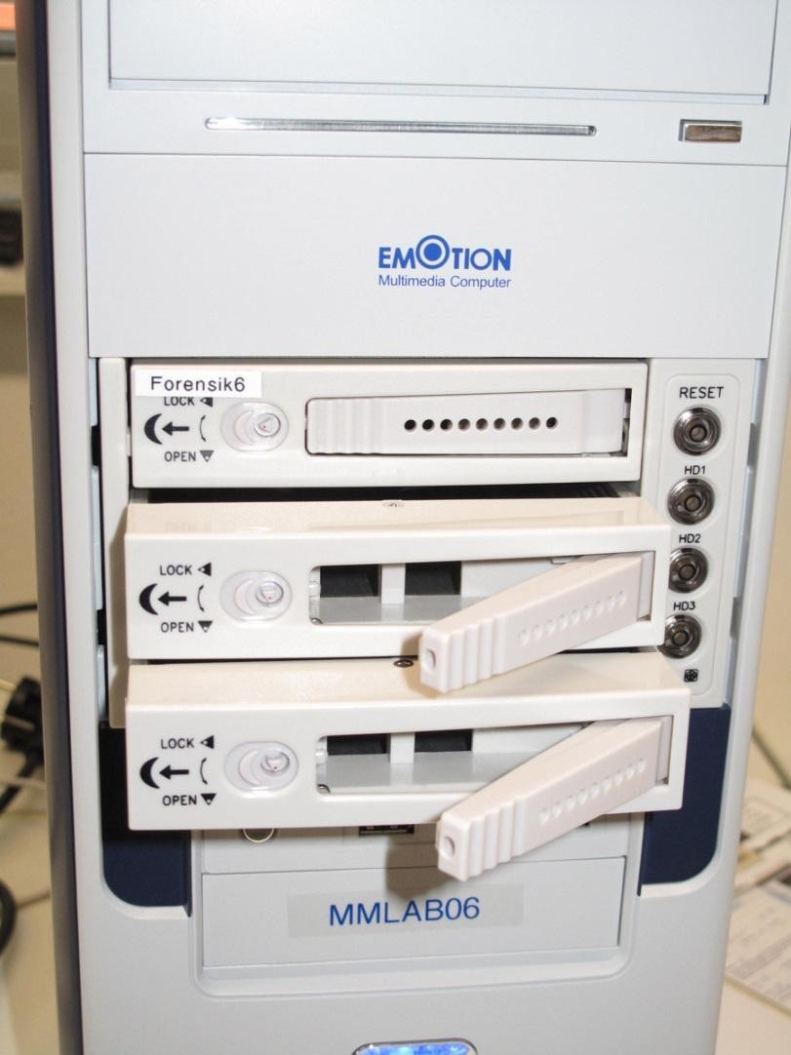
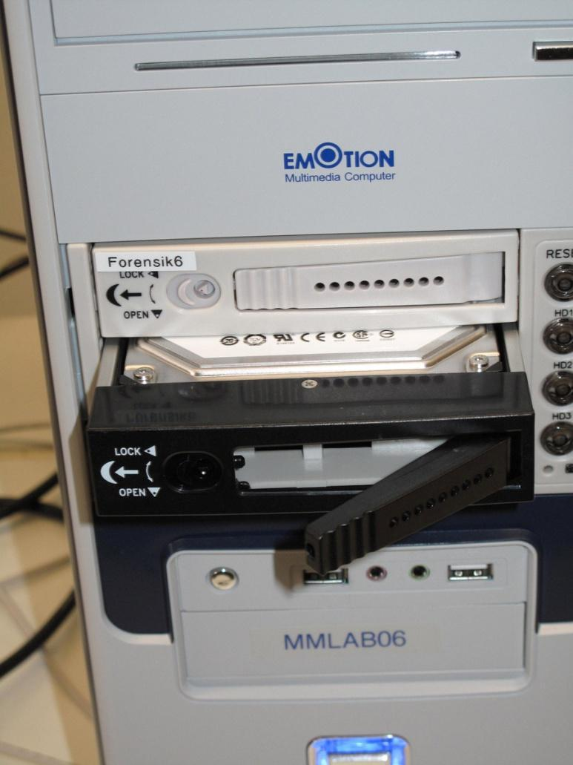

Slide 30
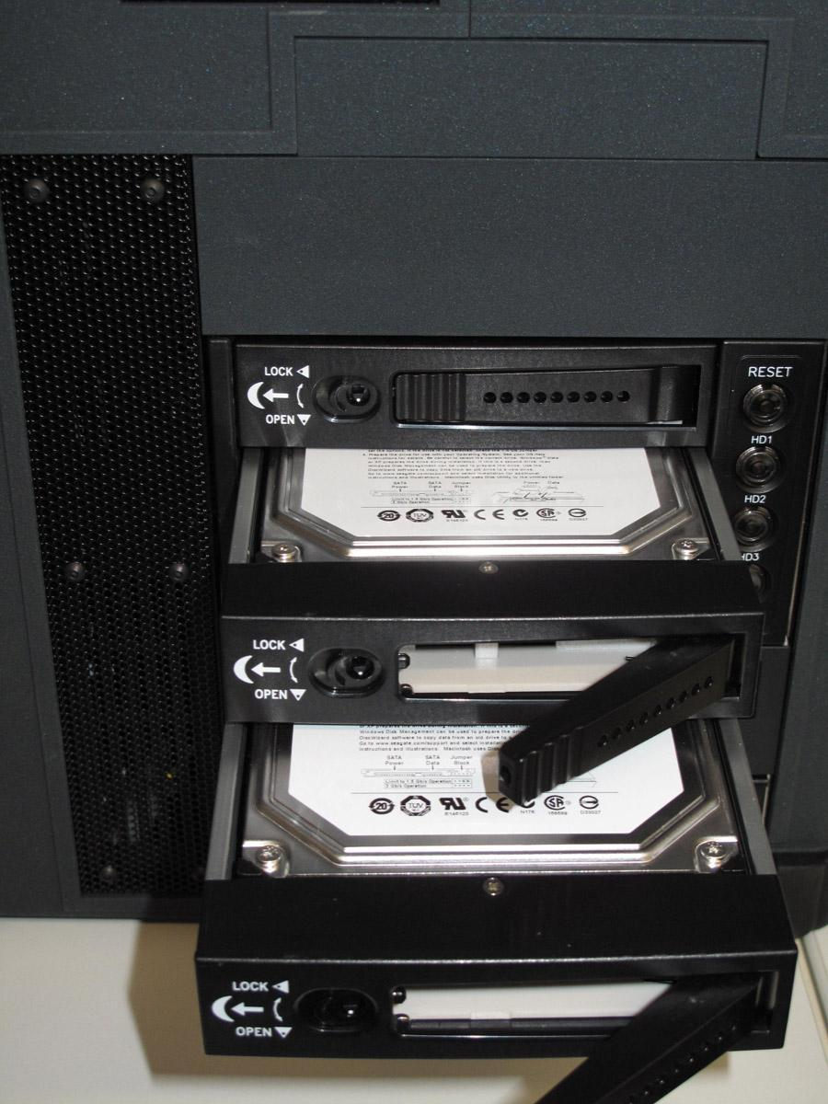
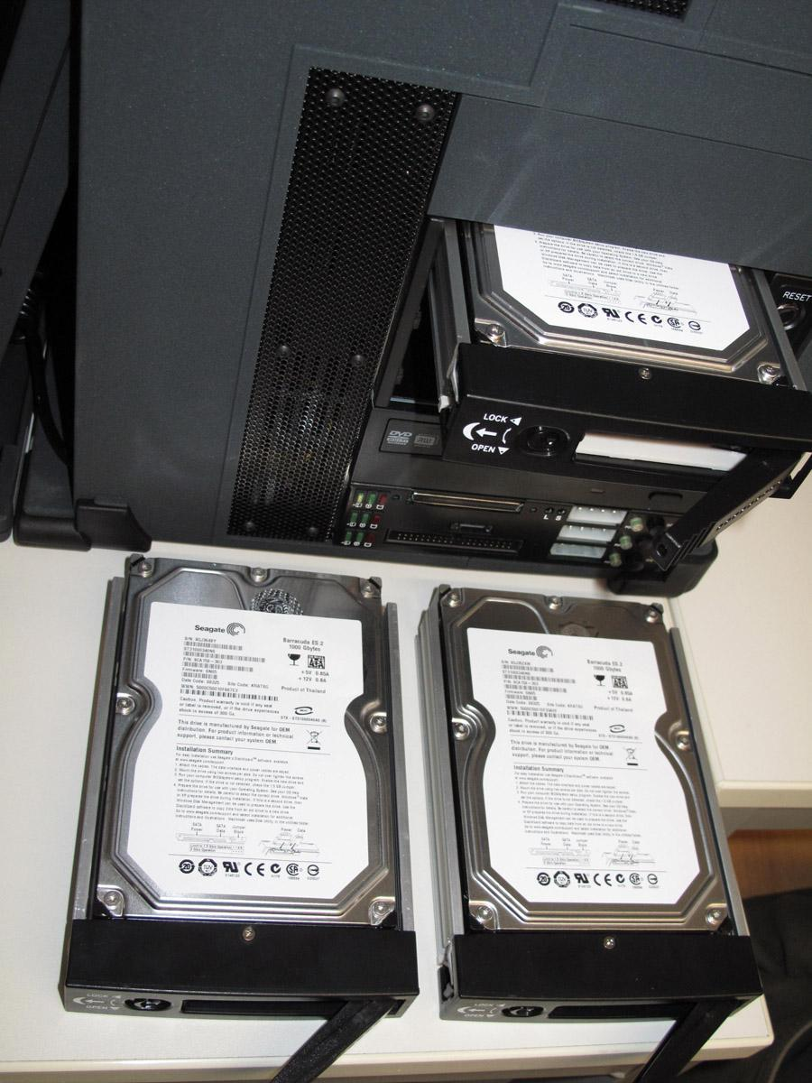
Interchangeable hard disks

Slide 31
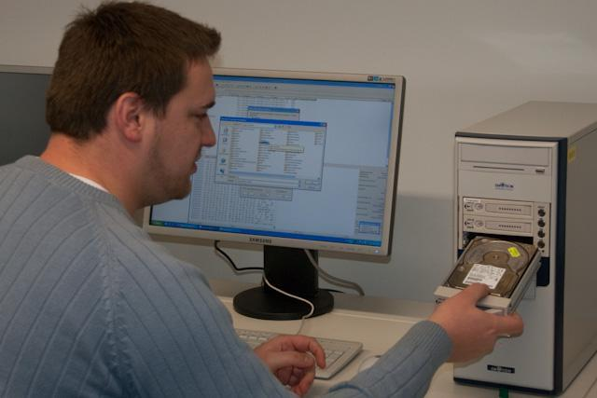

Slide 32
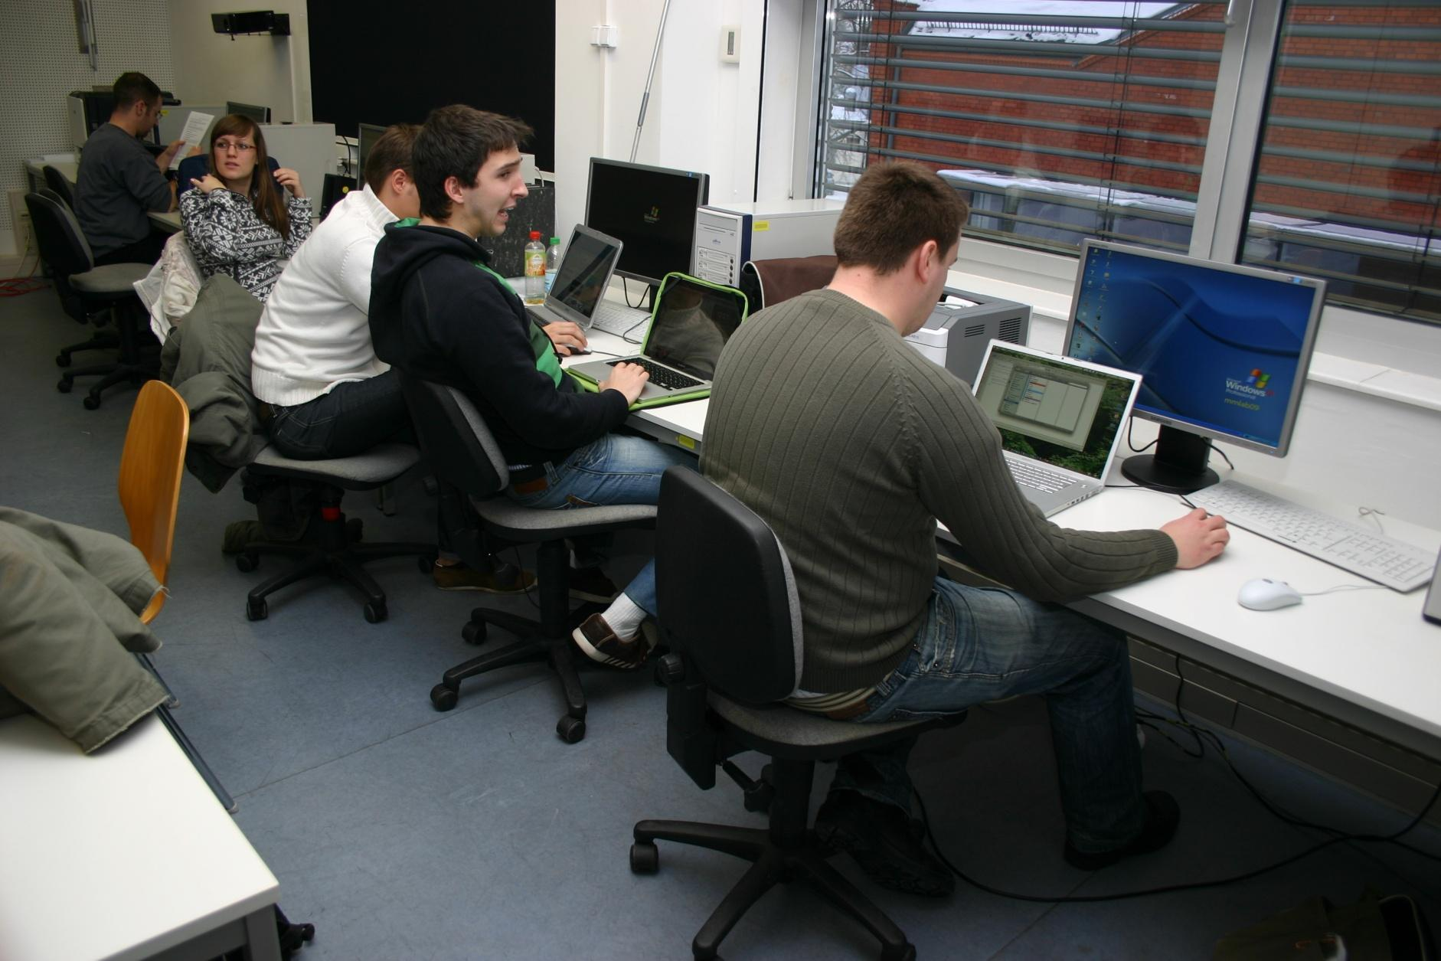

Slide 33
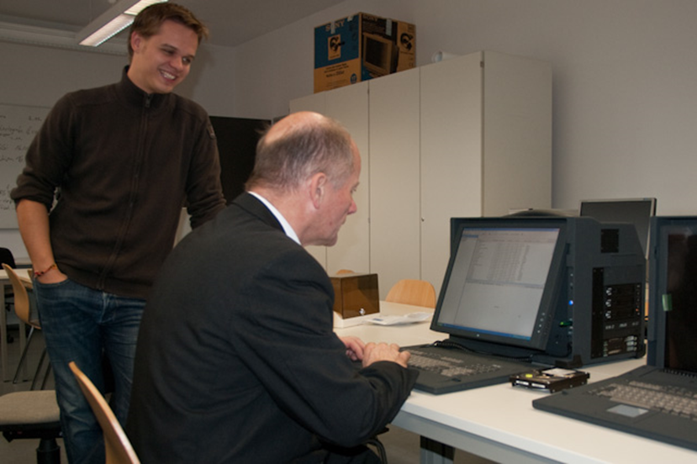
Lab work

Slide 34
Laboratory exercises in IT- and Media Forensics
1. Computer Forensics | 6. iOS forensics
2. HDD & SSD forensics | 7. Windows forensics
3. Network forensics | 8. Registry forensics
4. Mobile forensics | 9. Email forensics
5. Android forensics | 10. Many other areas .....

Slide 35
Laboratory exercises in IT- and Media Forensics
1. Computer Forensics | 6. iOS forensics
2. HDD & SSD forensics | 7. Windows forensics
3. Network forensics | 8. Registry forensics
4. Mobile forensics | 9. Email forensics
5. Android forensics | 10. Many other areas .....

Slide 36
Lab exercises, I
0 Theorieübung
1 Erstellen eines forensischen Duplikats
2 Einbinden eines forensischen Duplikats und Suchen nach gelöschten Daten
3 Extrahieren von Slack Space
4 E-Mail-Analyse
5 Windows7-Registry
6.1 Passwort-Analyse-PRTK
6.2 Passwort-Analyse-Office
6.3 Passwort-Analyse-Win7
7 Mobil-Forensik-Allgemein
8 Mobil-Forensik-Android I
9 Mobil-Forensik-Android II
10 Netzwerk-Forensik

Slide 37
Lab exercises, II
11 Netzwerk-Forensik
12 Netzwerk-Forensik
13 Netzwerk-Forensik
14 RAM und flüchtige Daten
15 RAM und flüchtige Daten
16 RAM und flüchtige Daten
17 DVD-Forensik
18 Linux-Forensik-Autopsy
20 Mac OS X Forensik
22 Linux-Forensik-Übung 1-4
23 Websicherheit: Analyse einer Login-Funktion und forensische Auswertung von Logdateien
24 Penetration Testing

Slide 38
Mobile Forensics – Exercises 1
Android Forensics Exercise 1 – Detailed forensic analysis of an Android mobile phone
  Learn how to connecting a device and collecting the data
  Learn how to use the mobile forensic software
    Oxygen Forensic Suite 2015
    CELLEBRITE UFED Physical Pro
  Perform an analysis of the Android phone
  Document the analysis
  Demonstrate the results
  Exchange ideas with other groups

Slide 39
Mobile Forensics – Exercises 1
Evaluation Exercise 1
What data structure will appear after adding the phone (is the root file system visible)?
What information did you find, where did you find it and why in your opinion are these data forensically interesting?
Compare with other groups: Which image provided the most valuable information that could be extracted and why?

Slide 40
Mobile Forensics – Exercises 2
Android Forensics Exercise 2 – Differences between rooted and unrooted devices
  access to the directory data/data/com.android.browser
  how many databases are on the device
  extract the data
  structure of deleted rows of data in SQLite databases
What information can be extracted?
What information is especially interesting?

Slide 41
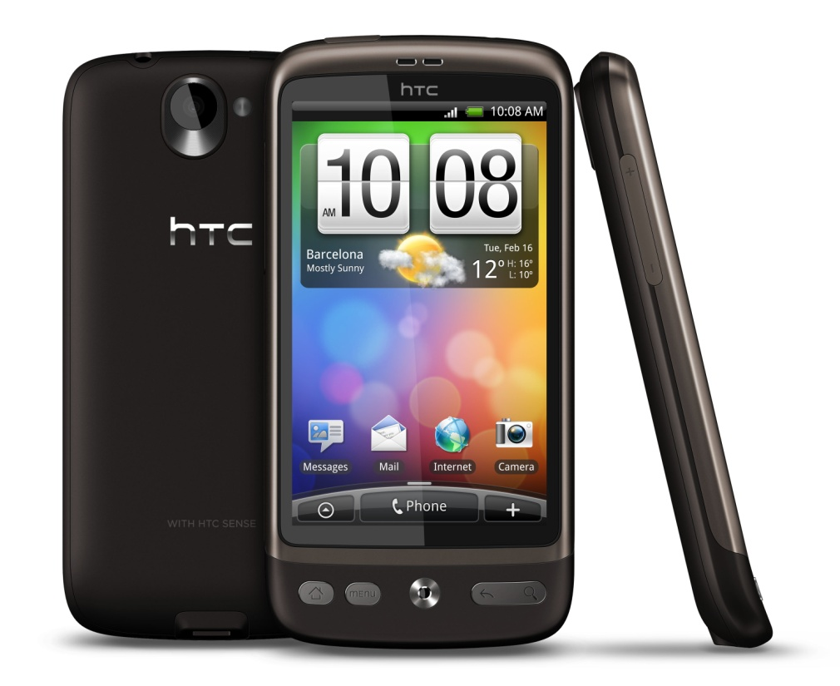
HTC Desire
X-Ways Forensics
EnCase Forensic
Access Data Forensic Toolkit(FTK)
Oxygen Forensic Suite 2011
MOBILedit! 5
Android SDK
SQLite Database Browser 2.0

Slide 42
Mobile Forensics – Usability
the exercises can be implemented and are practically feasible
for this purpose, they have been included in the Master Course on IT and Media Forensics at the Brandenburg University of Applied Sciences
the Android forensics exercises were evaluated as a part of the whole forensics training lesson
for the test 20 students of the Master of Science study program performed the tasks

Slide 43
Mobile Forensics – Usability
This eight questions had to be answered by each participant
  Did the exercises help you to better understand the complex topic of IT forensics?
  How do you evaluate the workload and time expenses of the exercises?
  How did you like the practical part of the exercises?
  How difficult did, you find the exercises.
  How difficult did, you find the tasks of the exercises.
  How complex (in your opinion) were the questions?
  Was the accompanying theory sufficient?
  How big was the learning experience through the practical exercises according to the topic?

Slide 44
Mobile Forensics – Usability
Suggestions for improvement
The main areas found in need of improvement were
  Deficiencies found in the understanding of the tasks
  very different hardware of the Android devices
  Android windows driver problems

Slide 45
Outlook
Increase of data to be investigated
Demand for simple software, that supports the investigator
Division of labour between forensic tools

Slide 46
Summary - Outlook
Lot of potential for further tasks
New emerging topics
  mobile devices (tablets, smartphones, PSP, navigation systems, ...)
  operating systems (iOS, Android)
  flash memory analysis (SSD)
  open source forensics
  game consoles
  cloud computing
  ...

Slide 47
Summary - Outlook
Need for specialized and well-trained experts and investigators
fast development in IT- and media forensics, new mobile devices
Forensic investigators need lifelong learning and training

Slide 48
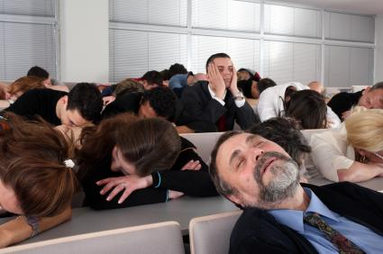

Death by Powerpoint !!!

Slide 49

Questions or tired?
Thank you for your attention!

