Slide 1
Data-Driven Recovery of Frequency Response from Ambient Synchrophasor Data
Hao Zhu
Assistant Professor
Department of ECE
The University of Texas at Austin
Acknowledgements: Phuc Huynh, Qianli Chen, Ahmed Elbanna, FNET/GridEye datasets, NSF ECCS-1802319, Siebel Energy Insititute

Slide 2
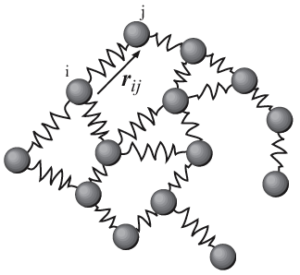
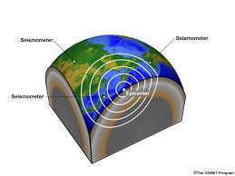
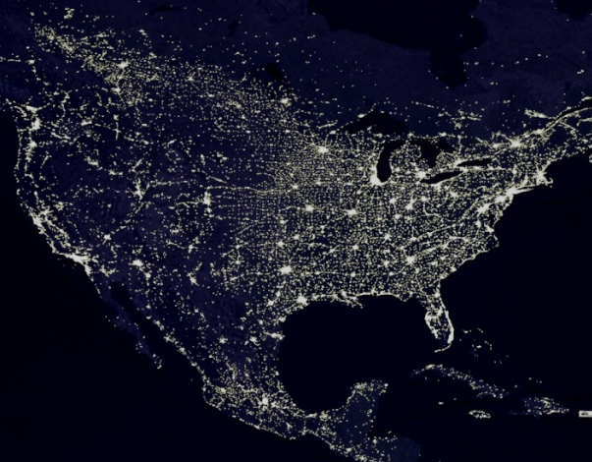



Oscillatory Networks
Many natural (even societal) networks have oscillatory dynamics
Sensors prevail in real networked systems, collecting huge volume of data during normal operating conditions (under small perturbations)
  Phasor measurement unit (PMU) in power systems
  Seismometers installed around the world

Slide 3
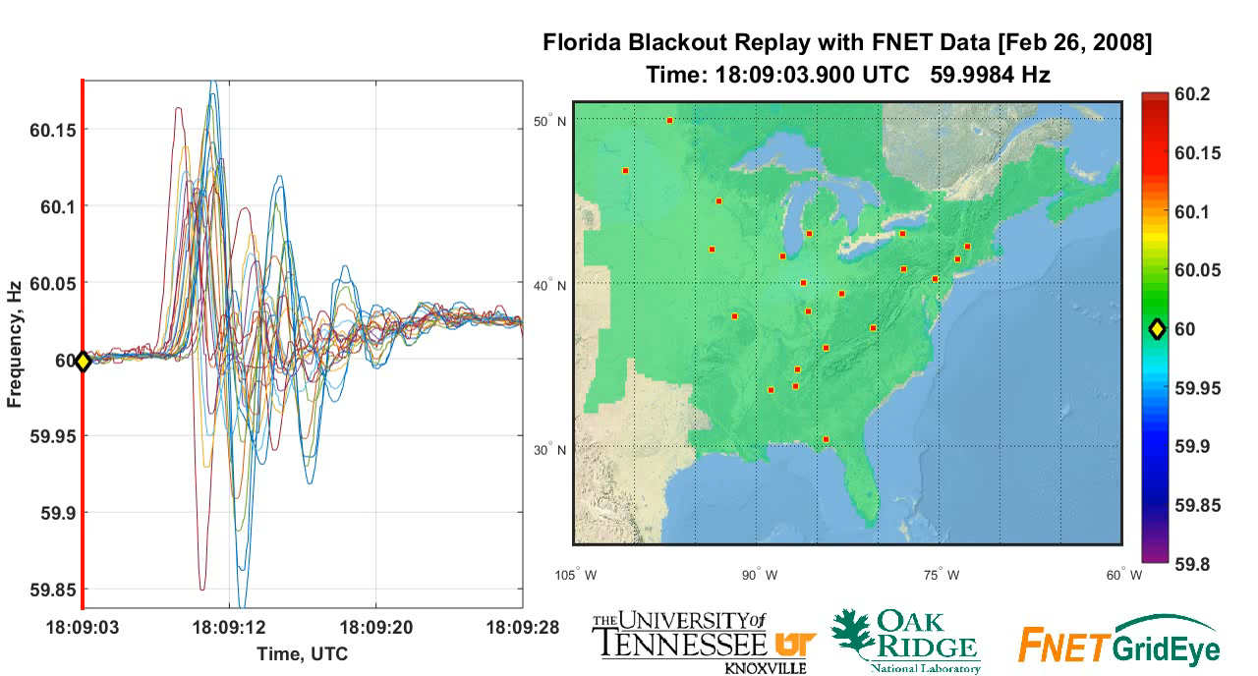
Electromechanical (EM) Oscillations
Can we infer the grid frequency response to any disturbance input using the ambient synchrophasor data?
https://www.youtube.com/watch?v=awvS4TtN77E

Slide 4
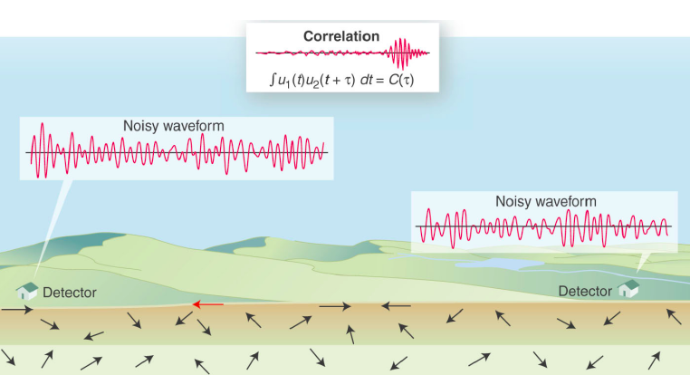
Related Work
In seismology, cross-correlating ambient noise fields for recovering propagation of earthquake waves
  Originally for uncorrelated diffusive fields [Lobkis &Weaver’01] along with extensions in [Sneider’04, Wapenaar’04, Sneider et al’07]
Green’s function of a medium between two points can be recovered by cross-correlating ambient noise fields recorded at these points. [Weaver 2007].
  Successfully validated on various types of seismic waves
  Analytical results established for homogeneous continuum medium
Internet tomography to infer the internal characteristics from indirect measurements [Coates et al’02]
  Static inverse problem under network topological constraints

Slide 5
Power System Dynamic Analysis
Mode estimation of frequency and damping from the correlation of ambient frequency/angle/voltage data
  Recursive estimation algorithms [Zhou et al’05]
  Pencil matrix method [Borden et al’13]
  Fast subspace-based algorithms [Ning et al’15]
Data-driven estimation of dynamic system model such as the dynamic state Jacobian matrix [Wang et al’16-17]
Green’s function connected to power systems [Backhaus et al’12]
  Continuum modeling of 2-dimensional EM wave propagation with homogeneously placed gens/loads/lines [Parashar et al’04]
Our focus: explore the analytical conditions/practical limitations of
cross-correlation based modeling of (primary) freq. response

Slide 6
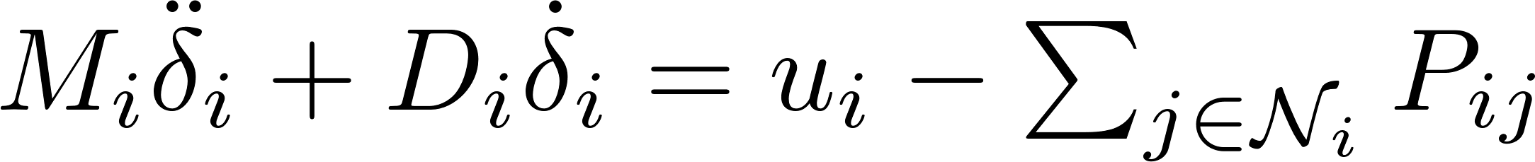







Dynamic System Modeling
Consider a system of n generators with the classical model
  ( ): rotor angle (speed) deviation
  ( ): angular momentum (damping coefficient)
  : local input of power imbalance
  : power flow from generator i to j (for equivalent network)
Using the linearized power flow model
  M and D are diagonal
  K is the power flow Jacobian matrix (~symmetric)
(SE)

Slide 7
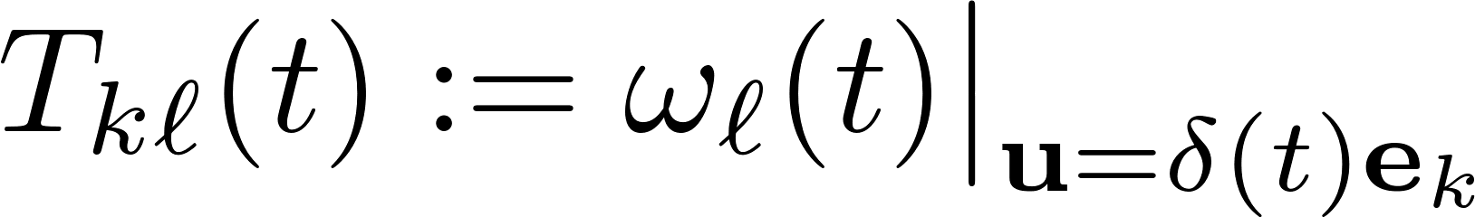
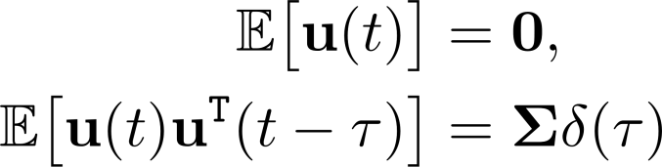
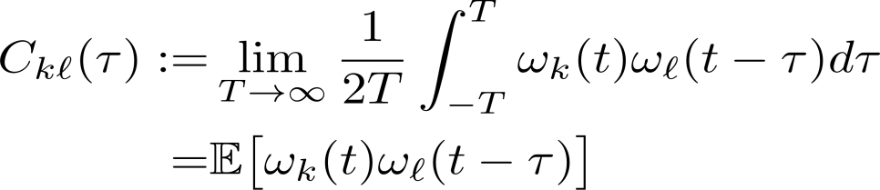
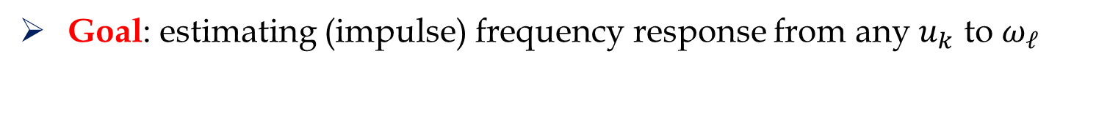
Ambient Data Modeling
Goal: estimating (impulse) frequency response from any $u_{k}$ to $ω_{ℓ}$
Ambient conditions: normal operations with small perturbations
  Random variations of power system loads/resources
(as1) The system (SE) is excited by zero-mean white noise input
(Normalized) cross-correlation of ambient speed (frequency) data

Slide 8








Model-based Analysis
For simplicity, consider undamped oscillations with
  Extended to uniformly damped systems (homogeneity relaxed!)
(SE’)
Oscillation modes for (SE’) solved by generalized eigen. problem
(as2) is positive definite (PD) and is symmetric
Lemma: Under (as2), the eigenvectors in are M-orthonormal; i.e.,
with having eigenvalues of

Slide 9




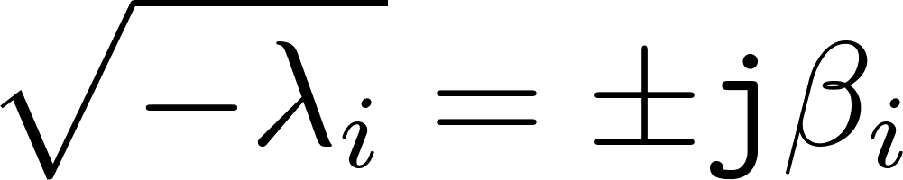
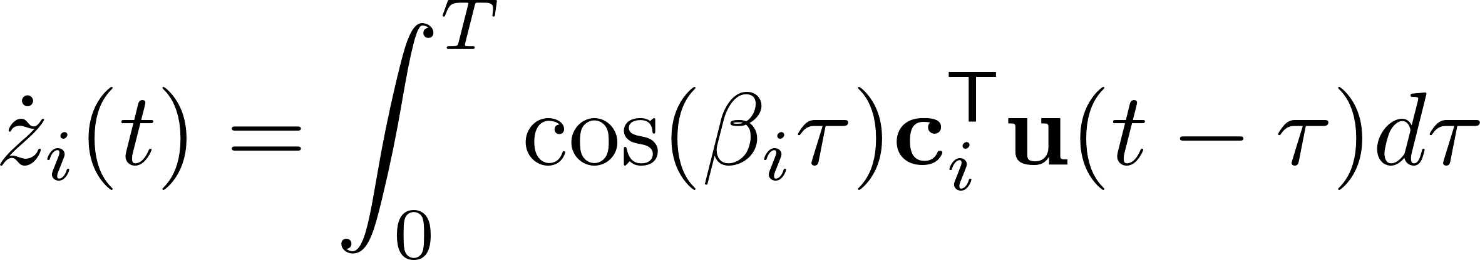
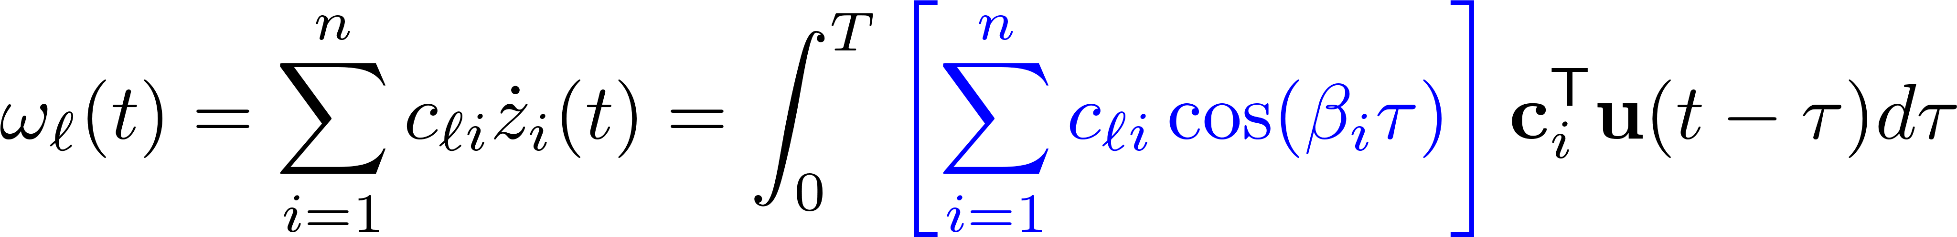
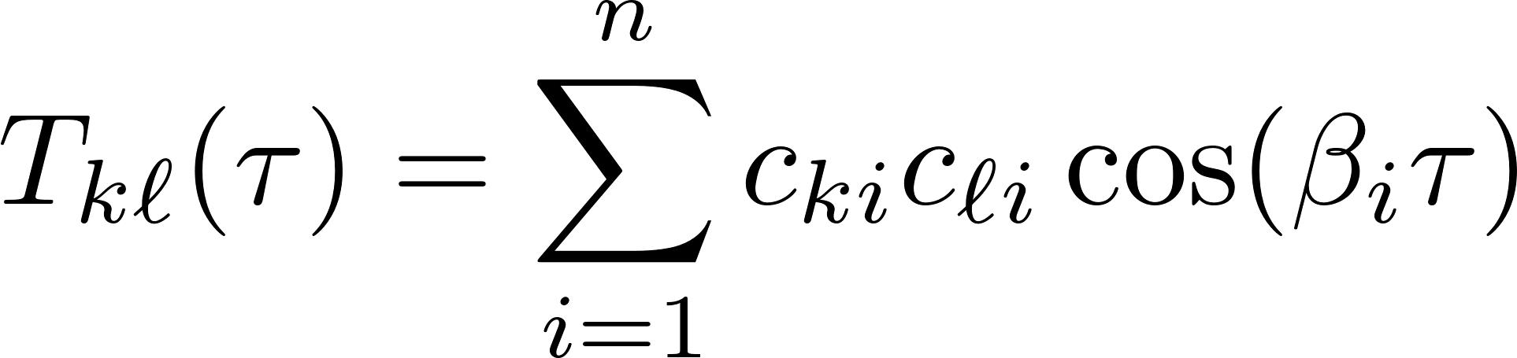
Uncoupled Modes
Linear transformation of (SE’): and
Each mode ( ) associated with
Under zero initialization
Impulse frequency response

Slide 10
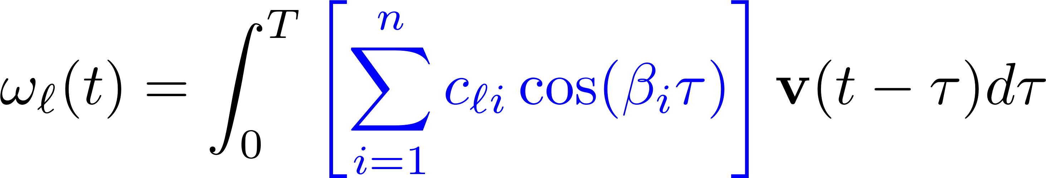



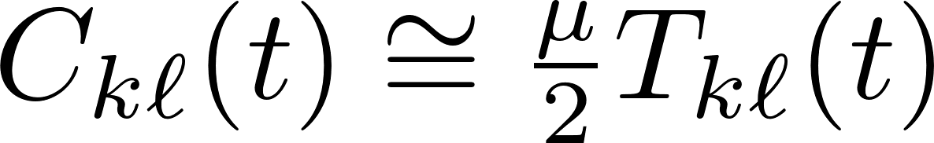
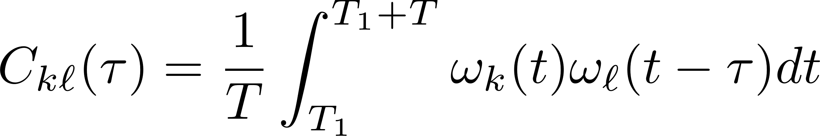
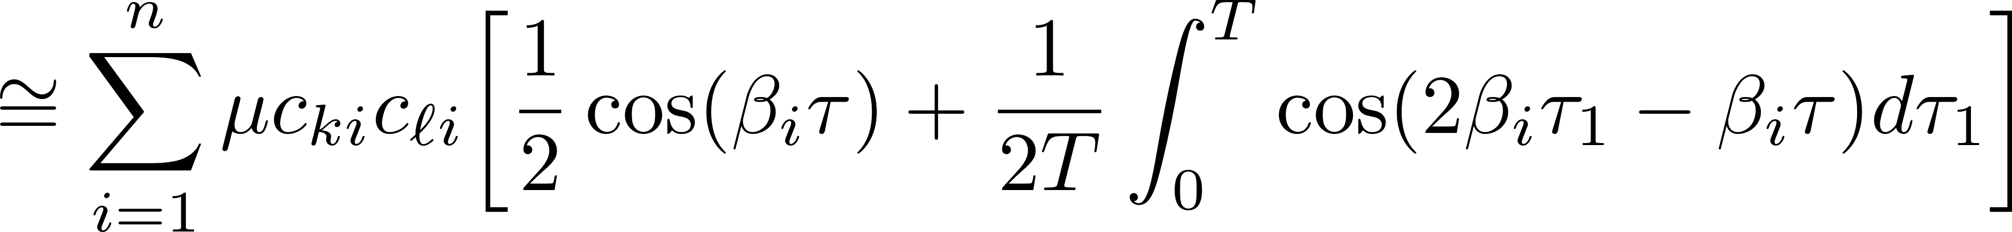
Equivalence Results
(as3) Input noise variance proportional to inertia; i.e.,
Homogeneously excited modes: identical and uncorrelated
Prop: Under (as1)-(as3), frequency response can be recovered by
cross-correlating and as
Under (as3), only intra-mode components exist!

Slide 11

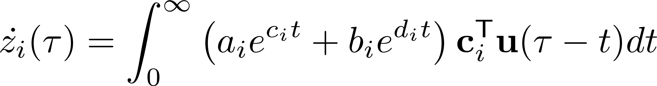
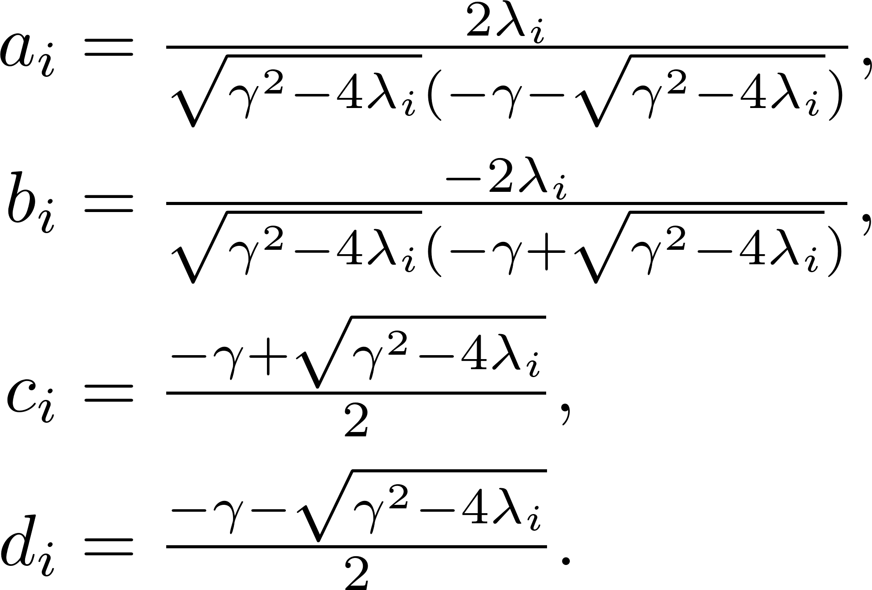
Damped System Extension
Under uniform damping, M-orthonormal property still holds
Each mode ( ) is updated to
with
Similarly, one can bound the inter-mode components of the cross-correlation function under uncorrelated modes

Slide 12
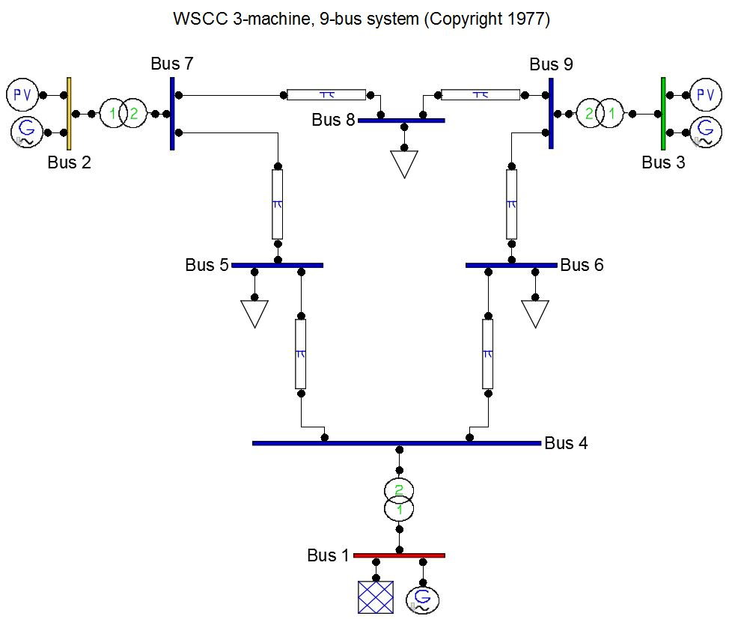
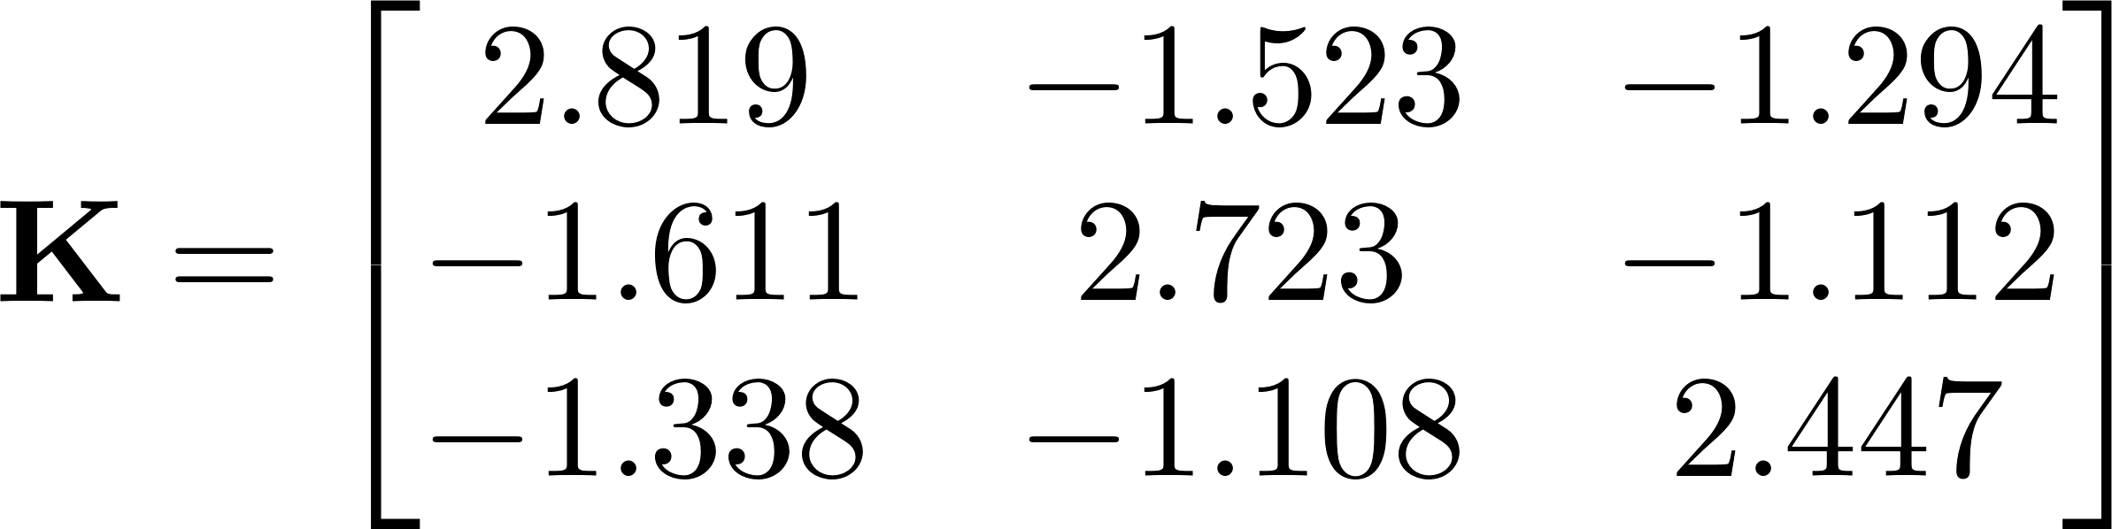
WSCC 9-Bus Test Case
Synthetic ambient speed outputs generated with randomly perturbing generator inputs using:
(i) linearized system model
(ii) time-domain simulation
With line losses, matrix K slightly asymmetric
WSCC 3-gen 9-bus case
one-line diagram [PSAT]

Slide 13



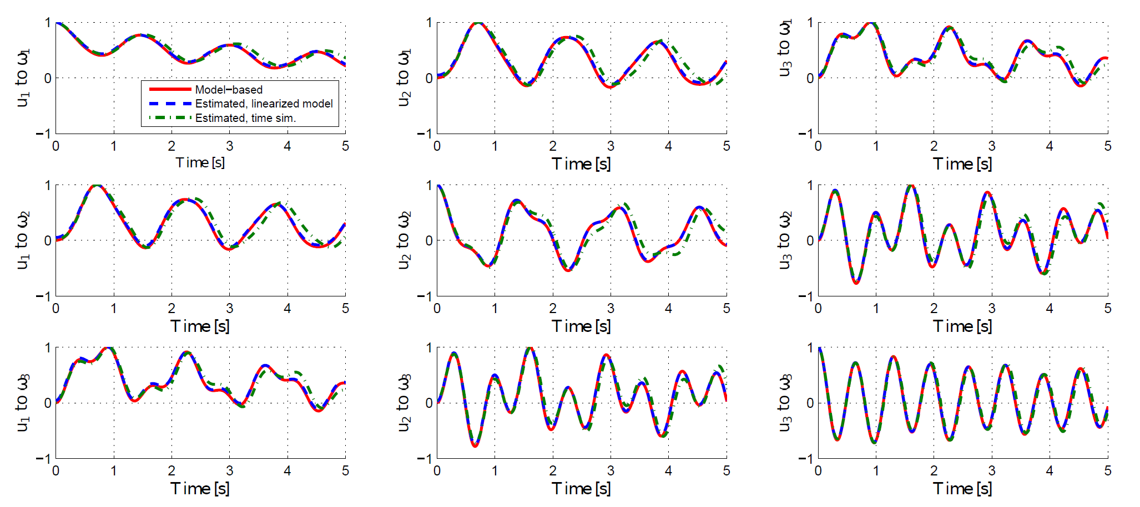



Uniform Damping
Great match with non-symmetric K under line losses!

Slide 14
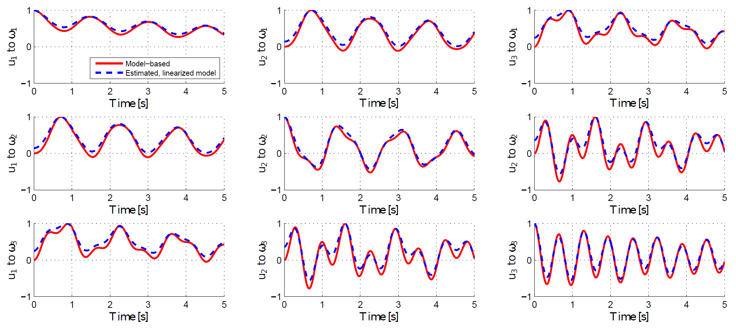
Non-uniform Damping
Less accurate estimation of scaling factor (mode coupling)

Slide 15
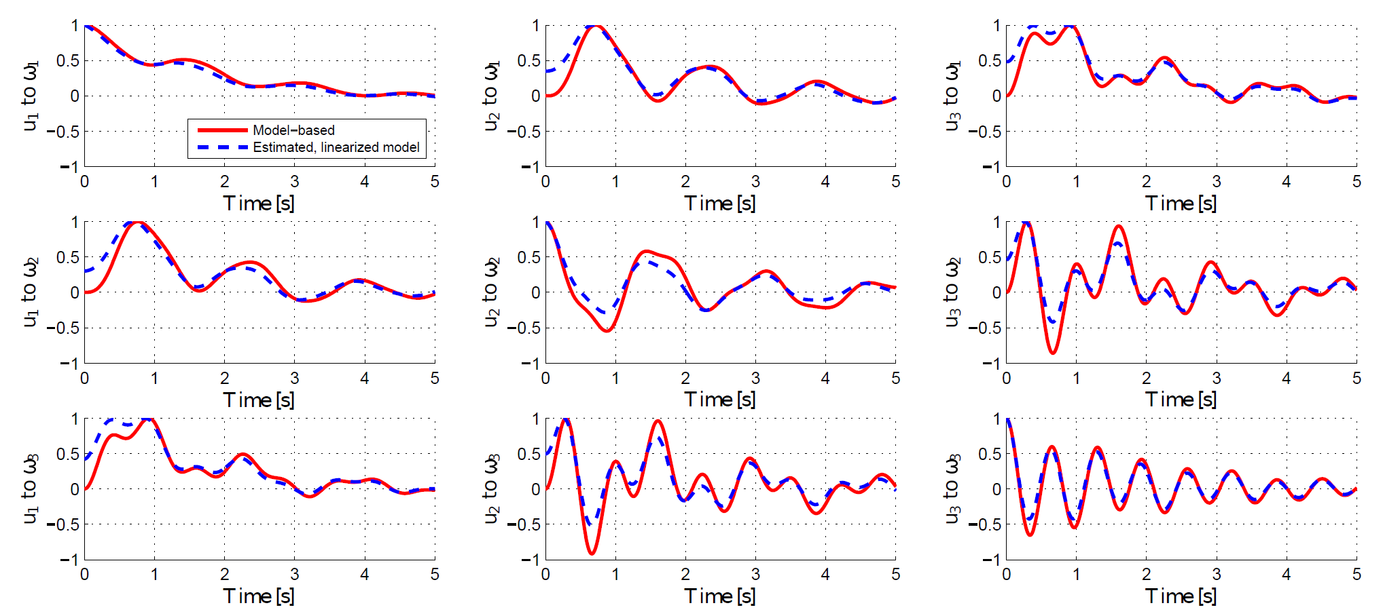
Higher-order Generator Model
Noticeable difference in the curve shape (correlated modes)

Slide 16
Real Data Tests
Frequency measurements for the Eastern Interconnection (EI) system under normal grid operations
  Collected from 10:00-10:15 AM on 01/20/2017 by FNET devices
Compared to the actual response to the disturbance of 2008 Florida blackout
Sample data
Filtered output

Slide 17
2008 Blackout Replay

Slide 18
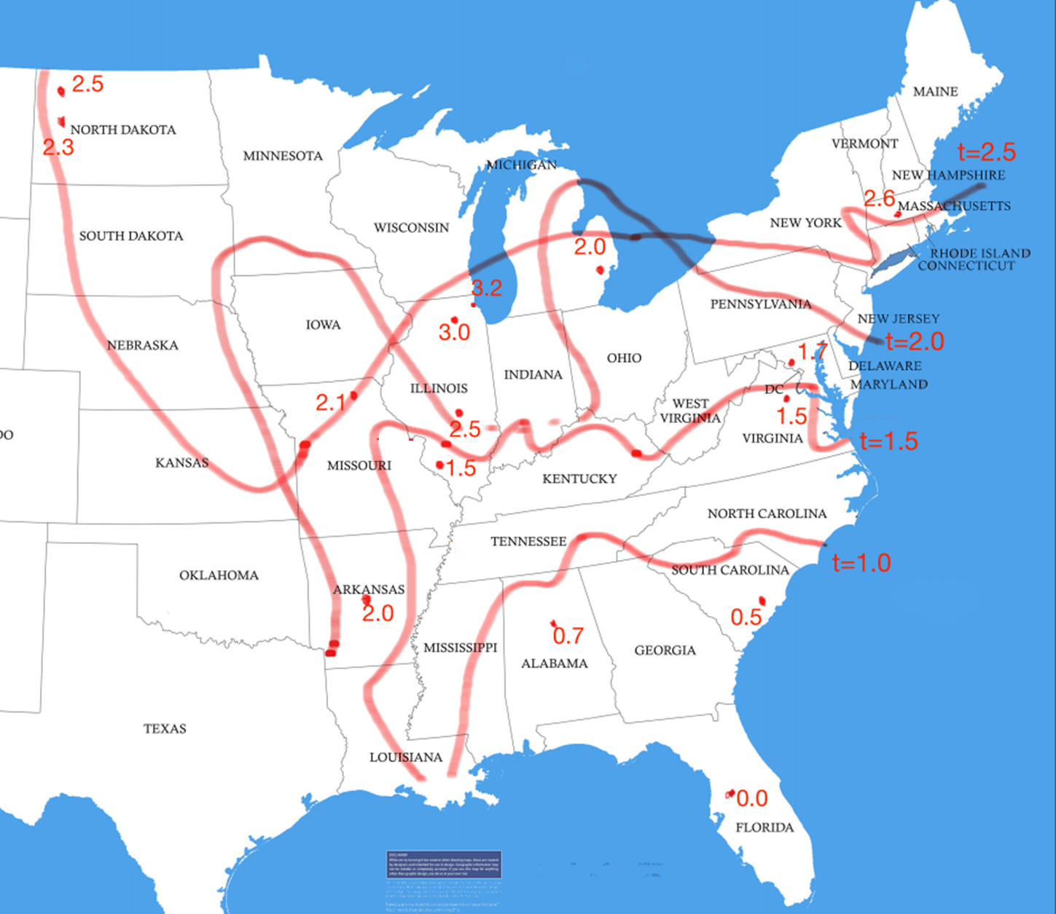
Propagation Time
726
2.6
Node # | Rec. | Est.
601 | 1.5 | 1.2
671 | 0.7 | 0.5
682 | 2.6 | 2.6
726 | 2.5 | 2.6
729 | 2.3 | 2.6
756 | 1.6 | 1.9
767 | 1.5 | 1.9
781 | 2.1 | 2.1
787 | 1.6 | 1.6
823 | 1.5 | 1.7
2.6
729
2.6
682
781
2.0
671
0.5
Meter index
Recorded propagation time
Estimated propagation time

Slide 19
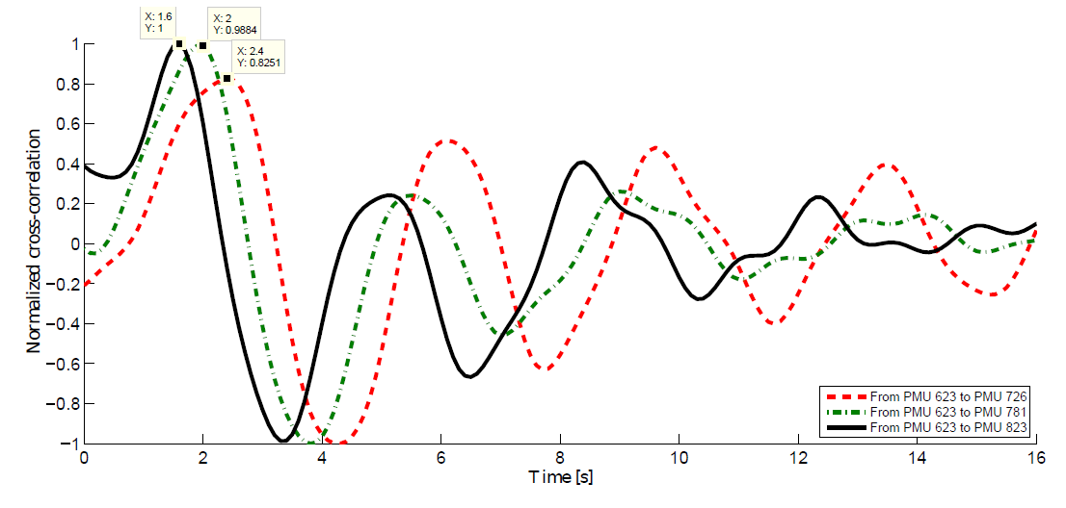
Estimated Response
From Florida to Arkansas, Missouri, and North Dakota

Slide 20
Conclusions and ?
Identified a set of analytical conditions to allow the recovery of frequency response using ambient data cross-correlation
  Uniformly damped system with uncoupled modes
  Each mode equally excited by zero-mean perturbations
These conditions may hold in practice, however, limiting this approach because of the following open questions
  Could the coupling/correlation be negligible among inter-area modes?
  How to include the dynamics of loads and renewables?
  Going beyond pair-wise correlation to high-dimensional representation
  Can we use/improve this tool for better instability monitoring or system designs?

Slide 21
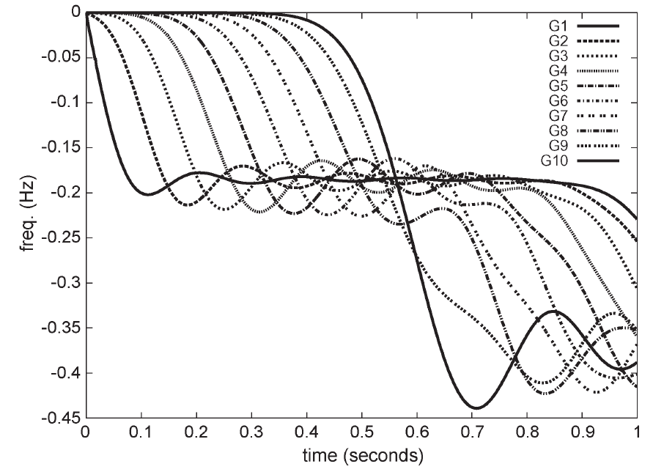
Disturbance Localization
With known propagation timing information, one can locate the source of disturbance input [Esmaeilian-Kezunovic’16]
  Based on the generic propagation time for homogeneous systems as given in [Thorp et al’98]
  Localization problem cast
  as a sparse inverse problem
Can we better characterize the propagation time based on specific system information?

