Slide 1
Effect of Different Optical Codes on a W-band WDM-over-OCDMA System
Morad Khosravi Eghbal¹, Farzan Aminian², and Mehdi Shadaram¹
¹Department of Electrical and Computer Engineering
University of Texas at San Antonio
San Antonio, TX
²Department of Engineering Science
Trinity University,
San Antonio, TX
ICTON 2017
Girona, Cataluña, Spain
July 2-6, 2017

Slide 2
Outline
Introduction
Millimeter Waves over Optical Fibers
WDM-over-OCDMA
Optical encoding/decoding
Codes
Results
Conclusion, Future work and Summary

Slide 3
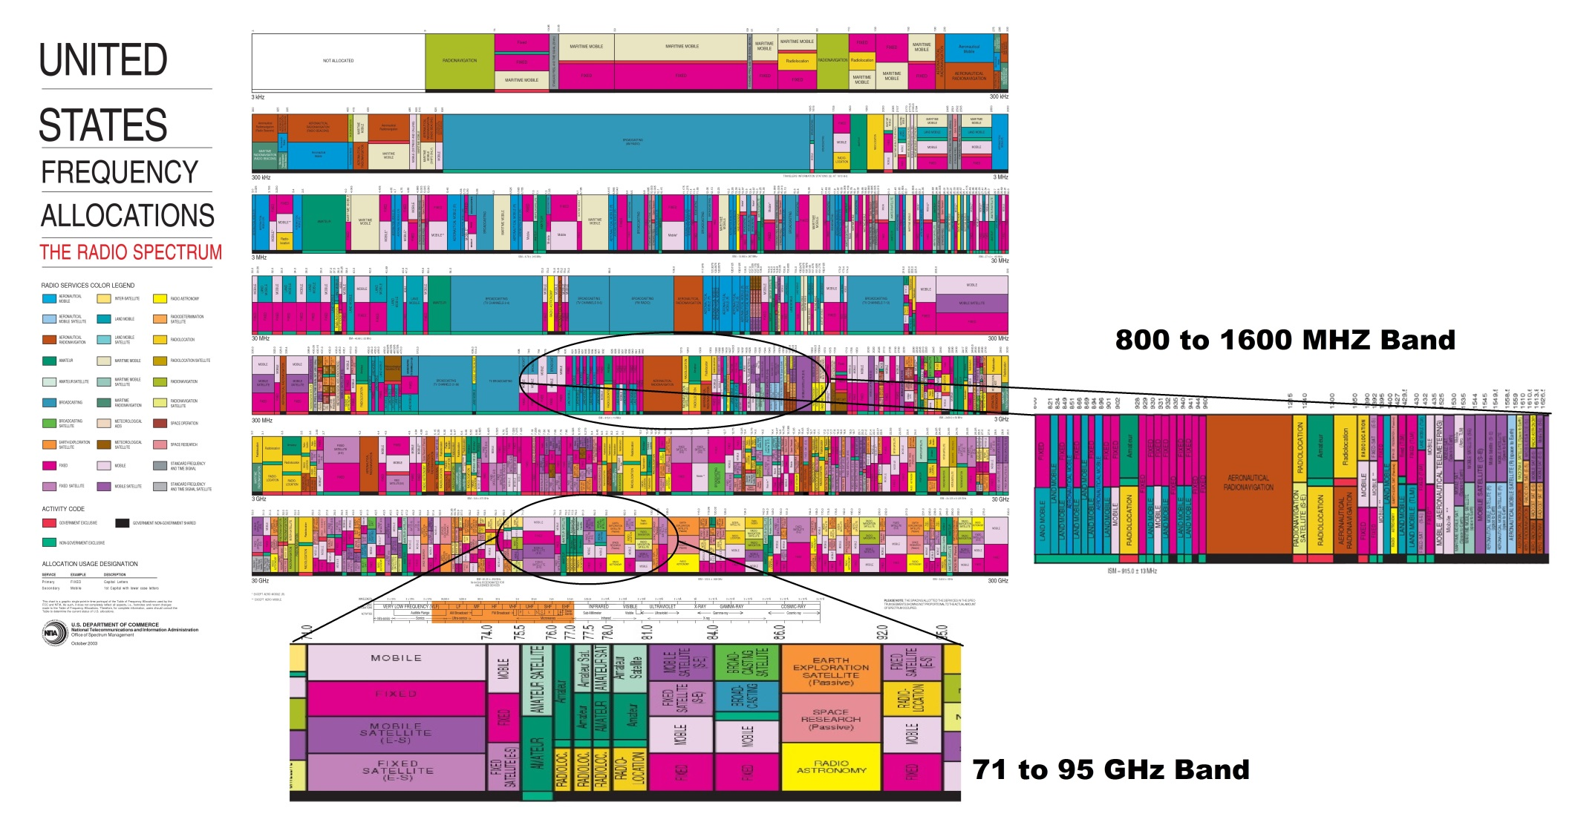
Millimeter Wave Radio-over-Fiber
Radio-over-Fiber is the method to transmit radio signals through fiber optic cable

Slide 4
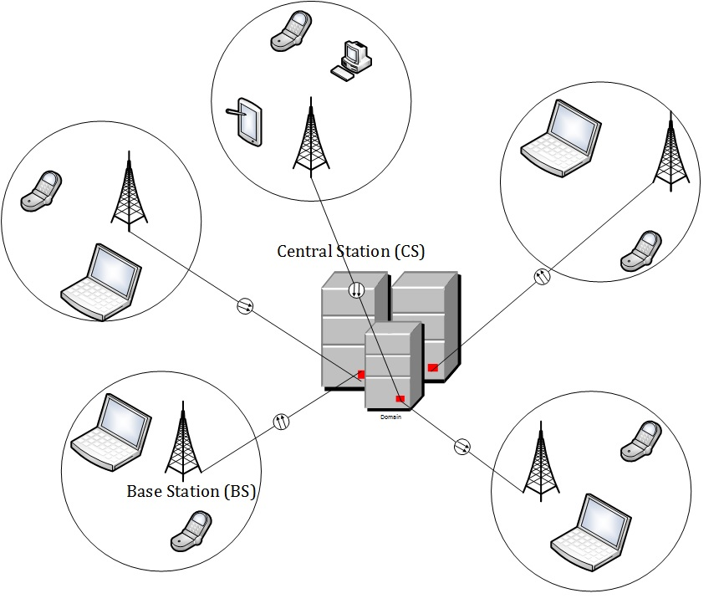
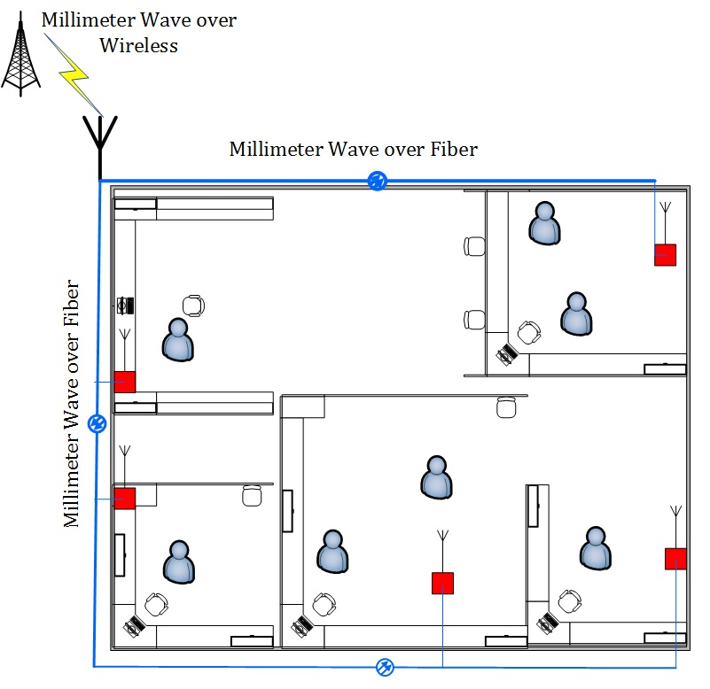
Millimeter Wave Radio-over-Fiber
Millimeter wave band (from 30GHz up to 300 GHz) is a suitable high frequency band Mostly unlicensed operation

Slide 5
Millimeter Wave Radio-over-Fiber
Advantages:
Lower microwave band is congested (e.g. Wi-Fi, GSM, etc.). Some other new wireless technologies (e.g. WiMAX) are still handled within the lower microwave regions (2–4 GHz).
Low Atmospheric attenuation at some bands (e.g. 28 GHz and 38 GHz)
Large bandwidth (40 Gb/s)
Some bands are License-Free spectrum (e.g. 60 GHz)
Short range can be a benefit, it cuts down on interference from other nearby radios. It also improves security.
Small size antenna and IC devices.

Slide 6
Millimeter Wave Radio-over-Fiber
Disadvantages:
High free space attenuation at some bands (e.g. Oxygen absorption loss at 60 GHZ)
High atmospheric loss due to fog, rain, etc. at some bands (e.g. 23 GHz and 180 GHz)
Highly Directional, "pencil-beam" Signal
Narrow Beam Antennas (Multiple Antennas are needed)
Design challenges due to small sizes

Slide 7
Air Attenuation at Different Frequency Bands
Source: George R. MacCartney Jr., Junhong Zhang, Shuai Nie, and Theodore S. Rappaport, GLOBCOM 2013

Slide 8
The Link Under Investigation

Slide 9
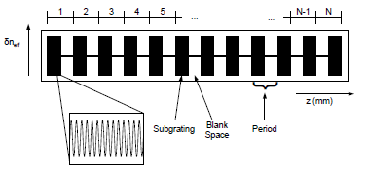
Optical Encoder/Decoder (SSFBG) Structure
The SSFBG is composed of N sections, with each section consisting of a subgrating and a blank space. The length of a section is referred to as the sampling period, Z₀, and the length of a subgrating is represented by L_{s}
SSFBG Refractive index profile
Blais, L., 2014. Superstructured fiber Bragg gratings and applications in microwave signal processing. Ph.D. Thesis, University of Ottawa

Slide 10
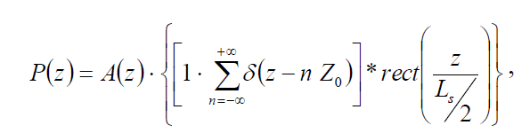
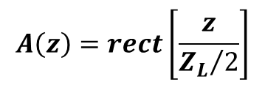
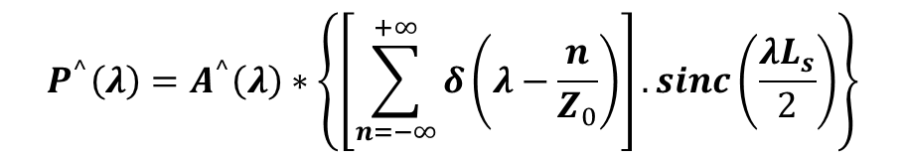
Superstructure Fiber Bragg Grating Structure
The spatial profile of a uniform SSFBG along the z-axis can be expressed by the sum of an infinite number of Dirac delta functions evenly spaced along the z-axis convoluted by a rectangular function representing the subgrating
A(z) is the apodization profile, δ(z) is the Dirac delta function, Z₀ is the sampling period, L_{s} is the subgrating length and ZL is the total superstructure length. The asterisk “*” denotes the convolution operation.
$$A\left(z\right)=rect\left[\frac{z}{{Z_{L}}/2}\right]$$
In the case of uniformly apodized SSFBG ➔
$$P^{^}\left(λ\right)=A^{^}\left(λ\right)∗\left\{\left[\sum_{n=−∞}^{+∞}{δ\left(λ−\frac{n}{Z_{0}}\right)}\right].sinc\left(\frac{λL_{s}}{2}\right)\right\}$$
Source: Blais, L., 2014. Superstructured fiber Bragg gratings and applications in microwave signal processing. Ph.D. Thesis, University of Ottawa

Slide 11
Optical Codes
M-sequence codes
Quaternary Phase Shift codes
Walsh-Hadamard codes
To compare the performance of each set of codes against the other two
To compare the features of each family of codes (length, number of users each can accommodate, sophistication and spectral characteristics, … ) for WDM-over-OCDMA

Slide 12
Optical Encoder/Decoder Format
A 7-segment (for M-sequence and Quaternary Phase Shift, QPS) and an 8-segment (for Walsh-Hadamard, WH codes) SSFBG encoder is used.
The decoder basically has a profile similar to the encoder but it is inversed
The codes are interpreted as the degree of phase shift at each segment

Slide 13
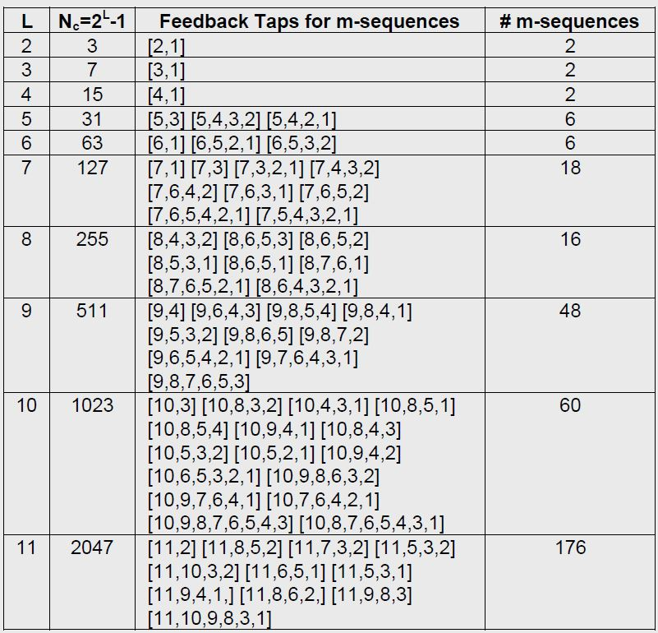
M-Sequence
M-Sequence codes based on the length of the shift register and number/location of taps:
Source: MEEL, J., (1999). Spread Spectrum. Studiedag Spread Spectrum – Oct 6th 1999, http://www.sss-mag.com/pdf/Ss_jme_denayer_intro_print.pdf

Slide 14
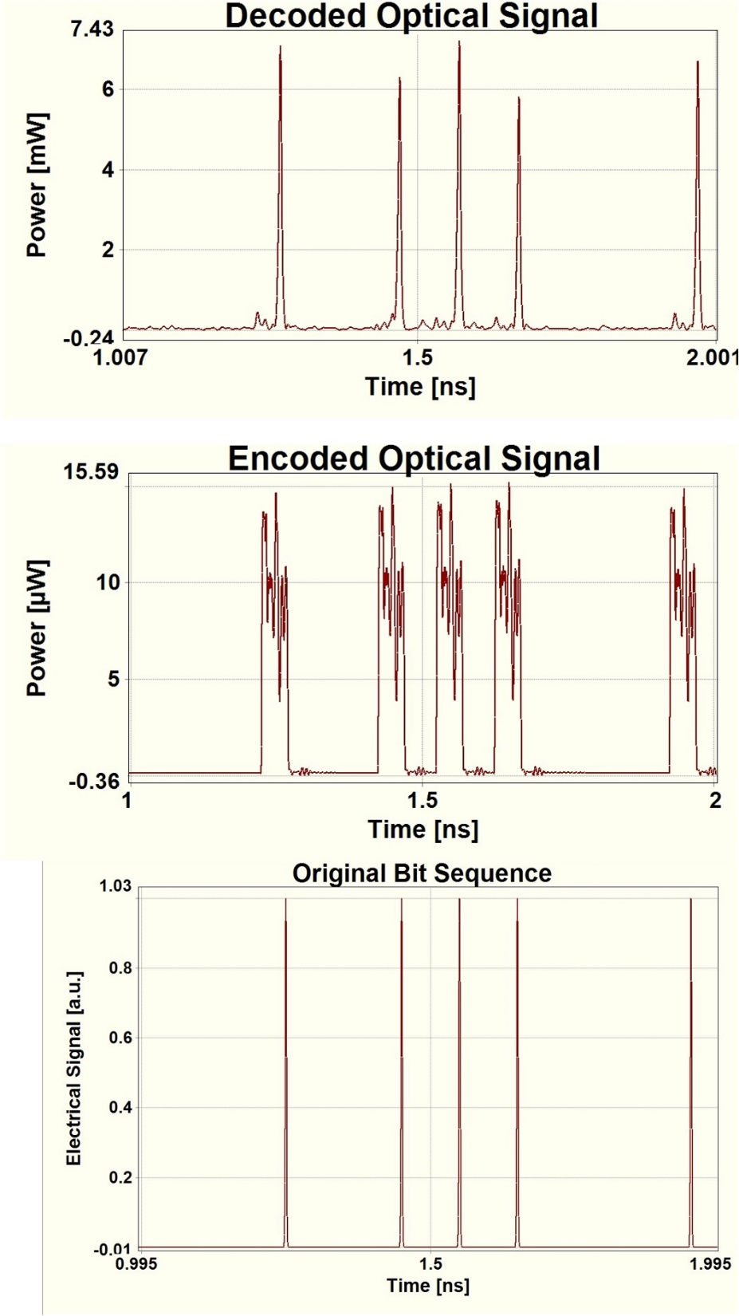
Example of M-Sequence Encoding/Decoding (Seven Segments)

Slide 15

M-Sequence
Codes has a length equal to 2^{L}-1 where, L is the number of shift registers that generate the code
Feedback function
a_{i} -1, a_{i}-2,…,a_{i}-n are the coefficients inside each cell of the shift register and c_{i}’s (either 1 or 0) are the coefficients of the feedback connections of the shift register
The type of m-sequence codes that are utilized in this work are unipolar (the phase shift changing between two values: 0 and π). M-sequence codes with length 7 (for two users)
There are two individual codewords generated by two 7-segment SSFBG devices: 0π0πππ0 (Mseq1) and π00πππ0 (Mseq2)

Slide 16
The List of Generators for the Initial QPS Codes
Characteristic Polynomials for Linear Recurrence Defining Family A
Degree 3 | 1213 | 1323
Degree 4 | 10231 | 13201
Degree 5 | 100323 130133 | 113013 | 113123 | 121003 | 123133
Degree 6 | 1002031 1320111 | 1110231 | 1211031 | 1301121 | 1302001
Degree 7 | 10020013 11122323 12122333 13210123 | 10030203 11131123 12303213 13212213 | 10201003 11321133 12311203 13223213 | 102211333 11332133 12331333 | 10233123 11332203 13002003

Slide 17
Quaternary Phase Shift
Codes generated in this family have four phase levels (0, π/2 , π, and 3 π/2)
Feedback function
These codes are defined based on the position of the feedback tabs and the initial values of the shift register
It maps into four phase levels that help increase the number of codeword generation with a fixed number of shift registers

Slide 18
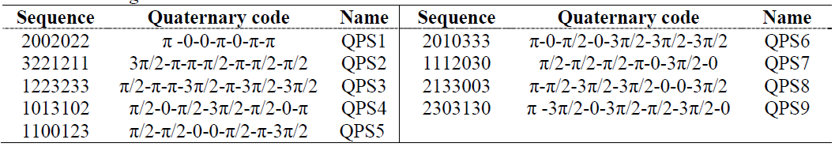
Quaternary Phase Shift
The number of generated codewords are similar to the bipolar gold codes
The cross-correlations of the codes are relatively better with the same length
Nine 7-segment Quaternary Phase Shift codes, the code sequences and their corresponding phase shifts between each segment

Slide 19

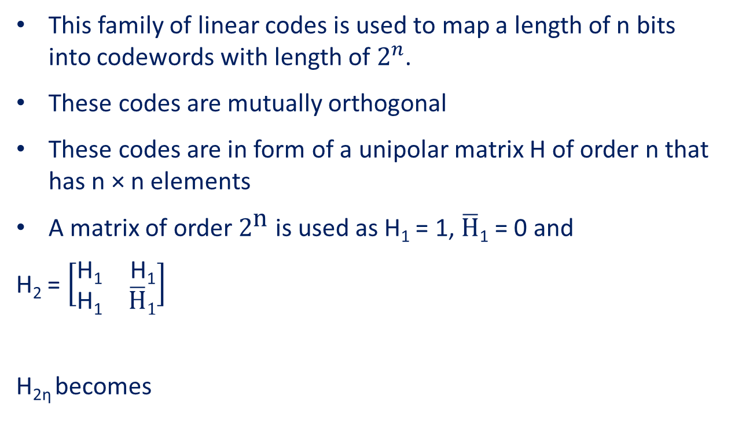
Walsh - Hadamard
This family of linear codes is used to map a length of n bits into codewords with length of $2^{n}$.
These codes are mutually orthogonal
These codes are in form of a unipolar matrix H of order n that has n × n elements
A matrix of order $2^{\text{n}}$ is used as H₁ = 1, $\overline{H}$₁ = 0 and
H₂ = $\left[\begin{matrix}\text{H}\text{1} & \text{H}\text{1} \\ \text{H}\text{1} & \overline{H}1\end{matrix}\right]$
H_{2η} becomes

Slide 20
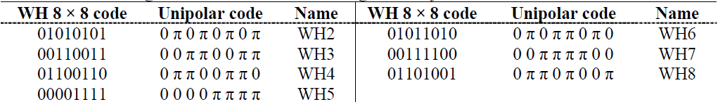
Walsh – Hadamard
An 8 × 8 matrix is used that generates 7 codewords of length 8 (since the first row of the matrix is all ‘1’s)
All the ‘1’s in the generated codewords are replaced with π to form a unipolar code fulfilling the encoding criteria.
Seven 8-segment Walsh-Hadamard code generated from H₈

Slide 21
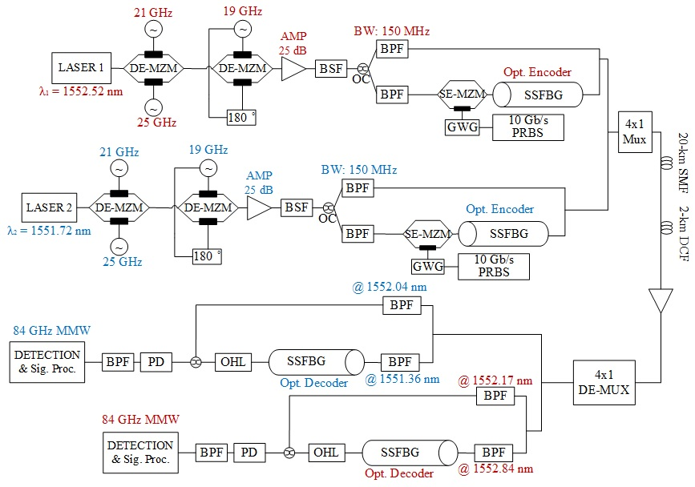
Simulation Setup

Slide 22
Focus of this work
RF-Optical signals are encoded and decoded with three different codes
Increase the capacity
Improve security
Improve spectral efficiency
For a two-wavelength (WDM) system, the performance of each code family is investigated

Slide 23
Results
Evaluate the performance of each family of codes, each optical wavelength are encoded at the transmitter with one of the codes and decoded at the receiver’s side.
The bit error rate vs. the received optical signal power are shown and compared for different code family

Slide 24
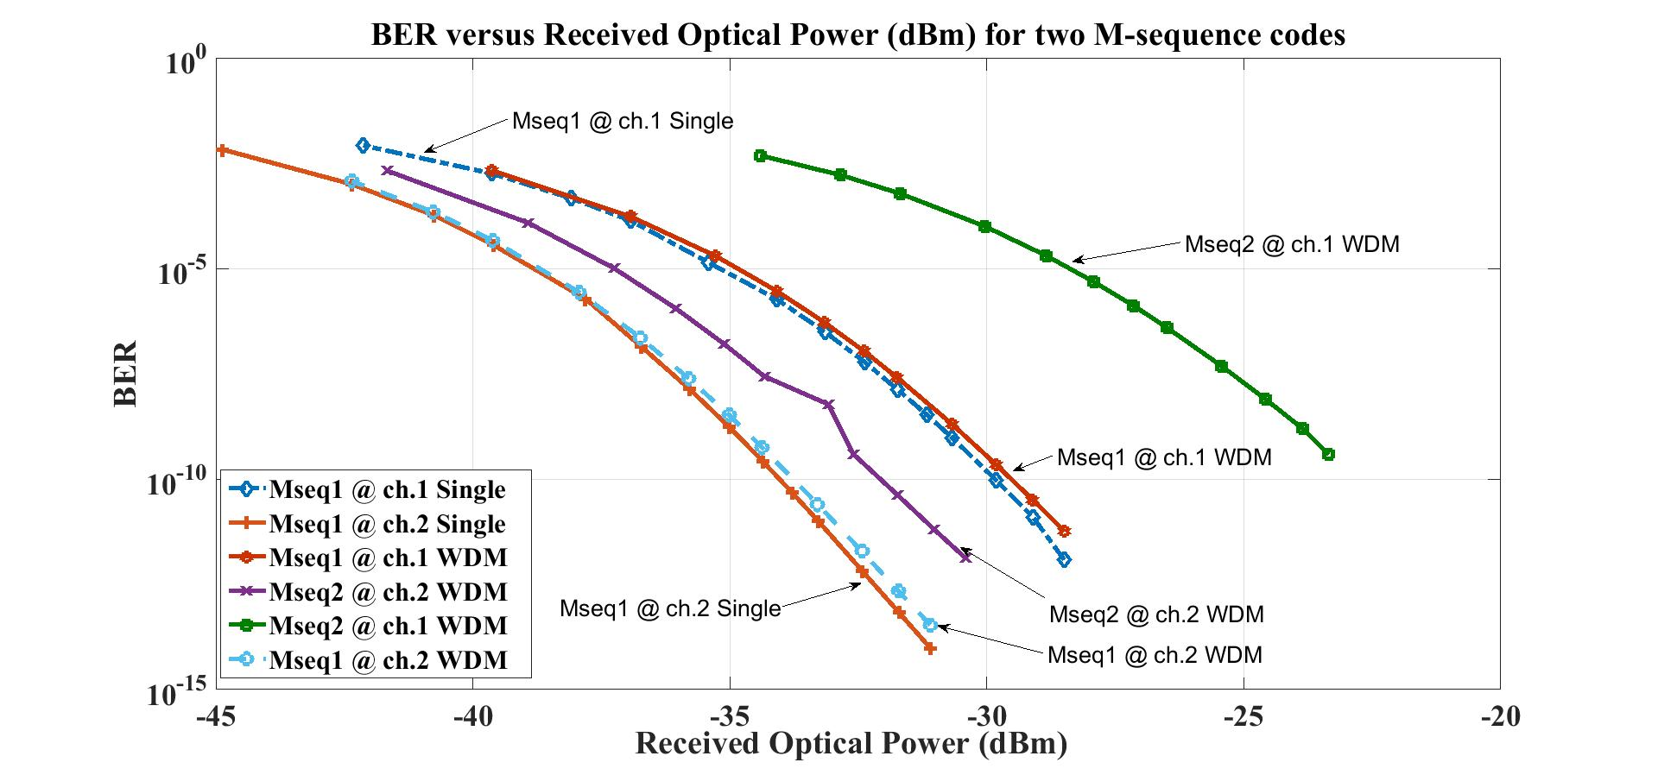
Results
M-Sequence codes: BER vs. Received Optical power for 2 M-sequence codes

Slide 25
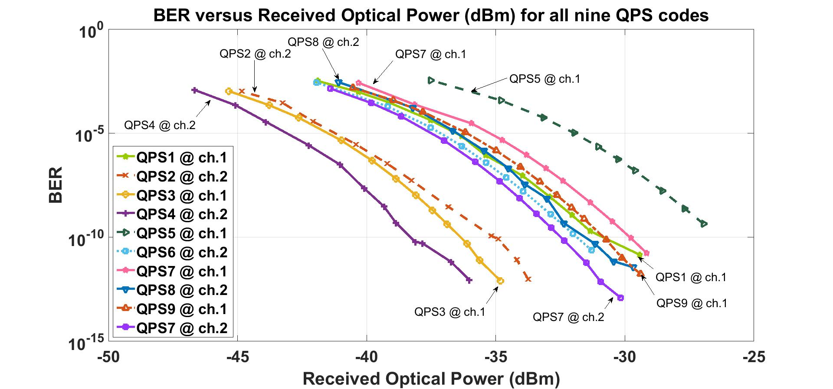
Results
Quaternary Phase Shift codes: BER vs. Received Optical power for 9 quaternary phase shift codes

Slide 26
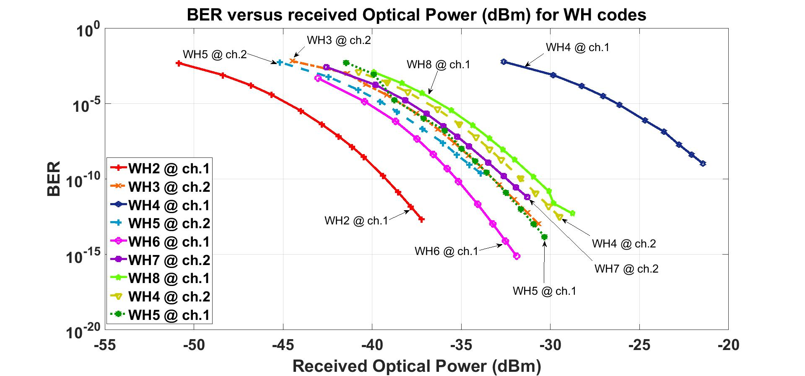
Results
Walsh-Hadamard codes: BER vs. Received Optical power for 7 Walsh-Hadamard codes

Slide 27
Conclusion
The performance of Mseq1 at channel 1 for both single (Channel 2’s laser is off) and WDM (Mseq1 at ch.1 and Mseq2 at ch.2) operations is perfectly aligned.
Transmission of Mseq1 at ch.2 for both single and WDM operations are identical. There is about 9 dB of gain for Mseq2 and about 4 dB gain for Mseq1 for each WDM channel
This is because of the wavelength difference (0.8 nm) between two channels that diminishes the operability for the lower wavelength channels. The higher the wavelength channel, the better will be the operation

Slide 28
Conclusion
For QPS codes, there is about 2.5 dB gain difference between codes operating at ch.1 and ch.2
The functionality of most QPS codes are relatively similar for both channels
WH codes show a relatively high gain when tested at each channel
Since there is irregularities with high gain differences for WH codes (>10 dB) and they are unwanted in a WDM system, the Walsh-Hadamard cannot be priorities over the two previous code families.

Slide 29
Future Work
It is mainly to improve key parameters of the system such as:
The reach : increasing the fiber length to 50 km
The number of users: increasing the number of users (orthogonal optical codes) to 48
The number of wavelength channels: increasing the capacity of the system by manifolding the proposed system at the WDM wavelength grid

Slide 30
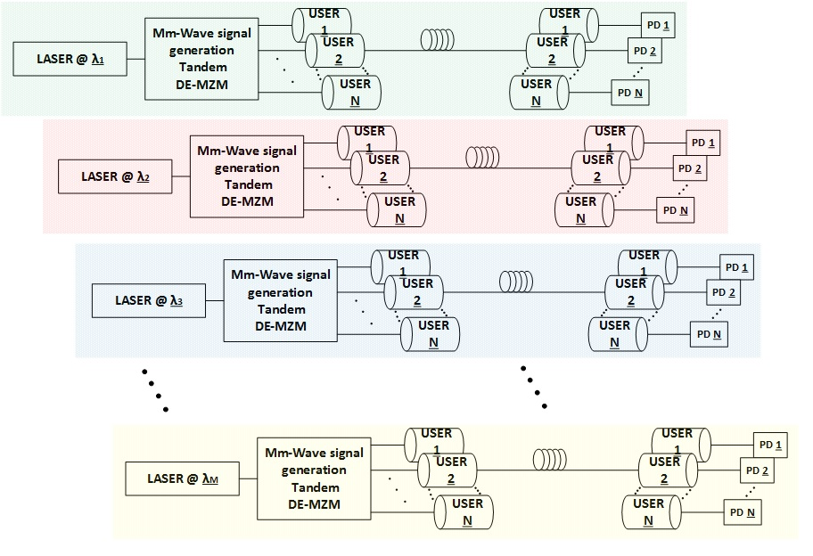
Future Work
A Hybrid OCDMA/WDM system with M wavelength and N users’ optical codes

Slide 31
Summary
By employing SSFBG encoder/decoder we can improve the security and efficiency of the link allowing simultaneous transmission for multiple users through a single length of fiber.
Capacity and flexibility of the link can be modified due to expansion of the bandwidth in the millimeter wave region and radio-over-fiber properties.
We have demonstrated the performance of three code families to the OCDMA system and what are the advantages and disadvantages associated with each code family for a WDM-over-OCDMA system

Slide 32
Thank You
Questions?

